Slide 2
Chemistry: Atoms First
Chapter 1
Chemistry:
The Science of Change
2
Copyright (c) The McGraw-Hill Companies, Inc. Permission required for reproduction or display.

Slide 4
Lab Safety Rules

Slide 5
Equipment worksheet
SAFETY TEST

Slide 6
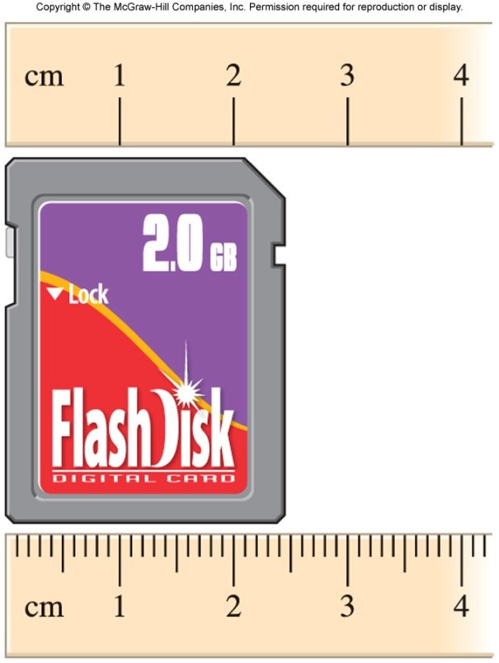
Chapter Summary: Key Points
1
The Scientific Method
States of Matter
Substances
Mixtures
Physical Properties
Chemical Properties
Extensive and Intensive Properties
SI Base Units
Mass
Temperature
Volume and Density
Significant Figures

Slide 8
Variables
Independent variables - The values that can be changed in a given model or equation. They provide the "input" which is modified by the model to change the "output."
Dependent variables - The values that result from the independent variables.
controlled variables. Controlled variables are quantities that a scientist wants to remain constant
Ex: A scientist studies the impact of a drug on cancer
Dependent : __________________________________
Independent: ________________________________

Slide 9
MATH CONCEPTS
Scientific Units:
Time
Length/ distance
Mass
Volume
Temp
Density
Speed

Slide 10
King Henry Doesn’t Usually Drink Chocolate Milk

Slide 12
Practice

Slide 13
Significant Figures Rules
Non-zero integers always will be significant figures.
Leading zeros – that come before non-zero digits NEVER count as SIG. FIG
Ex: 0.00123 → 3 SIG FIG
Zeros that fall between nonzero digits ALWAYS count as SIG FIG
Ex: 1.0012 → 5 sig fig

Slide 14
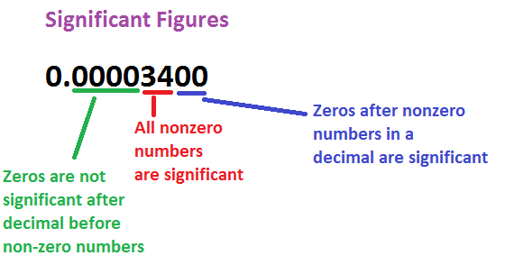
Cont.
4. Trailing Zeros
Ex: 1000 → 1sig fig
1000. → 4 sig fig
5. Exact numbers
Ex: 1in =2.54 cm

Slide 15
Multiply/ division
# of sig fig in the result is the same # as the small sig fig number
Ex : 5.16 x 1.3= 6.708 → 6.8
5.168/1.43 = 3.61398601 → 3.61

Slide 16
Addition /subtraction
Limited term is the one with the smallest no. of decimal place
Ex : 16.15 +14.1 + 1.016 →

Slide 17
Practice on Significant Figures in Operations
http://www.chemistrywithmsdana.org/wp-content/uploads/2012/07/SigFigOperations.html

Slide 18
Scientific Notation
Taking big or small numbers in a way to help us calculate!!
a x 10
1< a <10
Move decimal to the right → NEGATIVE
Move decimal to the left ← POSITIVE

Slide 19
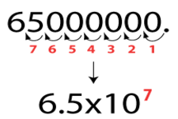

Slide 20
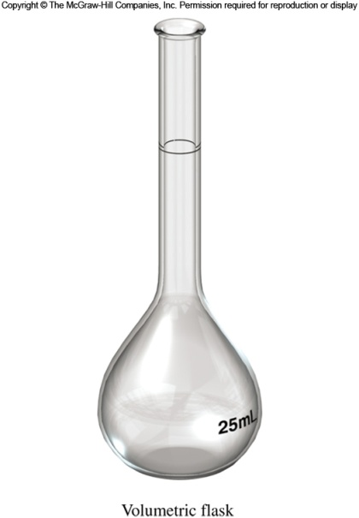
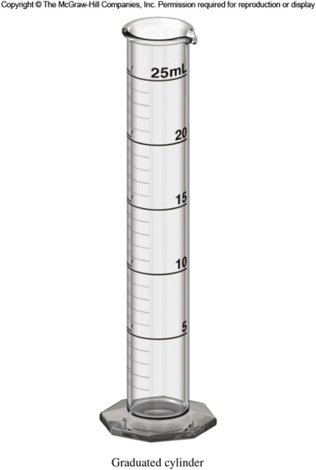
Scientific Measurement
1.4
Properties that can be measured are called quantitative properties.
A measured quantity must always include a unit.
The English system has units such as the foot, gallon, pound, etc.
The metric system includes units such as the meter, liter, kilogram, etc.

Slide 21
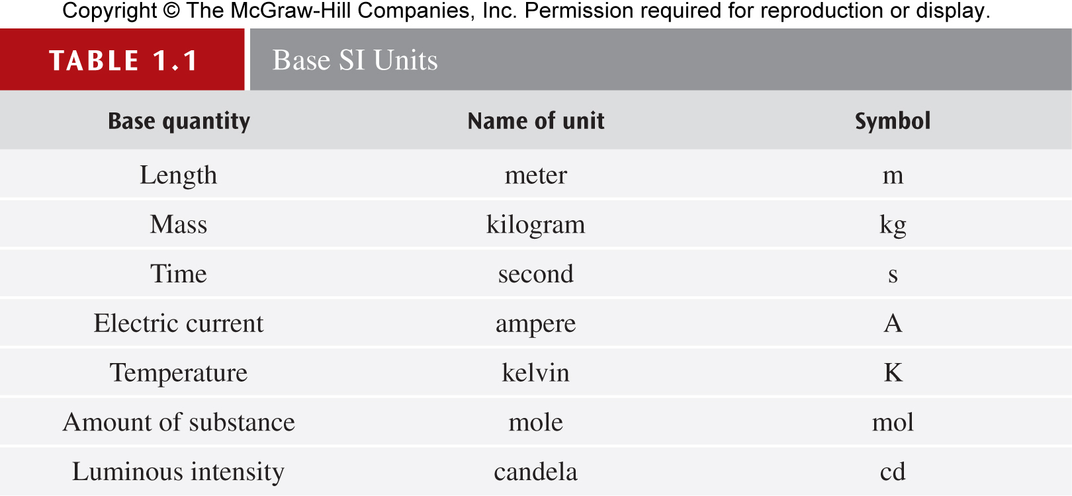
SI Base Units
The revised metric system is called the International System of Units (abbreviated SI Units) and was designed for universal use by scientists.
There are seven SI base units

Slide 22
Units in Measurements
Factor | Prefix | Symbol
1 x 10⁶ | Mega | M
1 x 10³ | Kilo | k
the base units | grams (g) meters (m) | Moles (mol) volume (L)
1 x 10⁻² | centi | c
1 x 10⁻³ | milli | m
1 x 10⁻⁶ | micro | μ
1 x 10⁻⁹ | nano | n
1 x 10⁻¹² | pico | p
Taylor 2010

Slide 23
Mass
Mass is a measure of the amount of matter in an object or sample.
Because gravity varies from location to location, the weight of an object varies depending on where it is measured. But mass doesn’t change.
The SI base unit of mass is the kilogram (kg), but in chemistry the smaller gram (g) is often used.
1 kg = 1000 g = 1×10³ g
Atomic mass unit (amu) is used to express the masses of atoms and other similar sized objects.
1 amu = 1.6605378×10⁻²⁴ g

Slide 24
Temperature
There are two temperature scales used in chemistry:
The Celsius scale (°C)
Freezing point (pure water): 0°C
Boiling point (pure water): 100°C
The Kelvin scale (K)
The “absolute” scale
Lowest possible temperature: 0 K (absolute zero)
K = °C + 273.15

Slide 26
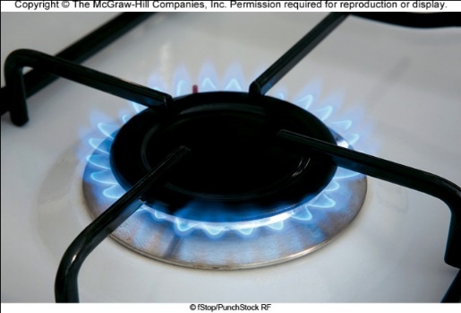
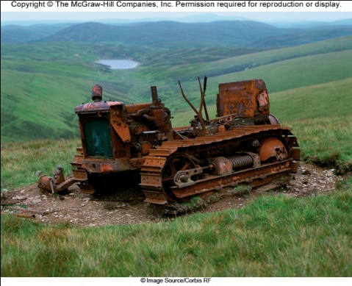
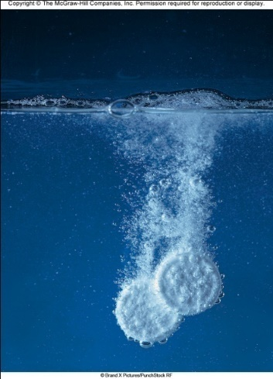
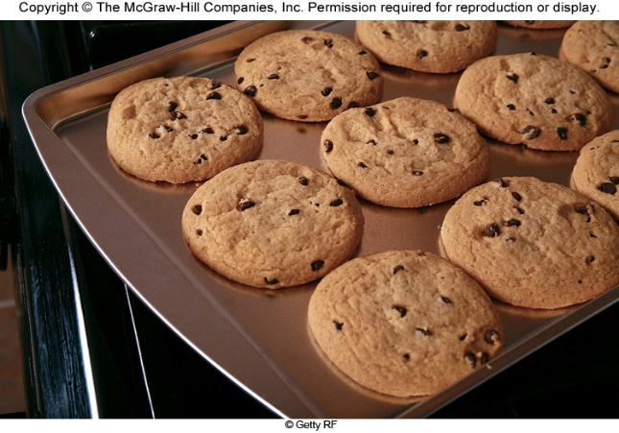
The Study of Chemistry
1.1
Chemistry is the study of matter and the changes that matter undergoes
A Chemical: is any substance that has a definite composition
Matter is anything that has mass and occupies space.

Slide 28
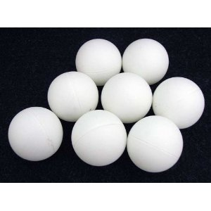
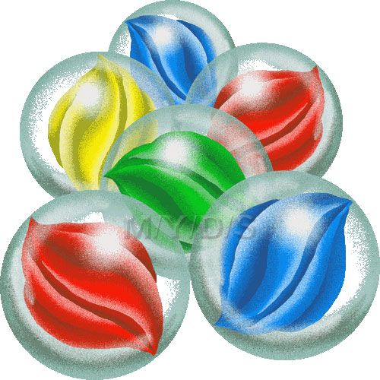
Matter Has Mass &Volume
Volume: the space an object occupies
Ex. The book has volume because it takes space
You can measure with LWH
Mass:
Quantity of matter contained in that object

Slide 29
Mass vs. Weight
They are NOT the same!!!
Mass measures the quantity of matter in an object, as long as the object is not changed it will have the same mass anywhere in the universe.
Weight: FORCE produced by gravity acting on the mass. Weight changes depending on gravity.
SEE Video BP

Slide 30
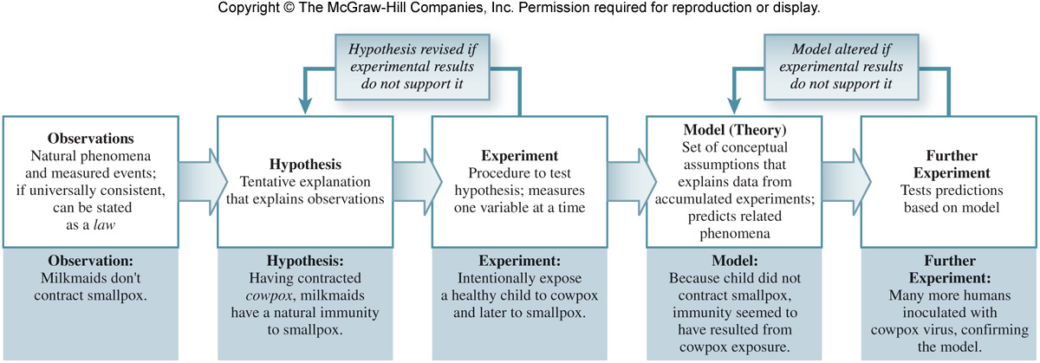
The Study of Chemistry
Scientists follow a set of guidelines known as the scientific method:
Gather data via observations and experiments
Identify patterns or trends in the collected data
Summarize their findings with a law
Formulate a hypothesis
with time a hypothesis may evolve into a theory

Slide 31
Classification of Matter
1.2
Chemists classify matter as either a substance or a mixture of substances.
A substance is a form of matter that has definite composition and distinct properties.
Examples: salt (sodium chloride), iron, water, mercury, carbon dioxide, and oxygen
Substances differ from one another in composition and may be identified by appearance, smell, taste, and other properties.
A mixture is a physical combination of two or more substances.
A homogeneous mixture is uniform throughout.
Also called a solution.
Examples: seawater, apple juice
A heterogeneous mixture is not uniform throughout.
Examples: trail mix, chicken noodle soup

Slide 32
How Matter is Classified?
Atoms: the smallest unit of an element that maintains the properties of that element.
Elements: are pure substances that contain one kind of atom.
Molecule : consists of two or more atoms combined in definite ratios. F2/ N2
Compound: 2 or more atoms that combined

Slide 33
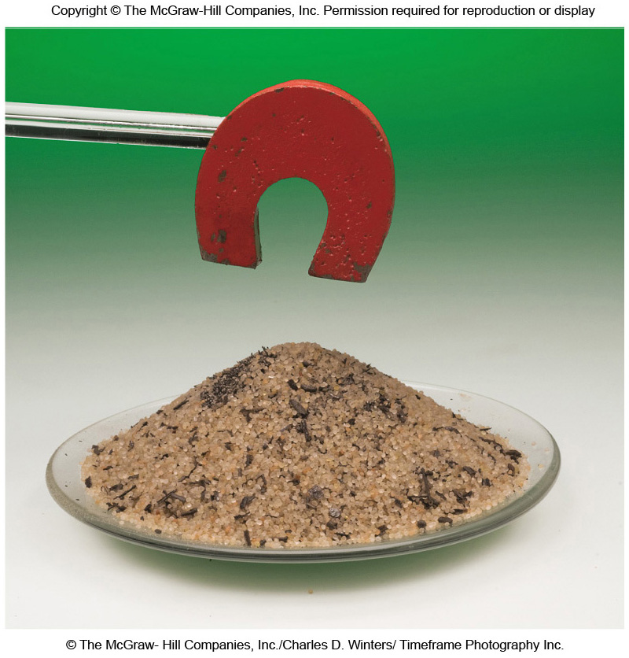
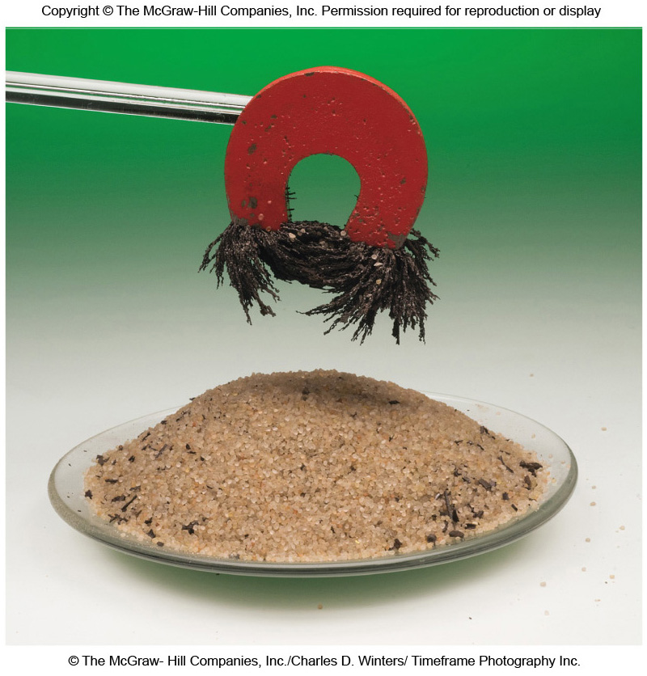
Classification of Matter
A mixture can be separated by physical means into its components without changing the identities of the components.

Slide 34
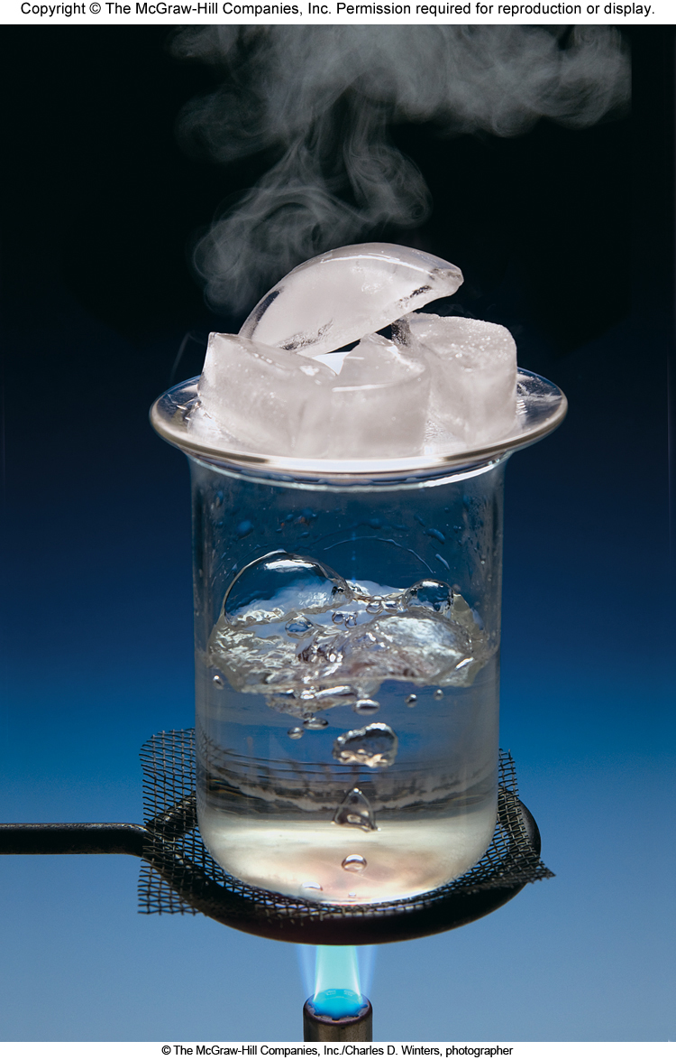
Classification of Matter
All substances can, in principle, exist as a solid, liquid or gas.
We can convert a substance from one state to another without changing the identity of the substance.

Slide 35
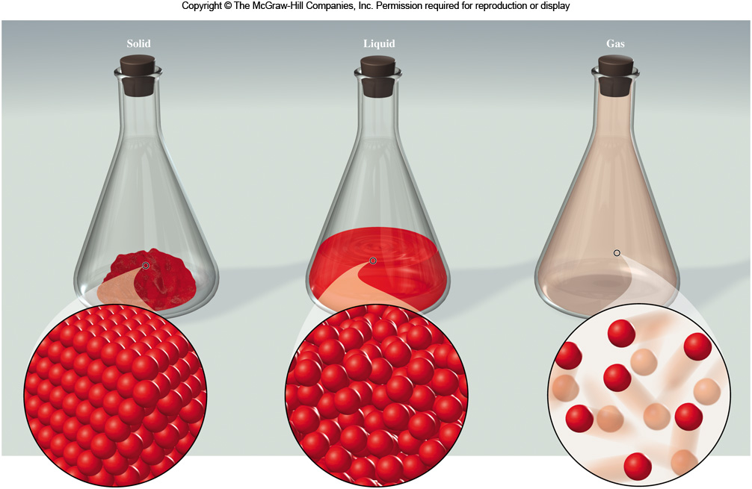
Classification of Matter
Gases assume both the shape and volume of their container.
Solids do not conform to the shape of their container.
Liquids do conform to the shape of their container.
Solid particles are held closely together in an ordered fashion.
Liquid particles are close together but are not held rigidly in position.
Gas particles have significant separation from each other and move freely.

Slide 36
The Properties of Matter
1.3
There are two general types of properties of matter:
1) Quantitative properties are measured and expressed with a number.
2) Qualitative properties do not require measurement and are usually based on observation.

Slide 37
The Properties of Matter
A physical property is one that can be observed and measured without changing the identity of the substance.
Examples: color, melting point, boiling point
A physical change is one in which the state of matter changes, but the identity of the matter does not change.
Examples: changes of state (melting, freezing, condensation)

Slide 38
The Properties of Matter
A chemical property is one a substance exhibits as it interacts with another substance.
Examples: flammability, corrosiveness
A chemical change is one that results in a change of composition; the original substances no longer exist.
Examples: digestion, combustion, oxidation

Slide 39
The Properties of Matter
An extensive property depends on the amount of matter.
Examples: mass, volume
An intensive property does not depend on the amount of matter.
Examples: temperature, density

Slide 40
LAUNCH + WORKSHEET

Slide 41
Worked Example 1.1
Normal human body temperature can range over the course of a day from about 36°C in the early morning to about 37°C in the afternoon. Express these two temperatures and the range that they span using the Kelvin scale.
Strategy Use K = °C + 273.15 to convert temperatures from Celsius to Kelvin.
Solution 36°C + 273 = 309 K
37°C + 273 = 310 K
What range do they span?
310 K - 309 K = 1 K
Depending on the precision required, the conversion from °C to K is often simply done by adding 273, rather than 273.15.
Think About It Remember that converting a temperature from °C to K is different from converting a range or difference in temperature from °C to K.

Slide 42
Temperature
The Fahrenheit scale is common in the United States.
Freezing point (pure water): 32°C
Boiling point (pure water): 212°C
There are 180 degrees between freezing and boiling in Fahrenheit (212°F-32°F) but only 100 degrees in Celsius (100°C-0°C).
The size of a degree on the Fahrenheit scale is only of a degree on the Celsius scale.
Temp in °F = ( ×temp in °C ) + 32°F

Slide 43
Worked Example 1.2
A body temperature above 39°C constitutes a high fever. Convert this temperature to the Fahrenheit scale.
Strategy We are given a temperature and asked to convert it to degrees Fahrenheit. We will use the equation below:
Temp in °F = ( × temp in °C ) + 32°F
Solution Temp in °F = ( × 39°C ) + 32°F
Temp in °F = 102°F
Think About It Knowing that normal body temperature on the Fahrenheit scale is approximately 98.6°F, 102°F seems like a reasonable answer.

