Slide 1
REVIEW Standard Benchmark TEST

Slide 2
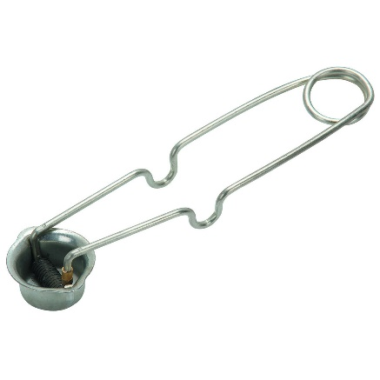
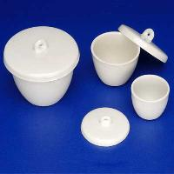
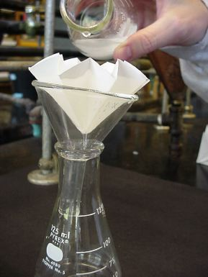
LAB EQUIPMENT
Flint Striker
Graduate Cylinder
Benson burner
Flask
Crucibles
Filter

Slide 3
NAMING COMPOUNDS
Metal + Nonmetal —> ionic compound (usually)
Metal + Polyatomic ion —> ionic compound (usually)
Nonmetal + Nonmetal —> covalent compound (usually)
Hydrogen + Nonmetal —> covalent compound (usually)

Slide 4
Name the following compounds
NaOH
Ca(NO₃)₂
K₃PO₄
(NH₄)₂SO₄
NH₄F
CaCO₃
Mg(C₂H₃O₂)₂
Fe(OH)₃
Cr₃(PO₄)₂

Slide 5
Sodium hydroxide
Ca(NO₃)₂ | Calcium nitrate
K₃PO₄ | Potassium phosphate
(NH₄)₂SO₄ | Ammonium sulfate
NH₄F | Ammonium fluoride
CaCO₃ | Calcium carbonate
Mg(C₂H₃O₂)₂ | Magnesium acetate
Fe(OH)₃ | Iron(III) hydroxide or ferrous hydroxide
Cr₃(PO₄)₂ | Chromium(II) phosphate
CrPO₄ | Chromium(III) phosphate
NaHCO₃ | Sodium hydrogen carbonate or sodium bicarbonate

Slide 6
ACID NAMING
Acids are compounds in which the "cation" is H. The word "hydrogen" is omitted, the word "acid" is added to the end; the suffix is changed as shown below:
Example | Compound Name | Acid name
HCl₃ | hydrogen chlorate | chloric acid
H₂SO₄ | hydrogen sulfate | sulfuric acid
HClO₂ | hydrogen chlorite | chlorous acid
HCl | hydrogen chloride | hydrochloric acid
Compound name | Acid name
-ate | -ic + acid
-ite | -ous + acid
-ide | hydro- -ic + acid

Slide 7
Acid salts are ionic compounds that still contain an acidic hydrogen, such as NaHSO₄.
NaHSO₄ | sodium hydrogen sulfate
NaH₂PO₄ | sodium dihydrogen phosphate
Na₂HPO₄ | sodium hydrogen phosphate
NaHCO₃ | sodium hydrogen carbonate or sodium bicarbonate

Slide 8
Binary Covalent
O₂ | sulfur dioxide
SO₃ | sulfur trioxide
N₂O | dinitrogen monoxide
NO | nitrogen monoxide
NO₂ | nitrogen dioxide
N₂O₄ | dinitrogen tetroxide
N₂O₅ | dinitrogen pentoxide

Slide 9
What are the charges and relative masses of the three main subatomic particles?
Positive-positive charge-relative mass=1 Electron-negative charge-relative mass=1/1840 Neutron-no charge-relative mass=1

Slide 10
Describe Thomson's and Millikan's contributions to atomic theory?
Thomson passed an electric current through sealed glass tubes filled with gases. The resulting glowing beam consisted of tiny negatively charged particles moving at high speed. Thomson concluded that electrons must be parts of the atoms of all elements.
Millikan determined the charge and mass of the electron.

Slide 11
How did Rutherford's model of the atom differ from Thomson's?
Rutherford's atomic model described the atom as having a positively charged dense nucleus that is tiny compared to the atom as a whole. In Thomson's plum-pudding model, electrons were stuck in a chunk of positive charge.

Slide 12
Three isotopes of chromium and chromium-50 chromium-52 and chromium-53. How many neutrons are in each isotope, given that chromium has an atomic number of 24?
Cr-26 Cr-28 Cr-29

Slide 13
Who founded the neutron? James Chadwick
Who did the Plum-pudding experiment? Thomson
Who did the oil drop experiment? Robert Millikan he determined the charge of electron
Who discovered the electron? Thomson
Number of protons plus the number of neutrons equals? Atomic Mass
Number of Protons equals? Atomic Number

Slide 14
Mass number-atomic number equals? Number of Neutrons
Same number of protons but different number of neutrons? Isotopes
The smallest particle of an element that retains its identity in a chemical reaction. Atom
Horizontal row of the periodic table? Period
Vertical column of the periodic table? Group

Slide 15
Convert To Kelvin
K = C +273
C = K- 273

Slide 16
What are Valence Electrons?? Electrons in the last shell 2. Bonding between elements with the same electronegativity has what kind of bond? Covalent bonds 3. The periodic table is arranged according to what? Atomic number

Slide 17
Elements in the same family group have the same valence electrons
Any compound that starts with an H is and ACID and starts with hydro + name of element –ic
HCL
HF
H2SO4
H3PO4 – PHOSPHORIC ACID

Slide 18
Roman Numerals are equivalent to what?
The charge of an element
Copper (III) Oxide

Slide 19
For energy to be absorbed or radiated in Quanta's
Which theory????

Slide 20
1.What density of an aqueous solution has a mass of 10.081g and 12.5ml?
Which element has 16 neutrons, 15 protons and 15 electrons??
In the formula for BaCl2 , Barium is written first why??
Best way to separate a solid from a liquid is ?

Slide 21
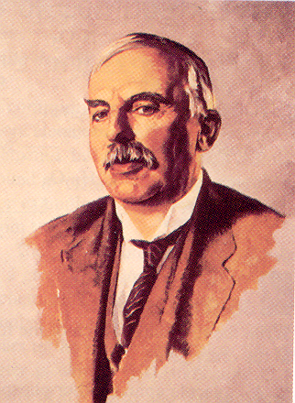
Theories
Rutherford – Stated that the nucleus of an atom is very small and dense and has a positive charge .

Slide 22
Rutherford ‘Scattering’
He fired α (alpha) particles at a very thin sample of gold foil
According to the Thomson model the α particles would only
be slightly deflected
Rutherford discovered that they were deflected through large angles and could even be reflected straight back to the source
Lead collimator
Gold foil
α
particle
source
θ
Notes:
Rutherford’s results strongly suggested that both the mass and positive charge are concentrated in a tiny fraction of the volume of the atom, called the nucleus.
Rutherford established that the nucleus of the hydrogen atom was a positively charged particle, which he called a proton.
Also suggested that the nuclei of elements other than hydrogen must contain electrically neutral particles with the same mass as the proton.
The neutron was discovered in 1932 by Rutherford’s student Chadwick.
Because of Rutherford’s work, it became clear that an α particle contains two protons and neutrons—the nucleus of a helium atom.

Slide 23
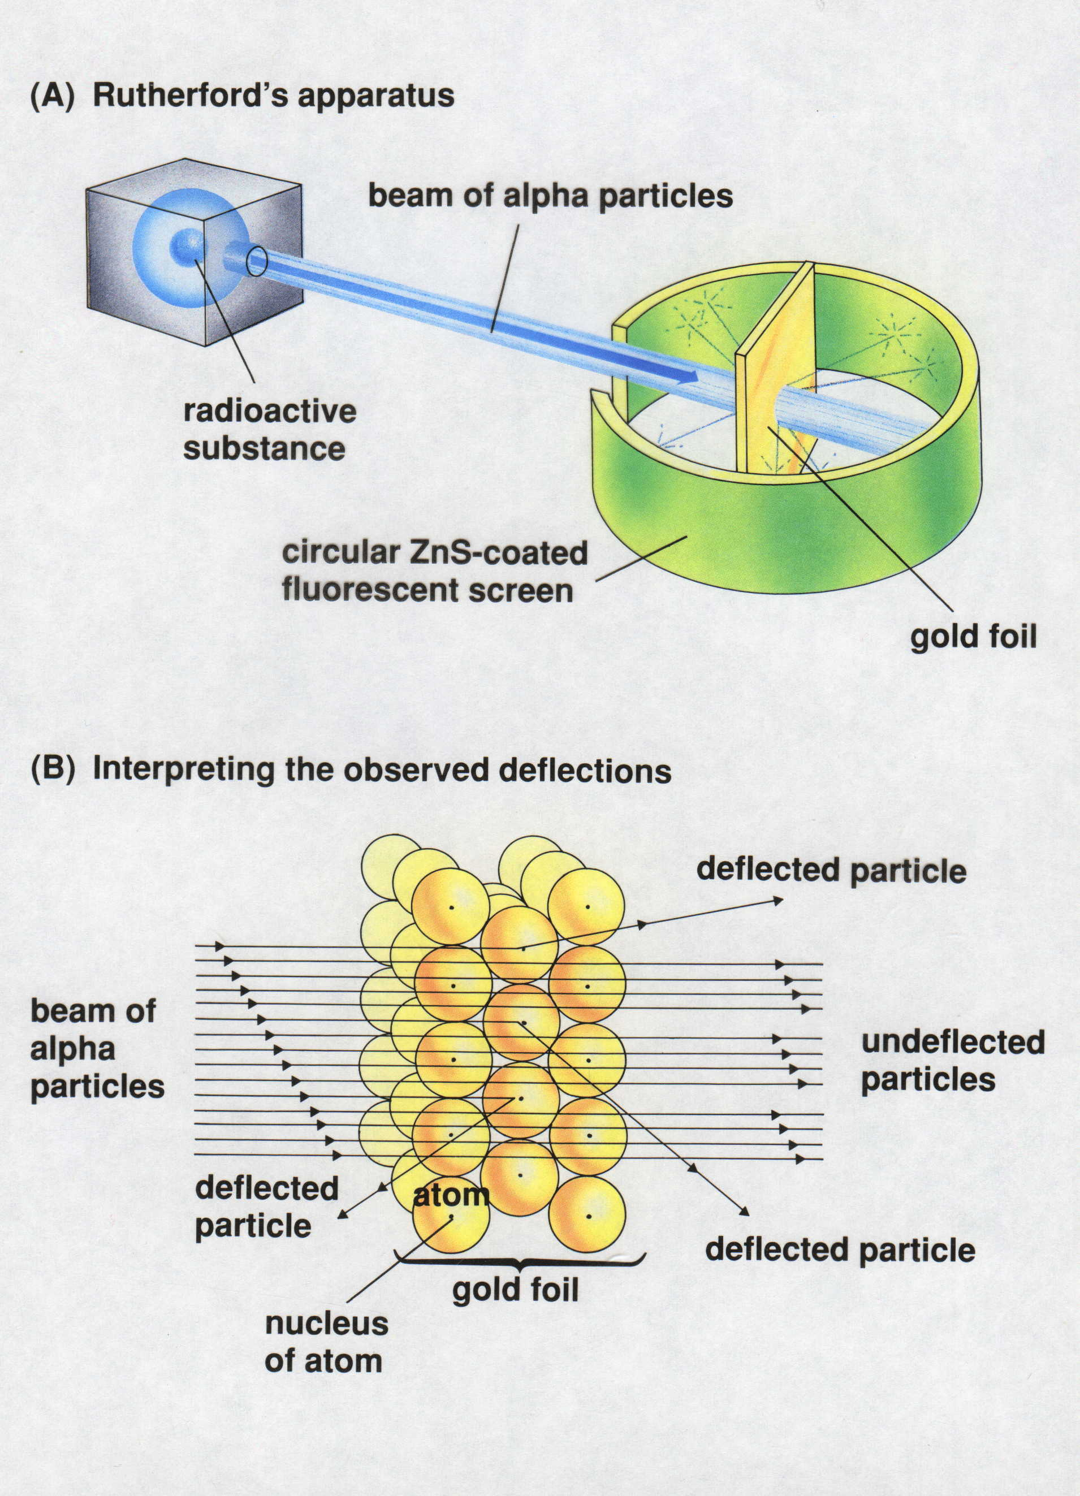
Rutherford’s Gold-Leaf Experiment Conclusions: Atom is mostly empty space Nucleus has (+) charge Electrons float around nucleus
Dorin, Demmin, Gabel, Chemistry The Study of Matter , 3rd Edition, 1990, page 120
Notes:
“Rutherford’s Gold-Leaf Experiment”
Description
This slide illustrates Ernest Rutherford’s experiment with alpha particles and gold foil and his interpretation of the results.
Basic Concepts
When charged particles are directed at high speed toward a metal foil target, most pass through with little or no deflection, but some particles are deflected at large angles.
Solids are composed of atoms that are closely packed. The atoms themselves are mostly empty space.
All atoms contain a relatively small, massive, positively charged nucleus. The nucleus is surrounded by negatively charged electrons of low mass that occupy a relatively large volume.
Teaching Suggestions
Use this slide to describe and explain Rutherford’s experiment. Rutherford designed the apparatus shown in figure (A) to study the scattering of alpha particles by gold. Students may have difficult with the concepts in this experiment because they lack the necessary physics background. To help students understand how it was determined that the nucleus is relatively massive, use questions 3 and 4 to explain the concept of inertia.
Explain that the electrostatic force is directly proportional to the quantity of electric charge involved. A greater charge exerts a greater force. (Try comparing the electrostatic force to the foce of gravity, which is greater near a massive object like the sun, but smaller near an object of lesser mass, such as the moon.) The force exerted on an alpha particle by a concentrated nucleus would be much greater that the force exerted on an alpha particle by a single proton. Hence, larger deflections will result from a dense nucleus than from an atom with diffuse positive charges.
Point out that Rutherford used physics to calculate how small the nucleus would have to be produce the large-angle deflections observed. He calculated that the maximum possible size of the nucleus is about 1/10,000 the diameter of the atom. Rutherford concluded that the atom is mostly space.
Questions
If gold atoms were solid spheres stacked together with no space between them, what would you expect would happen to particles shot at them? Explain your reasoning.
When Ernest Rutherford performed the experiment shown in diagram (A) he observed that most of the alpha particles passed straight through the gold foil. He also noted that the gold foil did not appear to be affected. How can these two observations be explained?
Can you explain why Rutherford concluded that the mass of the f\gold nucleus must be much greater than the mass of an alpha particle? (Hint: Imagine one marble striking another marble at high speed. Compare this with a marble striking a bowling ball.)
Do you think that, in Rutherford’s experiment, the electrons in the gold atoms would deflect the alpha particles significantly? Why or why not? (Hint: The mass of an electron is extremely small.)
Rutherford experimented with many kinds of metal foil as the target. The results were always similar. Why was it important to do this?
A friend tries to convince you that gold atoms are solid because gold feels solid. Your friend also argues that, because the negatively charged electrons are attracted to the positively charged nucleus, the electrons should collapse into the nucleus. How would you respond?
As you know, like charges repel each other. Yet, Rutherford determined that the nucleus contains all of an atom’s positive charges. Invent a theory to explain how all the positive charges can be contained in such a small area without repelling each other. Be creative!

Slide 24
Dalton
1) All matter is made of atoms. Atoms are indivisible and indestructible.
2) All atoms of a given element are identical in mass and properties
3) Compounds are formed by a combination of two or more different kinds of atoms.
4) A chemical reaction is arearrangementof atoms.

Slide 25
1. Why do elements lose or gain electrons? 2. What is the outer region of a compound called? Electron cloud 3. Transition metals are known for having an incomplete D level 4. MOVING ACROSS THE TABLE DO YOU GAIN NEUTRONS OR PROTONS???

Slide 26
MSDS
A Material Safety Data Sheet (MSDS) is a document that contains information on the potential health effects of exposure to chemicals, or other potentially dangerous substances, and on safe working procedures when handling chemical products.

Slide 27
Which term refers to a state of lower energy and highest energy
G. level
E. Level
How do you know an electron dropped from one level to the next?

Slide 28
1. What's a neutral atom? 2. Compare the size of atom between a cation and anion? 3. Draw an electron configuration and show them the difference between a cation and anion?

Slide 29
WHICH properties describe group 1A
HIGHLY REACTIVE AND FORMS STABLE COMPOUNDS

