Slide 1
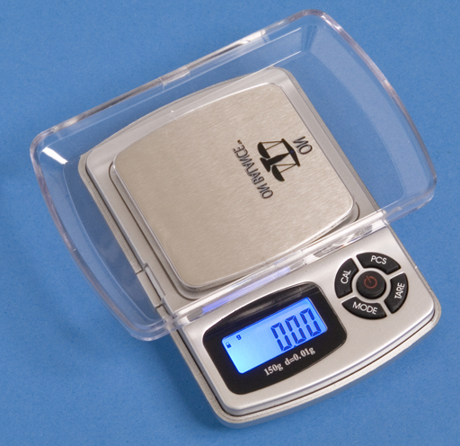
Measurements and Units
Chemistry is a quantitative science
How much of this blue powder do I have?
How long is this test tube?
How much liquid does this beaker hold?
When determining a quantity of a substance, a measurement is made. This is a numerical value that represents the quantity.
Measurements can be made with all sorts of tools.

Slide 2
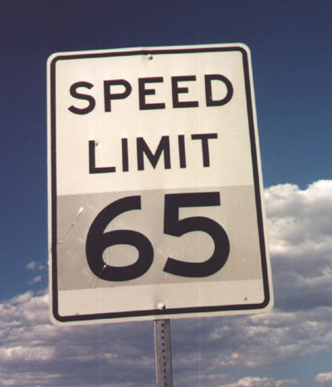
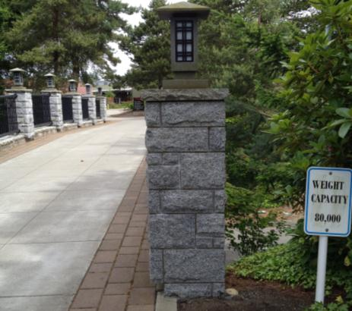
Measurements and Units
When we make a measurement, we have to define what it is that is being measured.
For example, it’s not enough to say that the speed limit is “65”. 65 what?
We say “65 miles per hour” to define this value as a rate of speed. The term “miles per hour” here serves as the units of measurement.

Slide 3
Exact and Inexact Numbers
Some measurements are exact. There is no error associated with them. These types of measurements are either definitions, or are counted.
[Example] How many people are in this room?
Other measurements are inexact. There is always some error associated with them.

Slide 4
Precision and Accuracy
When making measurements, a good strategy to use is to measure a quantity repeatedly and take the average.
This is done to minimize errors in measurement.
What types of error can occur in measurements? How do they affect our results?

Slide 5
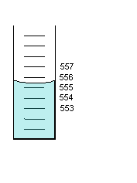
Precision and Accuracy
[Example] A group of four students made measurements for the amount of liquid in this cylinder (in mL).
555.4
555.6
555.6
555.5
These values are very close together! They are said to be precise.
Precision: little/no error between measurements.
How close are the measured values to the true value? If the values are close to a true value, they are said to be accurate.
Accuracy: measurement is close to the ‘correct’ value

Slide 6
Precision and Accuracy
[Example] Now, look at these measurements. What can you conclude about them?
554.0
554.1
554.1
553.9
Would these values be considered precise, accurate, both, or neither?
Because the values are all close together, there is little error between measurements. Thus, they are precise!
However, the average of the measurements doesn’t match up with what we’d say is the true value. So these results are NOT accurate.

Slide 7
Precision and Accuracy
In chemistry, various errors can influence our results.
A balance may be calibrated wrong. Or, we could read a beaker by not looking at it from head-on.
These types of errors are called systematic errors. These errors are the fault of how our instrument is looking at data. They affect the accuracy of data (but the precision may still be good!).

Slide 8
Precision and Accuracy
Another type of error is called random error. They can come from various factors (such as room temperature fluctuation, pressure, shaky hands, etc).
These errors affect precision (which can also affect accuracy.

Slide 9
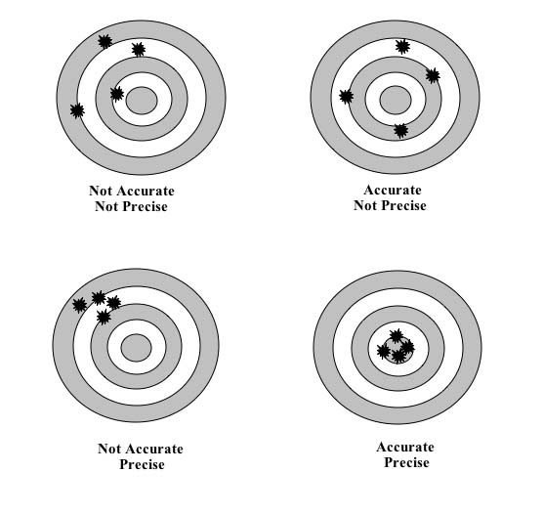
Precision and Accuracy

Slide 10
Measurements in Chemistry
When things are measured, it’s important to be both precise and accurate.
In the lab, make multiple measurements of everything you do. If one of your measurements is way off of the others, perhaps something led to an error.
In that case, make a note of your error in your lab notes and explain why you think it was wrong. Then you can use that data or discard it based on that conclusion.

Slide 11
Uncertainty in Measurements
When dealing with quantities, our precision is limited based on the tools we use.
A millimeter caliper is more precise than a centimeter ruler

Slide 12
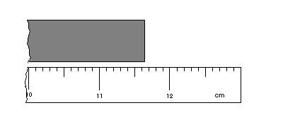
Uncertainty in Measurements
a bit less than 11.65 cm…
measurement: 11.64 ± 0.01 cm
11.6~11.7 cm
When measuring objects, our precision is limited by the device we are using…
What should we write down for the length of this object?

Slide 13
Uncertainty in Measurements
Whenever you deal with numbers, there will always be a bit of uncertainty. You should write down this uncertainty next to the number.
[Example] A balance shows a mass of solid that fluctuates between 0.259 g and 0.261 g. What should you write down?
Take the average, and include the uncertainty.
Writing 0.260 ± 0.001 gives us the best estimate.

Slide 14
Uncertainty and Error
When we make measurements, we have error associated with the uncertainty.
Human error is a result of our uncertainty from what we observe.
Instrument error is the result of uncertainty from a device, such as a balance.

Slide 15
Uncertainty and Error
[Example] A student weighs a sample of solid into a weighing boat three times, but forgets to press tare to zero the balance. The weighing boat has a mass of 3.00 g.
The masses of solid she gets are 4.15 g, 4.24 g, and 4.19 g.
What type of error is this? (Systematic, random, human, instrument?)
How will the student’s results be affected by this error?

Slide 16
Significant Figures
11.64 cm
4 sig figs!
11.6482765 cm
9 sig figs!
When we make measurements with tools or devices, it’s important to know the number of significant figures we use in our result.
A significant figure is a digit that is reliably known, or is closely estimated based on our measurement.
The more sig figs, the more precise our answer is.

Slide 17
What are Significant Figures?
A significant figure in a measurement is any digit that is non-zero.
Zero is sometimes a significant figure. Let’s look at cases where it is a sig fig, and when it’s not.

Slide 18
Zero as a Sig Fig
Zero is sometimes a significant figure. It depends how it’s used.
If 0 is used as a place holder, it is not significant.
[Example] 1250000 has only 3 sig figs.
[Example] 0.00004386 has only 4 sig figs.

Slide 19
Zero as a Sig Fig
If zeroes are “buried” between other numbers, those zeroes are significant.
[Example] 867530900000 has 7 sig figs.
In decimals, zeroes after other significant figures are also significant. The rule for this:
Any zeroes to the right of a sig fig and a decimal are also sig figs.
[Example] 0.000052500 has 5 sig figs.

Slide 20
Zero as a Sig Fig
[Danger!] If your answer is a whole (non-decimal) number preceded by a decimal point, then the zeroes are significant
[Example] 125000. has 6 sig figs!

Slide 21
Significant Figures Summary
[More Examples]
123000 3 sig figs
0.002749 4 sig figs
123000.0 7 sig figs
10101000 5 sig figs
0.00040 2 sig figs

Slide 22
Significant Figures Summary
[More Examples]
123000 3 sig figs
0.002749 4 sig figs
123000.0 7 sig figs
10101000 5 sig figs
0.00040 2 sig figs

Slide 23
Sig Figs and Exact Numbers
An exact number has no error associated with it. How many sig figs would such a number have?
Because there is no error, the number is infinitely precise! There is an infinite number of sig figs for exact numbers.

Slide 24
Now You Try It
Count the number of sig figs in each number.
92960000 mi, average distance to sun
90210, a zip code?
0.0870 g, the mass of a flea.
500. mL, the volume of a certain volumetric flask.

Slide 25
Rounding and Sig Figs
Standard rounding rules apply when Mathing with sig figs.
[Example] If you type 2.53 x 12.0 into your calculator, it gives a value of 30.36.
Keep the first 3 digits and round to the third place. So 30.36 becomes 30.4.
If the digit to the right of where we stop is < 5, we discard the remaining numbers and keep the digit the same.
If the digit to the right of where we stop is ≥ 5, we discard the remaining numbers and round the digit up.

Slide 26
Sig Figs In Math
For multiplication or division, look at the number of sig figs in each of the numbers you used.
The value with the least sig figs is the limitation of your answer. Round your answer as appropriate.
[Example 1] 5.4336 x 1.2 = 6.52032
We’d write 6.5 as our result (rounded down).
[Example 2] 7.4 / 2 = ???

Slide 27
Adding / Subtracting Sig Figs
438.2
10.734
+ 6.05
454.984
455.0
The least accurate decimal is your limitation.

Slide 28
Adding / Subtracting Sig Figs
[Example 3] (0.038) + (0.21) = 0.248
We write 0.25 as our result (result is rounded up).
[Example 4] (300) + (6) = ???

Slide 29
Sig Figs In Math
Try typing in 6.362 + 1.638 into your calculator.
How many sig figs should your result have?
How many does your calculator show?
In short: Calculators are stupid. Don’t trust them.
Finally, note that when an exact number is used in sig fig calculations, they should not affect the accuracy of ther answer (because they have an infinite number of sig figs, they can’t influence it).

Slide 30
Sig Figs In Math
Summary:
Multiplication/Division:
Final answer is limited by least accurate sig fig input
Addition/Subtraction:
Final answer is limited by least accurate decimal place

Slide 31
Now You Try It
Try the following calculations, with your result expressed to the correct number of sig figs.
(0.0019) x (21.39)
(8.321) / (4.1)
3000 + 20.3 + 0.009
[6.1 x (4.33 – 3.12)] / (3.14159 x 2)
The “2” is an exact number.

Slide 32
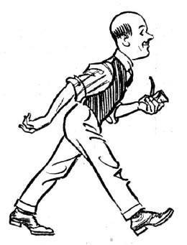
Really Big (or Small) Numbers…
An average person has about ten trillion cells!
10 000 000 000 000
x 10⁰
moving this decimal point to the left one place is like dividing by 10 (or 10¹)…
moving it 3 places would be dividing by 10³… and so on.
It becomes tedious to write very large or very small numbers. What can we do to make this easier?

Slide 33
Really Big (or Small) Numbers…
10 000 000 000 000
x 10⁰
x 10¹³
the decimal moves left 13 places…
…so we increase this exponent by 13.
1.0 x 10¹³
Our answer in scientific notation has one decimal place.
Every time we move the decimal place over to the left once, we divide by 10¹. To get the same number, we’ll increase the “x 10⁰” by one per space we move over.

Slide 34
Scientific Notation
A single hair is about 0.000085 m thick.
0 000 085
x 10⁰
x 10⁻⁵
the decimal moves right 5 places…
…so we decrease the exponent by 5.
8.5 x 10⁻⁵
Our answer in scientific notation.
When working with really small numbers, you can use the same process.

Slide 35
Scientific Notation Summary
Big numbers: the decimal place moves left and you increase the exponent.
[Example] 1350000 becomes 1.35 x 10⁶.
Small numbers: the decimal place moves right and you decrease the exponent.
[Example] 0.00000733 becomes 7.33 x 10⁻⁶.

Slide 36
Now You Try It
Convert the following numbers into scientific notation.
4 487 940 000 000 meters, the diameter of the solar system.
361 000 000 000 000 square meters, the surface area of all oceans on Earth.
0.000 000 000 031 meters, the width of a helium atom.

Slide 37
Doing Math in Scientific Notation
(3.5 x 10⁴) x (1.7 x 10⁻²)
multiply the numbers separately from the exponents…
(3.5 x 1.7) x (10⁴ x 10⁻²)
when multiplying exponents of 10, just add the exponents together
6.0 x 10²
and it’s done! hooray!
We can easily do multiplication and division using scientific notation.

Slide 38
Doing Math in Scientific Notation
(2.51 x 10⁵)
(1.36 x 10⁻³)
divide the numbers separately from the exponents…
(2.51)
(1.36)
(10⁵)
(10⁻³)
x
when dividing exponents of 10, just subtract the exponents
1.85 x 10⁸
and it’s done! hooray!
We can easily do multiplication and division using scientific notation.

Slide 39
Doing Math in Scientific Notation
Addition/Subtraction is more difficult
Need to make the exponents the same to add values
[Example] What is 3.05 x 10⁵ – 1.07 x 10⁴?
First, make both exponents the same.
(3.05 x 10⁵ becomes 30.5 x 10⁴)
Then, we can do math using the rules for addition and subtraction.
Answer: 29.4 x 10⁴ = 2.94 x 10⁵

Slide 40
Now You Try It
Write the answers to these problems to the correct number of sig figs.
(6.02 x 10²³) x 18.02 =
(4.1 x 10⁻⁵) / (2.55 x 10⁻⁶) =
(3.52 x 10³) + (2.11 x 10¹) – (9.01 x 10²) =

