Slide 1

Atomic Structure
Unit 2
Notes:
Atoms and Molecules
“The idea that matter is made of tiny indivisible particles was first suggested by the Greek philosopher Democritus (c460-370 BC). He called these particles atoms. In the late 18th century a modern theory about atoms originated. By then new gases, metals, and other substances had been discovered. Many chemical reactions were studied and the weights of substances involved were measured carefully. John Dalton’s atomic theory arose from these observations. He believed that the atoms of an element were all identical and differed from those of a different element. Two or more of these atoms could join together in chemical combination producing “molecules” of substances called compounds. The molecules in a compound were all identical. The Italian thinker Amadeo Avagadro (1776-1856) asserted that the same volume of any gas would contain the same number of molecules. Although this idea was not immediately accepted, it eventually helped chemists calculate atomic and molecular weights. These weights are related to the weight of hydrogen, which is counted as one.”
Eyewitness Science “Chemistry” , Dr. Ann Newmark, DK Publishing, Inc., 1993, pg 16

Slide 2

Table of Contents
‘Atomic Structure’
A). Development of the Atom
Dalton Model of the Atom
Thomson
Rutherford
Bohr
Quantum Mechanical
Review
Millikan Oil Drop
Notes:
Topics:
Describe the contributions of Democritus and early Greek Philosophers, Dalton, Thompson, Millikan, Chadwick, Rutherford on the structure of the atom.
Describe the experimental evidence that used to construct the principles of modern atomic theory.
Laws of Conservation of Mass, Definite Composition, and Multiple Proportions
Cathode ray experiment
Oil Drop Experiment
Gold Foil Experiment
Distinguish between the three particles that make up the atom and their relative charges, masses and positions in the atom
Use the periodic table to give the symbol, atomic mass, atomic number, number of protons, electrons, and neutrons for a given element.
Isotopes
Define atomic mass unit and explain how masses of atoms were first determined.
Define isotope and explain why atomic masses are not whole numbers
State that isotopes have the same chemical properties but different physical properties (mass and radioactivity)
Write isotopes using isotope notation
Use isotope notation to give the numbers of protons, neutrons and electrons
Calculate atomic mass from isotope abundances.
Unstable Nuclei
Explain the relationship between unstable nuclei and radioactive decay
State that mass can be converted into energy and is the source of energy released in nuclear reactions.
Characterize alpha, beta, and gamma radiation in terms of mass and charge
Solve half-life problems
List applications of radioactivity
Distinguish between fusion and fission
Describe the formation of naturally occurring and synthetic elements
*Because all scientific ideas depend on experimental and observational confirmation, all scientific knowledge is subject to change as new evidence becomes available.
*Scientific explanations must meet certain criteria: they must be consistent with experimental and observational evidence about nature and must make accurate predictions when appropriate about systems being studied.
*Atoms are made up of 3 subatomic particles and a lot of empty space; two particles make up the mass of the atom and are located in the nucleus and one, the electron, is located in the area outside of the nucleus.
More Specifically...:
History through Rutherford
Describe the contributions of Democritus and early Greek Philosophers, Dalton, Thompson, Millikan, and Rutherford on the structure of the atom.
a. particles - Democritus
b. first atomic theory of matter - John Dalton
c. discovery of the electron - J. J. Thompson
d. discovery of the nucleus - Ernest Rutherford
e. discovery of charge of electron - Robert Millikan
f. discovery of the neutron - James Chadwick
Describe the experimental evidence that used to construct the principles of modern atomic theory.
a. Laws of Conservation of Mass, Definite Composition, and Multiple Proportions
b. Cathode ray experiment
c. Oil Drop Experiment
d. Gold Foil Experiment
Distinguish between the three particles that make up the atom and their relative charges, masses and positions in the atom
Use the periodic table to give the symbol, atomic mass, atomic number, number of protons, electrons, and neutrons for a given element.
*Nuclear energy comes from the conversion of mass into energy as a result of unstable nuclei. This requires an adjustment to the conservation of energy and the conservation of mass to be the conservation of mass and energy.
*New elements can be created through the process of fusion and this was how the universe as we know it was created.
*Radiation is a natural, daily occurrence and can have both beneficial and negative impacts
*Because atoms cannot, practically, be measured individually and because atoms of the same element can have different masses which occur in various proportions, the use of the weighted average and molar quantities are used
More Specifically...:
Atomic Mass
List the two particles that make up most of the mass of the atom
Define atomic mass unit and explain how masses of atoms were first determined.
Define Avogadro's number and its relationship to the atomic mass scale.
Define the mole and use dimension analysis to convert between
a. Grams and moles
b. Particles and moles
c. Particles and grams
*The quantum model uses probability to describe the position of an electron and the position of the electron is important to understanding such ideas as bonding, valence, and chemical interactions.
*The color of light indicates the relative amount of energy of the light.
*Spectroscopic information can be used to identify elements because the amount of energy that can be absorbed or emitted is dependent on how much energy it takes to change the motion or position of a particle within an atom which is controlled by the atomic structure of the substance
More Specifically...:
History from Bohr - Schrodinger
Describe the contributions of Bohr, Planck, Heisenberg, and de Broglie on the modern theory of the atom.
a. planetary model of atom - Niels Bohr
b. quantum nature of energy - Max Planck
c. uncertainty principle - Werner Heisenberg
d. wave theory - Louis de Broglie.
e. Wave equation - Schrodinger
Give the relative energy associated with a particular color of light
Use E=hv to calculate the energy of a given frequency or wavelength of light.
Calculate the wavelength of light given a frequency
Draw Bohr diagrams and indicate what happens to the electrons when light is absorbed and emitted.
Relate emitted light to an element's characteristic spectra
State that light can be considered a wave or a particle and that this is known as the wave-particle duality
Compare and contrast the Bohr model of the atom with the quantum mechanical model in which,
a. Electrons are both particle and wave
b. The exact position of the electron cannot be known
c. Electrons do not orbit the nucleus but are thought to exist in certain areas around the nucleus known as orbitals
Electron Configurations
Describe the shapes of the s, p, d, f-orbitals
Identify the four quantum numbers
Draw orbital diagrams for a given element
Draw electron configurations for a given element
Convert between the noble gas configuration and the long-hand electron configuration
Convert between orbital diagrams and electron configurations
Recognize incorrect orbital diagrams and electron configurations and attribute the rule that is broken to:
a. Hund
b. Pauli or
c. Aufbau
Write electronic configuration of simple ions

Slide 3
Development of the Atom

Slide 4

The Greeks
History of the Atom
Not the history of atom, but the idea of the atom
In 400 B.C the Greeks tried to understand matter (chemicals) and broke them down into earth, wind, fire, and air.
Democritus and Leucippus Greek philosophers
∼
∼

Slide 5
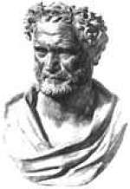
Greek Model
“To understand the very large,
we must understand the very small.”
Democritus
Greek philosopher
Idea of ‘atomos’
  Atomos = ‘indivisible’
  A- absence, Tomas- Split
No experiments to support idea! Bread! Sand
He believed that atoms were indivisible, solid, indestructible, and exists in empty space.
Democritus’s model of atom
No protons, electrons, or neutrons
Solid and INDESTRUCTABLE
Notes:
Atomists; they argued for a completely materialistic universe consisting of atoms moving in a void.
Since mere fragments of the ideas of Leucippus are known, his pupil, Democritus of Abdera (c 460 -370 B.C.)
is considered the elaborator of this concept.
Aaron J. Ihde The Development of Modern Chemistry, Dover Publishing, 1984 pg 6
It should also be noted that the Romans were not a scientific people and made almost no scientific contributions of their own.
“To understand the very large, we must understand the very small.”
-Democritus
The world
Reality to Democritus consists of the atoms and the void. Atoms are indivisible, indestructible, eternal, and are in constant motion. However, they are not all the same as they differ in shape, arrangement and position. As the atoms move they come into contact with other atoms and form bodies. A thing comes into being when the atoms that make it up are appropriately associated and passes away when these parts disperse.
This leaves no room for the intelligent direction of things, either by human or divine intelligence, as all that exists are atoms and the void. Democritus stated, "Nothing occurs at random, but everything occurs for a reason and by necessity."
The soul
Although intelligence is not allowed to explain the organization of the world, according to Democritus, he does give place for the existence of a soul, which he contends is composed of exceedingly fine and spherical atoms. He holds that, "spherical atoms move because it is their nature never to be still, and that as they move they draw the whole body along with them, and set it in motion." In this way, he viewed soul-atoms as being similar to fire-atoms: small, spherical, capable of penetrating solid bodies and good examples of spontaneous motion.

Slide 6
Democritus
DEMOCRITUS (400 BC) – First Atomic Hypothesis
Atomos: Greek for “uncuttable”. Chop up a piece of matter until you reach the atomos.
Properties of atoms:
  indestructible.
  changeable, however, into different forms.
  an infinite number of kinds so there are an infinite number of elements.
  hard substances have rough, prickly atoms that stick together.
  liquids have round, smooth atoms that slide over one another.
  smell is caused by atoms interacting with the nose – rough atoms hurt.
  sleep is caused by atoms escaping the brain.
  death – too many escaped or didn’t return.
  the heart is the center of anger.
  the brain is the center of thought.
  the liver is the seat of desire.
“Nothing exists but atoms and space, all else is opinion”.

Slide 7
Four Element Theory
Aristotle :
Thought all matter was composed of 4 elements:
  Earth (cool, heavy)
  Water (wet)
  Fire (hot)
  Air (light)
  Ether (close to heaven)
FIRE
Hot
Dry
‘MATTER’
AIR
EARTH
Wet
Cold
WATER
Relation of the four elements and the four qualities
Blend these “elements” in different proportions to get all substances
Notes:
THE SCEPTICAL CHYMIST (1661)
“The Greeks believed that earth, air, fire, and water were the fundamental elements that made up everything else. Writing in 1661, Robert Boyle (1627-1691) argued against this idea, paving the way for modern ideas of the elements. He defined an element accurately as a substance that could not be broken down into simpler substances.”
Eyewitness Science “Chemistry” , Dr. Ann Newmark, DK Publishing, Inc., 1993, pg 18
Plato was Aristotle's student. It was Aristotle that suggested qualities of "hot, dry, cold, wet".

Slide 8

Who Was Right?
did not experiment
Greeks settled disagreements by argument
Aristotle was more famous
He won!
His ideas carried through middle ages.
Notes:
California WEB
http://www.rightsleeve.com/images/large/RS_2265_lrg.jpg

Slide 9
Alchemy
After that chemistry was ruled by alchemy.
They believed that that could take any cheap metals and turn them into gold.
Alchemists were almost like magicians.
  elixirs, physical immortality

Slide 10
Alchemy
Alchemical symbols for substances…
.
. .
. . .
. . . .
. . . . .
GOLD
SILVER
COPPER
IRON
SAND
transmutation: changing one substance into another
Δ
In ordinary chemistry, we cannot transmute elements.

Slide 11
Dalton Model of the Atom
Late 1700’s - John Dalton- England
Teacher- summarized results of his experiments and those of others
Combined ideas of elements with that of atoms in Dalton’s Atomic Theory
Notes:
Objective: To describe the Dalton model of the atom.
John Dalton (1766 -1844) established a continuing tradition of chemical atomism.

Slide 12
The Atomic Theory of Matter
In 1803, Dalton proposed that elements consist of individual particles called atoms.
His atomic theory of matter contains four hypotheses:
    1. All matter is composed of tiny particles called atoms.
    2. Atoms can not be created or destroyed.
    3. All Atoms of the same element are identical .
    4. In chemical reactions, atoms from one or more
    compounds or elements redistribute or rearrange in
    relation to other atoms to form one or more new
    compounds. Atoms themselves do not undergo a
    change of identity in chemical reactions.
    5. Atoms are indivisible.
Copyright © 2007 Pearson Benjamin Cummings. All rights reserved.

Slide 13
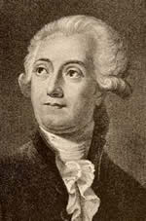
Modern Chemistry
In the late eighteenth century:
Lavoisier discovered respiration and wrote the first modern chemistry text.
His most important contribution was the
law of conservation of mass.
which states
that in any chemical reaction, the mass of
the substances that react equals the mass
of the products that are formed.
He is known
as the father of modern chemistry.
Lavoisier
Copyright © 2007 Pearson Benjamin Cummings. All rights reserved.

Slide 14
Foundations of Atomic Theory
Law of Conservation of Mass
  Mass is neither destroyed nor created during ordinary chemical reactions.
Law of Definite Proportions
  The fact that a chemical compound contains the same elements in exactly the same proportions by mass regardless of the size of the sample or source of the compound.
Law of Multiple Proportions
  If two or more different compounds are composed of the same two elements, then the ratio of the masses of the second element combined with a certain mass of the first elements is always a ratio of small whole numbers.
Notes:
Lavoisier (credited with Law of Conservation of Mass).
Proust (credited with Law of Definite Proportions).
Dalton (credited with Law of Multiple Proportions).

Slide 15
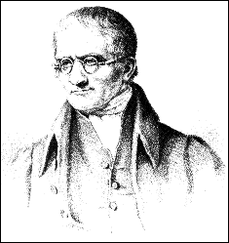
Conservation of Atoms
2 H₂ + O₂
2 H₂O
John Dalton
H
H
O
O
H₂
H₂O
H
O₂
H
+
O
H
H
H₂
O
H
H₂O
H
4 atoms hydrogen
2 atoms oxygen
4 atoms hydrogen
2 atoms oxygen
Dorin, Demmin, Gabel, Chemistry The Study of Matter , 3rd Edition, 1990, page 204
Notes:
“Conservation of Atoms”
Description: This slide illustrates conservation of atoms in a chemical reaction.
Basic Concepts
Atoms are conserved in chemical reactions, but molecules are not.
Atoms are neither created nor destroyed in chemical reactions. They are only rearranged.
Equation coefficients can be interpreted as the relative numbers of molecules, formula units, or moles of reactants and products.
Teaching Suggestions
This slide shows that atoms are neither created nor destroyed in a chemical reaction but are merely rearranged. Use this slide and worksheet to help students understand formula equations. You may need to review how gram formula mass is determined.
Questions
State the law that explains why the number of oxygen and hydrogen atoms is the same on both sides of the equation shown in the diagram.
In what ways are the atoms rearranged by the reaction?
Write a word equation for the reaction taking place in the diagram.
In the balanced equation shown in the diagram, what is the coefficient of H₂? Of O₂? Give two ways in which the coefficients in the balanced equation can be interpreted.
Use the balanced equation to determine how many moles of H₂O would be produced by the reaction of 4 moles of H₂ with 2 moles of O₂.
The gram formula mass of a substance is the number of grams of the substance containing a mole of formula units.
Write the equation for the reaction in question 5 showing the number of moles of the reactants and the product.
Calculate the gram formula mass of H₂, O₂, and H₂O.
How many grams of H₂ and O₂ react in the reaction in part a? How many grams of H₂O are produced?
Rewrite the equation, giving the masses of reactants and products. How do you know that mass is conserved in this reaction?
Do the masses of the reactants in the equation in part d have the same ratio as the coefficients of the equation in part a? Why or why not?
Which do you think is most useful to a chemist: the balanced formula equation (at the top of the diagram), the molecular sketch, the word equation, or an equation that gives the masses of reactants and products? Which would be the least useful? Explain your reasoning.

Slide 16
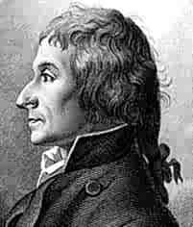
Law of Definite Proportions
Joseph Louis Proust (1754 – 1826)
Each compound has a specific ratio of elements
It is a ratio by mass
Water is always 8 grams of oxygen for every one gram of hydrogen
Notes:
Photo pg 100 Ihde text (Edgar Fahs Smith Collection)
Joseph Louis Proust (1754- 1826), French chemist given credit for law of definite composition.
Whether synthesized in the laboratory or obtained from various natural sources, copper carbonate always has the same composition. Analysis of this compound led Proust to formulate the law of definite proportions.

Slide 17
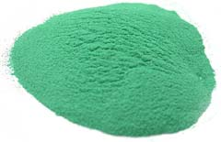


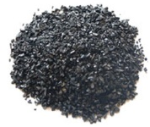
Law of Definite Proportions
Whether synthesized in the laboratory or obtained from
various natural sources, copper carbonate always has
the same composition.
Analysis of this compound led Proust to formulate
the law of definite proportions.
+
+
103 g of
copper carbonate
53 g of
copper
40 g of oxygen
10 g of carbon
Ralph A. Burns, Fundamentals of Chemistry 1999, page 90

Slide 18
The Law of Multiple Proportions
Dalton could not use his theory to determine the elemental compositions of chemical compounds because he had no reliable scale of atomic masses.
Dalton’s data led to a general statement known as the law of multiple proportions.
Law states that when two elements form a series of compounds, the ratios of the masses of the second element that are present per gram of the first element can almost always be expressed as the ratios of integers.
Copyright © 2007 Pearson Benjamin Cummings. All rights reserved.

Slide 19
Law of Multiple Proportions
John Dalton (1766 – 1844)
If two elements form more than one compound, the ratio of the second element that combines with 1 gram of the first element in each is a simple whole number.
  e.g. H₂O & H₂O₂
  water hydrogen peroxide
  Ratio of oxygen is 1:2 (an exact ratio)
Notes:
MY BROTHER, JOHN
We lived at Eaglesfield in Cumberland in a small thatched cottage when my brother John was born. I was seven and our sister, Mary, was two. John's birth was not recorded in the family Bible, but when he asked later, the old people told him it was 5 September 1766. Our family had been Quakers since the 1690's when Grandfather Jonathan, my namesake, converted. Grandmother Abigail was a Fearon whose dowry brought our family a holding, which Grandfather enlarged to sixty acres. My father Joseph, their second son, inherited this estate. My mother was Deborah Greenup of a Quaker farming family. John and I helped with the field work and in the shop where my father wove cloth. Mary helped Mother with the house and sold paper, ink and quills. Although we were not hungry, we were poor. Other poor boys received little education, but as Quakers, we Dalton children received an empirical and utilitarian education at the nearest Quaker school. This was quite a feat since, at that time, only one of every 215 English people could read. John and I went to the Quaker school at Pardshow Hall. John was quick at studies and tireless at mathematical problems. John Fletcher, the master, was a superior man who did not use the rod to hammer in learning. He was to provide John with a superb background and lifelong quest for knowledge. Elihu Robinson, a rich Quaker gentleman, became John's mentor and another source of mental stimulation in mathematics and science, especially meteorology.
When my brother was twelve, he opened a school in Eaglesfield. He was threatened by the older boys who wanted to fight with the young master, but apparently he managed to control them for two years. Due to the poor salary, John returned to the land briefly and worked for our rich uncle. Meanwhile, I had left home to assist George Bewley with his school at Kendall. When John joined me in 1781, we planned to run the school together when cousin George retired. In 1785 our school opened and we offered English, Latin, Greek, French, along with twenty-one mathematics and science subjects. Mary came to keep house for us. Although we had sixty pupils, we were often forced to borrow and take outside jobs to support ourselves.
For the twelve years at Kendall, John worked at self improvement, including answering questions from ladies' and gentlemen's magazines. His responses appeared in print sixty times. John found a new friend and mentor in John Gough, the blind son of a wealthy tradesman, he taught John languages, mathematics and optics, and shared his extensive library. Later, John dedicated his earliest two books to Gough who had encouraged his lifelong interest in meteorology by suggesting that John keep a daily journal. As John's interest in science expanded to include optics, pneumatics, astronomy and geography, he began in 1787 to supplement his low income with public lectures. He also approached a nearby museum with an offer to sell his eleven volume classified botanical collection. He collected butterflies and studied snails, mites and maggots by suspending them in water and vacuums. He measured his own intake of food to compare with his production of waste. His studies were to prepare him to go to medical school, but we discouraged him because we lacked the money and did not feel that John was suited to be a physician.
Once, on our mother's birthday, John bought her some very special stockings. This was to be a treat for she always wore homespun stockings. Mother exclaimed to John, "Why did you buy me scarlet stockings?" John had thought they were blue and turned to me to verify their suitable color. Since we both saw blue instead of scarlet, Mother took the stockings out to some of the other women. So at the age of twenty -six, John discovered that we were both color-blind. John experimented and wrote about this phenomenon in his first important scientific paper. Many years later when John had an audience with the King, he refused to wear the customary dress which included a sword. In a compromise, he agreed to wear his Oxford honorary doctoral robe. John thought the robe was grey, but in reality it was red, which at that time was not an appropriate color for a Quaker. The condition of color-blindness came to be known as Daltonism in France.
In 1793, John moved to Manchester as tutor at New College founded by the Presbyterians. It was here that John would rise above his country schoolteacher background to do his greatest work. He immediately joined the Manchester Literary and Philosophical Society. In 1793, he published his first book, Meteorological Observations and Essays. In it he said that each gas exists and acts independently and purely physically, rather than chemically. This means that gases act according to mechanical repulsion rather than chemical attraction. As a chemistry tutor, John taught from Lavoisier's Elements of Chemistry. After six years John resigned to conduct private research supported by tutoring at two shillings a lesson.
In 1802, in the grandly titled "Experimental Essays on the Constitution of Mixed Gases; on the Force of Steam or Vapour from water and other liquids in different temperatures, both in a Torricellian vacuum and in air; on Evaporation; and on the Expansion of Gasses by Heat," John stated his law of partial pressures. He explained that when two elastic fluids, A and B, are mixed together, there is no mutual repulsion between their particles; that is, A particles do not repel B particles, but a B particle will repel another B. Consequently, the pressure or whole weight of the gas arises solely from its particles. One of his experiments involved the addition of water vapor to dry air. The increase in pressure was the same as the pressure of the added water. He also established a relationship between vapor pressure and temperature.
John's interest in gases arose from his meteorological studies. He always carried his weather apparatus with him wherever he went, even on his infrequent vacations. He was constantly studying the weather and atmosphere. During his lifetime, John made over 200,000 observations, which he wrote in a journal, his constant companion. It was in these observations that his mathematical mind saw the numerical connections between the data.
In 1803, while attempting to explain his law of partial pressures, John started to formulate his most important contribution to science the atomic theory. He was studying nitrogen oxides for Dr. Priestley's test for percentage of nitrogen in the air. Among the reactions he studied were those of nitric oxide with oxygen. He discovered that the reaction can take place in two different porportions in exact ratios, namely:
2NO + O ---> N2O3
NO + O ---> NO2 John stated that oxygen combines with nitrogen sometimes 1 to 1.7 and at other times 1 to 3.4 by weight. On 4 August 1803, he stated the law of multiple porportions: the weights of elements always combine with each other in small whole number ratios. John published his first list of atomic weights and symbols that year, which gave chemistry a language of its own. The ensuing years were very busy for my brother. He lectured, tutored, and of course, experimented. He orally reported the results of the experiments at the "Lit and Phil" and published them in a book in 1808. This was his most famous work, A New System of Chemical Philosophy, Part I. On page 71 he states, "No two elastic fluids, probably, therefore have the same number of particles or the same weight." John had relied on his observations and mathematical reasoning to produce a revolutionary book containing a revolutionary theory. His train of reasoning from his "rule of greatest simplicity" (all combinations of atoms occur in the simplest possible) to his belief in the caloric theory led him to this theory. John adopted the idea of atoms and drew individual particles to illustrate chemical reactions.
Not everyone accepted the atomic theory and John had to defend it from critics. In 1810, he published Part II of his New System, giving more empirical evidence for it. It was amazing to me that my little brother John could have produced the theory which quantified chemical theory.
John died on 27 July 1844 of a stroke, after noting the weather conditions for the day in his journal. He had requested an autopsy to determine the cause of his color-blindness. It was his final experiment and proved that the condition called Daltonism is not caused by the eye itself, but some deficient sensory power. Manchester buried John with kingly honors with his body lying in state and a funeral as for a monarch. John was viewed by more than 400,000 people while his body lay in state and the procession was over a mile long. This was in direct violation to the simple Quaker principles by which John had lived. Furthermore,the city has honored him with both a large monument and a statue.
Bibliography
J. Dalton, J. Gay-Lussac, and A. Avogadro, Foundation of the Molecular Theory: Comprising Papers and Extracts, The University of Chicago Press, Chicago, 1906, pp. 5-7. D.A. Davenport, "John Dalton's First Paper and Last Experiment", ChemMatters, 1984, April, p.14.
J. T. Moore, A History of Chemistry, McGraw-Hill Book, Co., Inc., New York, London, 1939, pp.115-131.
E.C. Patterson, John Dalton and the Atomic Theory, Doubleday and Co, Inc., Garden City, New York, 1970.
A.J. Rocke, Chemical Atomism in the Nineteenth Century, Ohio State University Press, Columbus, Ohio, 1984, pp.21-43.
H.E. Roscoe, John Dalton and the Rise of Modern Chemistry, MacMillan and Co., New York and London, 1895.
T. Thomson, The History of Chemistry, Arno Press, New York, 1975, pp.277-308.
A. G. VanMelsen, From Atomos to Atom, Harper Torchbooks, The Science Library, New York, 1952, pp. 136-138.
http://www.woodrow.org/teachers/chemistry/institutes/1992/Dalton.html

Slide 20


What?
Water is 8 grams of oxygen per gram of hydrogen.
Hydrogen peroxide is 16 grams of oxygen per gram of hydrogen.
16 g to 8 g is a 2:1 ratio
True, because you have to add a whole atom, you can’t add a piece of an atom.
Notes:
http://graphics.samsclub.com/images/products/0030869470710_LG.jpg

Slide 21
Thomson Model of the Atom
J. J. Thomson - English physicist. 1897
Made a piece of equipment called a cathode ray tube.
It is a vacuum tube - all the air has been pumped out.
Notes:
Objectives:
To describe the Thomson plum-pudding model of the atom.
To state the relative charge on an electron and a proton.
The electron was discovered as a constituent of all mater by J. J. Thomson following his experiments with cathode ray tubes. By passing an electric discharge through a gas at low pressure, a beam of rays is generated at the cathode. These rays consist of high energy electrons. The negative charge of the electron is demonstrated by the fact that they are deflected away from a negative plate.
Thomson was able to determine the charge/mass ratio for the electron (e/m = -1.76 x 10¹¹ C/kg).
R A Millikan was later to determine the mass of the electron as ¹/₁₈₃₆ amu.
You can find descriptions of Thomson's and Millikan's work in most standard texts. Mass of the electron = 9.109 x 10⁻³¹ kg Charge of the electron = 1.602 x 10⁻¹⁹ C

Slide 22
Cathode Ray Experiment
1897 Experimentation
Using a cathode ray tube, Thomson was able to deflect cathode rays with an electrical field.
The rays bent towards the positive pole, indicating that they are negatively charged.

Slide 23
The Effect of an Electric Field on Cathode Rays
negative
plate
High
voltage
source of
high voltage
_
cathode
+
anode
positive
plate
Dorin, Demmin, Gabel, Chemistry The Study of Matter , 3rd Edition, 1990, page 117
Notes:
Charged particles tend to move away from particles with the same charge and toward particles with the opposite charge. When the cathode rays bent away from the negative pole of the magnet and toward the positive pole, this rule caused Thomson to realize the cathode rays were negatively charged.

Slide 24
Cathode Rays
(A) The effect of an obstruction on cathode rays
High
voltage
source of
high voltage
shadow
cathode
yellow-green
fluorescence
Cathode ray = electron
Electrons have a
negative charge
(B) The effect of an electric field on cathode rays
negative
plate
High
voltage
source of
high voltage
-
source of
low voltage
cathode
+
anode
positive
plate
Dorin, Demmin, Gabel, Chemistry The Study of Matter , 3rd Edition, 1990, pages 117-118
Notes:
“Cathode Rays”
This slide demonstrates the use of a cathode ray tube in J.J. Thomson’s discovery of the electron.
Basic Concepts
In a cathode ray tube, negative particles or radiation are emitted from the cathode and attracted to the anode.
Electrons are fundamental particles present in the atoms of all elements.
Teaching Suggestions
Use this slide to familiarize students with the experiments that led to the discovery of the electron. Discuss how Thomson was able to conclude from his observations that electrons are fundamental particles found within all atoms. Explain that most of the air was removed from the tube and that a high voltage was applied, producing negatively charged terminal (cathode) and a positively charged terminal (anode). Review that negatively charged particles are attracted to positively charged objects.
Questions
When William Crookes conducted the experiments shown in diagram (A), he noted that a shadow appeared on the end of the tube. What did this shadow tell him about cathode rays? Explain.
To find out more about the nature of cathode rays, J.J. Thomson placed a disk with a slit in it in front of the cathode. What happened to the cathode rays?
The other modifications J.J. Thomson made to the tube was to install positively and negatively charged plates, as shown in diagram (B). To his surprise, the beam of rays was bent toward the positively charged plate. What did this observation tell Thomson about the nature of cathode rays?
What would have happened if the rays had been positively charged particles? What if the rays had no electrical charge (for example, if they were light rays)?
Thomson repeated his experiments using different materials for the electrodes and a variety of gases in the cathode ray tube. In all cases, the cathode ray particles behaved in the same manner. What did these results tell Thomson? Why was it important to conduct these additional experiments?

Slide 25
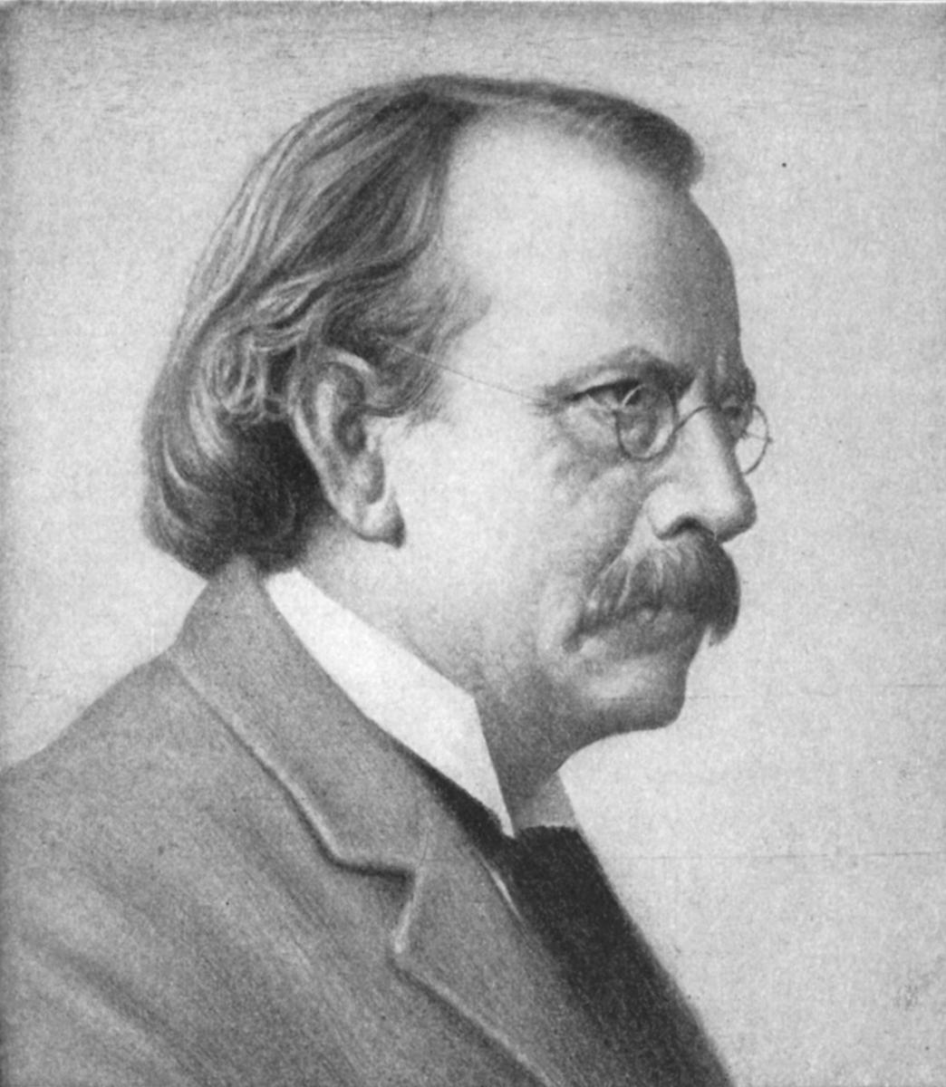
J.J. Thomson
He proved that atoms of any element can be made to emit tiny negative particles.
He called them electrons
J.J. Thomson
Notes:
J.J. Thomson (1856 - 1940) proposed a model of the atom with subatomic particles (1903).
This model was called the plum-pudding or raisin pudding model of the atom.
(Sir Joseph John) J. J. Thompson was born in Manchester in 1856. His father was a bookseller and publisher. Thompson was Cavendish Professor of experimental physics,
Cambridge University from 1894 - 1919. He was described as humble, devout, generous, a good conversationalist and had an uncanny memory. He valued and inspired enthusiasm in his students. Thompson was awarded the Nobel Prize for physics for his investigations of the passage of electricity through gases. In 1897, he discovered the electron through his work on cathode rays. Thomson´s son, Sir George Paget, shared the Nobel Prize for physics with C.J. Davisson in 1937. Seven of Thomson´s
trainees were also awarded Nobel Prizes. J.J. Thompson is buried in Westminster Abbey close to some of the World’s greatest scientists, Newton, Kelvin, Darwin, Hershel and Rutherford.
Thomson won the Nobel Prize in 1906 for characterizing the electron.

Slide 26
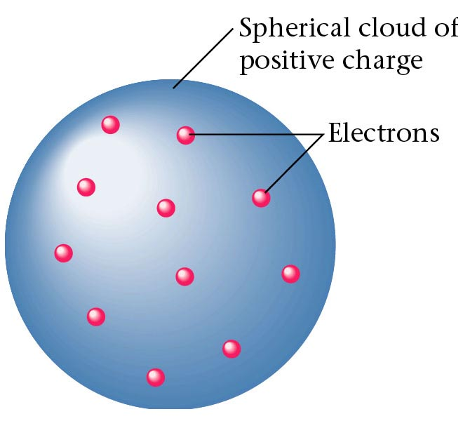
In 1910 proposed the Plum Pudding model
J.J. Thomson discovered the electron and knew that electrons could be emitted from matter (1897).
The electrons were like currants in a plum pudding.
This is called the ‘plum pudding’ model of the atom
Spherical cloud of
Positive charge
Electrons
Zumdahl, Zumdahl, DeCoste, World of Chemistry 2002, page 56
Notes:
Named after a dessert, the plum pudding model portrays the atom as a big ball of positive charge containing small particles with negative charge.

Slide 27
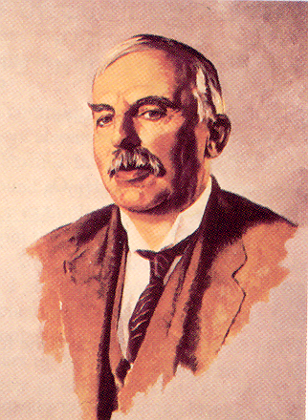
Ernest Rutherford (1871-1937)
Rutherford
PAPER
Learned physics in J.J. Thomson’ lab.
Noticed that ‘alpha’ particles were sometime deflected by something in the air.
Gold-foil experiment
Animation by Raymond Chang – All rights reserved.
Notes:
Ernest Rutherford received the Nobel Prize in chemistry (1908) for his work with radioactivity.
Ernest Rutherford (1871-1937) was born in Nelson, New Zealand in 1871. He began work in J.J. Thompson’s laboratory in 1895. He later moved to McGill University in Montreal
where he became one of the leading figures in the field of radioactivity. From 1907 on he was professor at the University of Manchester where he worked with Geiger and Marsden. He was awarded the Nobel Prize for Chemistry in 1908 for his work on radioactivity. In 1910, with co-workers Geiger and Marsden he discovered that alpha-particles could be deflected by thin metal foil. This work enabled him to propose a structure for the atom. Later on he proposed the existence of the proton and predicted the existence of the neutron. He died in 1937 and like J.J. Thompson is buried in Westminster Abbey. He was one of the most distinguished scientists of his century.
Is the Nucleus Fundamental?
Because it appeared small, solid, and dense, scientists originally thought that the nucleus was fundamental. Later, they discovered that it was made of protons (p+), which are positively charged, and neutrons (n), which have no charge.

Slide 28
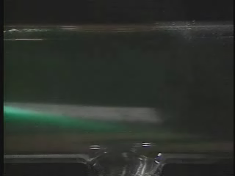
Rutherford ‘Scattering’
In 1909 Rutherford undertook a series of experiments
He fired α (alpha) particles at a very thin sample of gold foil
According to the Thomson model the α particles would only
be slightly deflected
Rutherford discovered that they were deflected through large angles and could even be reflected straight back to the source
Lead collimator
Gold foil
α
particle
source
θ
Notes:
Rutherford’s results strongly suggested that both the mass and positive charge are concentrated in a tiny fraction of the volume of the atom, called the nucleus.
Rutherford established that the nucleus of the hydrogen atom was a positively charged particle, which he called a proton.
Also suggested that the nuclei of elements other than hydrogen must contain electrically neutral particles with the same mass as the proton.
The neutron was discovered in 1932 by Rutherford’s student Chadwick.
Because of Rutherford’s work, it became clear that an α particle contains two protons and neutrons—the nucleus of a helium atom.

Slide 29

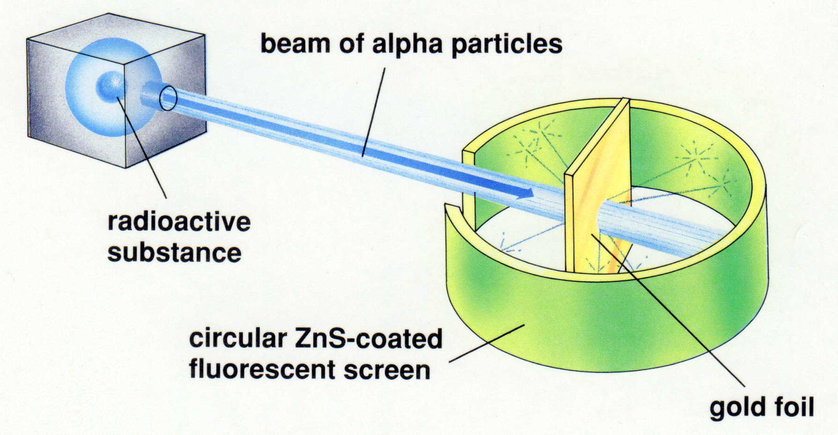

Rutherford’s Apparatus
Rutherford received the 1908 Nobel Prize in Chemistry for his pioneering work in nuclear chemistry.
beam of alpha particles
radioactive
substance
circular ZnS - coated
fluorescent screen
gold foil
Dorin, Demmin, Gabel, Chemistry The Study of Matter , 3rd Edition, 1990, page 120
Notes:
MODERN ALCHEMY
“Ernest Rutherford (1871-1937) was the first person to bombard atoms artificially to produce transmutated elements. The physicist from New Zealand described atoms as having a central nucleus with electrons revolving around it. He showed that radium atoms emitted “rays” and were transformed into radon atoms. Nuclear reactions like this can be regarded as transmutations – one element changing into another, the process alchemists sought in vain to achieve by chemical means.”
Eyewitness Science “Chemistry” , Dr. Ann Newmark, DK Publishing, Inc., 1993, pg 35
When Rutherford shot alpha particles at a thin piece of gold foil, he found that while most of them traveled straight through, some of them were deflected by huge angles.

Slide 30
What He Expected
The alpha particles to pass through without changing direction (very much)
Because
The positive charges were spread out evenly. Alone they were not enough to stop the alpha particles
California WEB

Slide 31
What he got…
richocheting
alpha particles

Slide 32
Density and the Atom
Since most of the particles went through, the atom was mostly empty.
Because the alpha rays were deflected so much, the positive pieces it was striking were heavy.
Small volume and big mass = big density
This small dense positive area is the nucleus
California WEB

Slide 33
Rutherford Scattering (cont.)
Rutherford interpreted this result by suggesting that the α particles interacted with very small and heavy particles
Case A
Particle bounces off
of atom?
Case B
Particle goes through
atom?
Case C
Particle attracts
to atom?
.
Particle path is altered
as it passes through atom?
Case D
Notes:
In the first case, one would assume the alpha particle (positively charged) struck another positively charged particle. Perhaps William Thomson (Lord Kelvin) was correct and the atom is like plum-pudding and is a positive ball with electrons embedded.
In the middle example, where the alpha particles pass straight through and are not deflected, it implies the atom is mostly empty space or the alpha particle is too penetrating to give any useful information about the composition of an atom.
The third example is NOT what is observed. For this to occur, the atom would have to be negatively charged and absorb all the positively charged alpha particles. At some point the atom would be “full” of alpha particles and then the atom would begin to bounce off of its surface alpha particles.
The last example also occurs. In the gold foil experiment, Rutherford observed case A and D (rarely) and mostly case B. This was explained by saying the atom was mostly empty space where electrons spin rapidly around a positively charged, massive (most of the mass of the atom) but tiny nucleus.

Slide 34
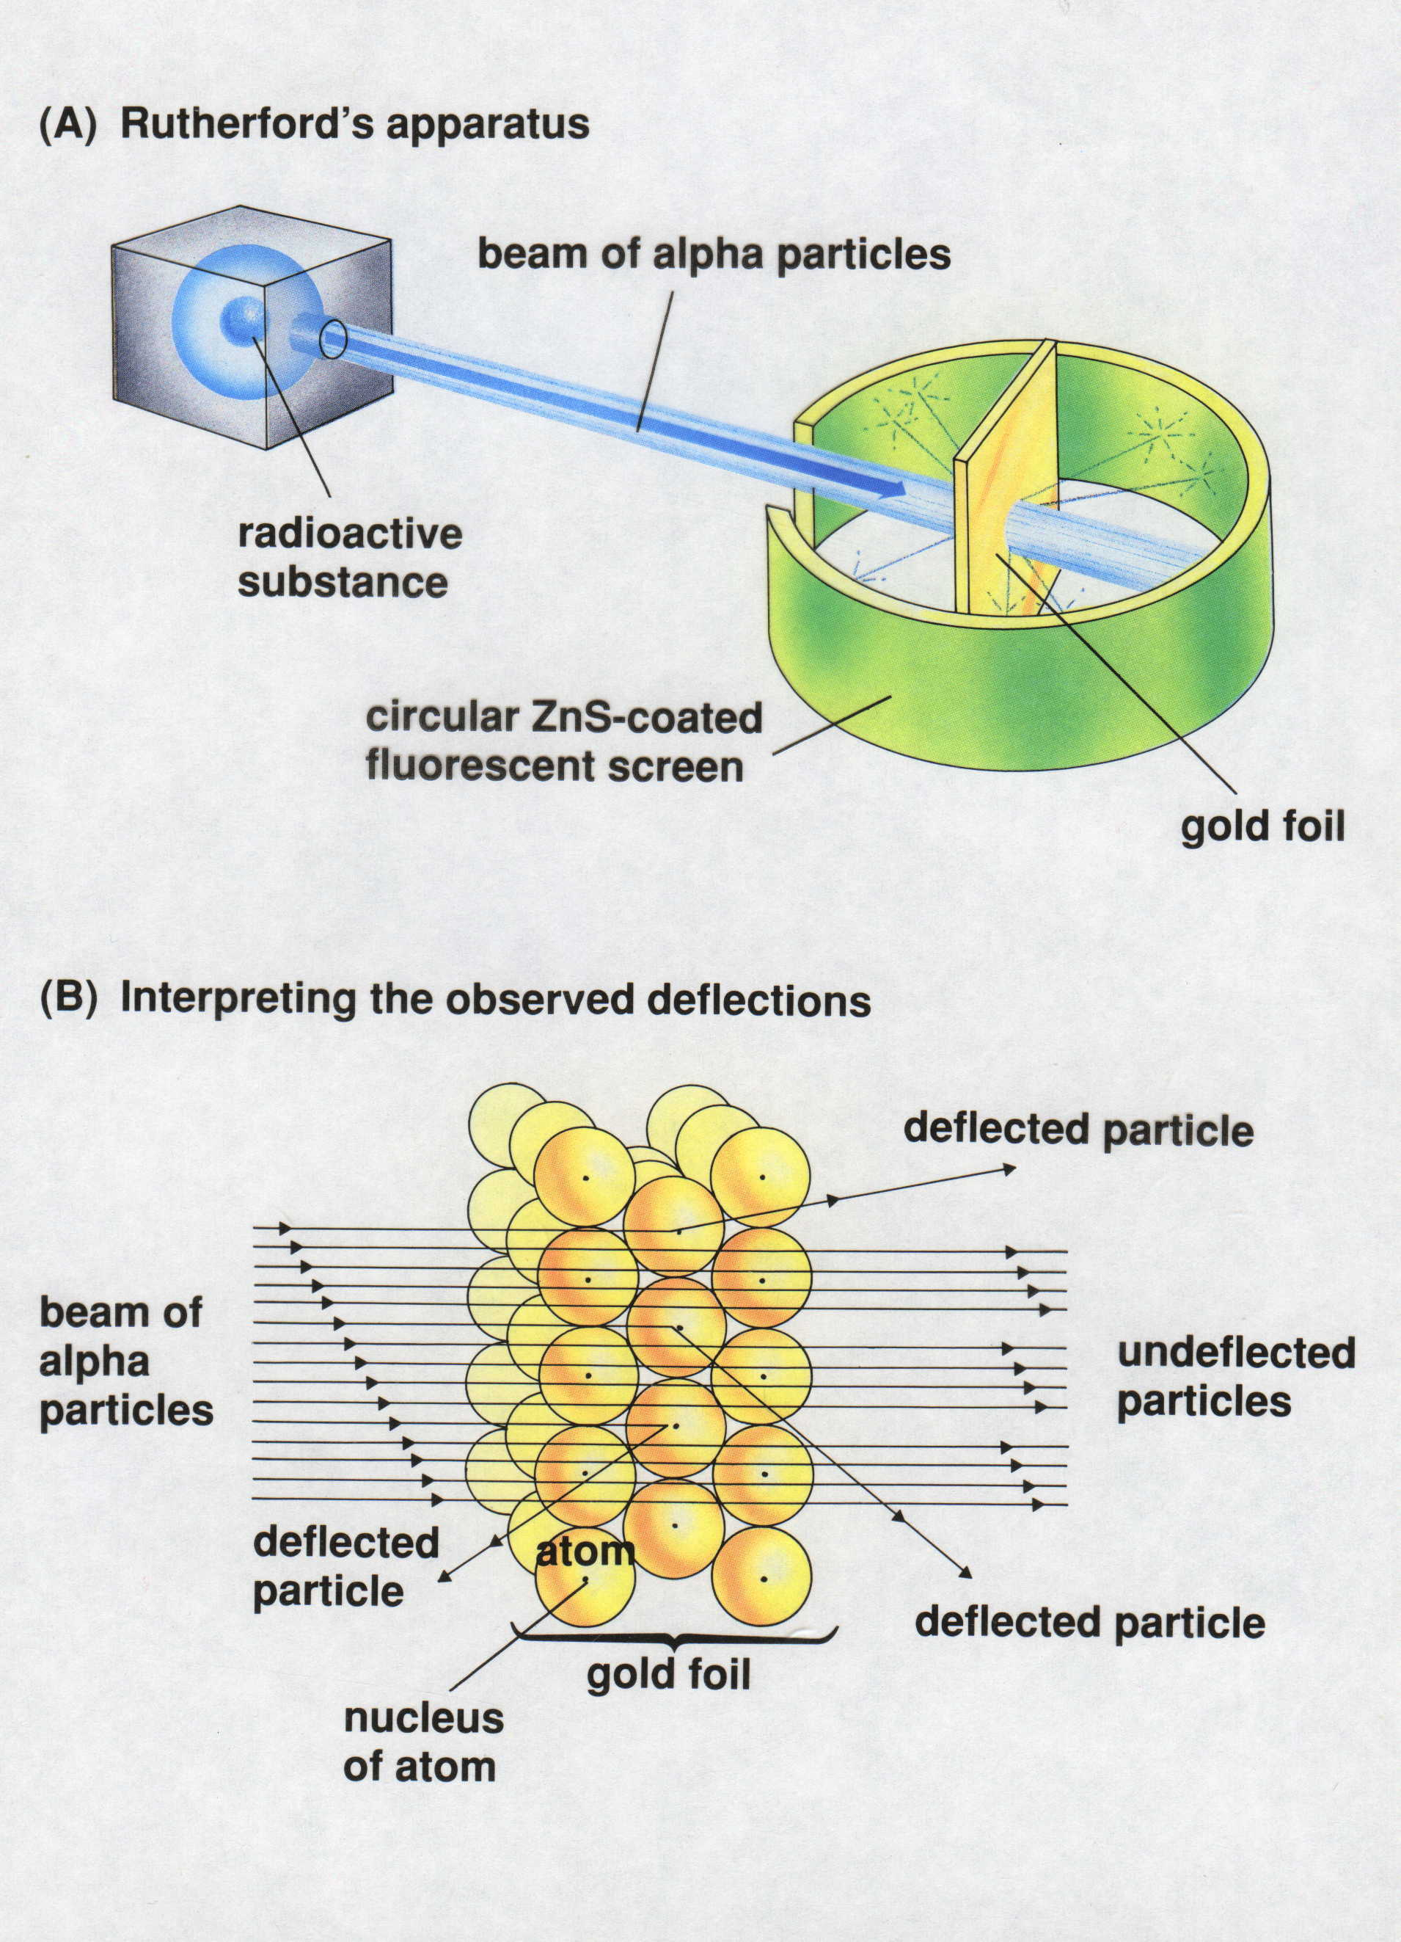
Rutherford’s
Gold-Leaf Experiment
Conclusions:
Atom is mostly empty space
Nucleus has (+) charge
Electrons float around nucleus
Dorin, Demmin, Gabel, Chemistry The Study of Matter , 3rd Edition, 1990, page 120
Notes:
“Rutherford’s Gold-Leaf Experiment”
Description
This slide illustrates Ernest Rutherford’s experiment with alpha particles and gold foil and his interpretation of the results.
Basic Concepts
When charged particles are directed at high speed toward a metal foil target, most pass through with little or no deflection, but some particles are deflected at large angles.
Solids are composed of atoms that are closely packed. The atoms themselves are mostly empty space.
All atoms contain a relatively small, massive, positively charged nucleus. The nucleus is surrounded by negatively charged electrons of low mass that occupy a relatively large volume.
Teaching Suggestions
Use this slide to describe and explain Rutherford’s experiment. Rutherford designed the apparatus shown in figure (A) to study the scattering of alpha particles by gold. Students may have difficult with the concepts in this experiment because they lack the necessary physics background. To help students understand how it was determined that the nucleus is relatively massive, use questions 3 and 4 to explain the concept of inertia.
Explain that the electrostatic force is directly proportional to the quantity of electric charge involved. A greater charge exerts a greater force. (Try comparing the electrostatic force to the foce of gravity, which is greater near a massive object like the sun, but smaller near an object of lesser mass, such as the moon.) The force exerted on an alpha particle by a concentrated nucleus would be much greater that the force exerted on an alpha particle by a single proton. Hence, larger deflections will result from a dense nucleus than from an atom with diffuse positive charges.
Point out that Rutherford used physics to calculate how small the nucleus would have to be produce the large-angle deflections observed. He calculated that the maximum possible size of the nucleus is about 1/10,000 the diameter of the atom. Rutherford concluded that the atom is mostly space.
Questions
If gold atoms were solid spheres stacked together with no space between them, what would you expect would happen to particles shot at them? Explain your reasoning.
When Ernest Rutherford performed the experiment shown in diagram (A) he observed that most of the alpha particles passed straight through the gold foil. He also noted that the gold foil did not appear to be affected. How can these two observations be explained?
Can you explain why Rutherford concluded that the mass of the f\gold nucleus must be much greater than the mass of an alpha particle? (Hint: Imagine one marble striking another marble at high speed. Compare this with a marble striking a bowling ball.)
Do you think that, in Rutherford’s experiment, the electrons in the gold atoms would deflect the alpha particles significantly? Why or why not? (Hint: The mass of an electron is extremely small.)
Rutherford experimented with many kinds of metal foil as the target. The results were always similar. Why was it important to do this?
A friend tries to convince you that gold atoms are solid because gold feels solid. Your friend also argues that, because the negatively charged electrons are attracted to the positively charged nucleus, the electrons should collapse into the nucleus. How would you respond?
As you know, like charges repel each other. Yet, Rutherford determined that the nucleus contains all of an atom’s positive charges. Invent a theory to explain how all the positive charges can be contained in such a small area without repelling each other. Be creative!

Slide 35
Millikan’s Oil Drop Experiment
Notes:
In 1897, Thomson demonstrated that cathode rays could be deflected, or bent, by magnetic or electric fields, which indicated that the cathode rays consisted of charged particles.
Measuring the extent of the deflection of the cathode rays, Thomson calculated the mass-to-charge ratio of the particles.
Since like charges repel each other and opposite charges attract, Thomson concluded that the particles had a net negative charge. These particles are called electrons.
Millikan calculated the charge on a single electron and determined the mass of an electron:
mass X charge = mass
charge

Slide 36
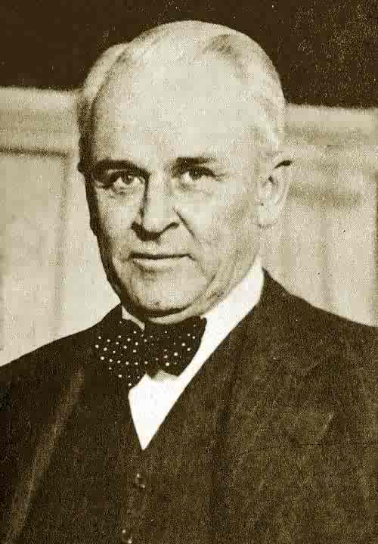
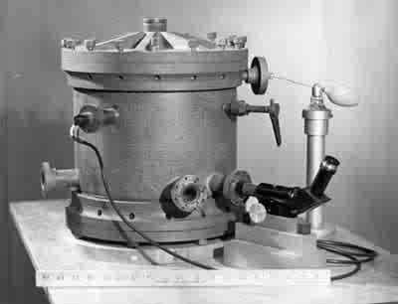
Actual Apparatus used by Millikan in his Oil Drop Experiment
Notes:
Millikan oil drop experiment.
A fine mist of oil droplets is introduced into the chamber. The gas molecules inside the chamber are ionized (split into electrons and positive ions) by a beam of x-rays (not represented). The electrons adhere to the oil droplets, some droplets having one electron, some two electrons, and so forth. These negatively charged oil droplets fall under the force of gravity into the region between the electrically charged plates. If you carefully adjust the voltage on the plates, the force of gravity can be exactly counterbalanced by the attractive force between the negative oil drop and upper, positively charged plate. Analysis of these forces leads to a value for the charge on thee electron.
Robert Andrews Millikan (1868 – 1953) won the Nobel physics prize in 1923 for his work in isolating and weighing the electron.

Slide 37
Evidence for Particles
Chadwick (1932) discovered particles with similar mass to proton
but zero charge.
- discovered neutrons

Slide 38
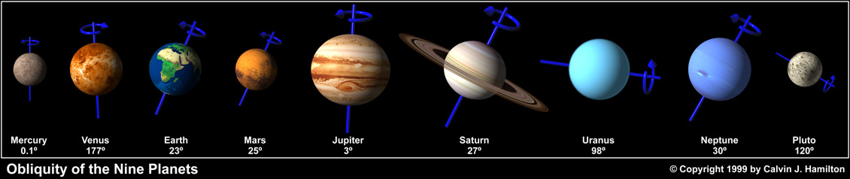
Bohr Atom
The Planetary Model of the Atom
Notes:
Objectives:
To describe the Bohr model of the atom.
To explain the relationship between energy levels in an atom and lines in an emission spectrum.

Slide 39
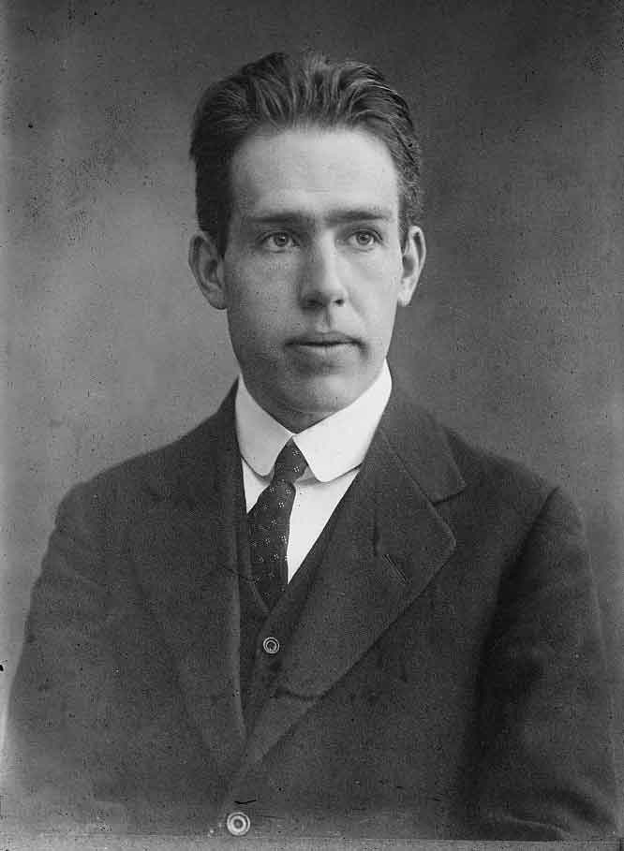
Niels Bohr

Slide 40
Bohr’s Model
Nucleus
Electron
Orbit
Energy Levels

Slide 41
Bohr Model of Atom
Increasing energy
of orbits
n = 3
e⁻
n = 2
e⁻
e⁻
e⁻
n = 1
e⁻
e⁻
e⁻
e⁻
e⁻
e⁻
e⁻
A photon is emitted
with energy E = hf
The Bohr model of the atom, like many ideas in
the history of science, was at first prompted by
and later partially disproved by experimentation.
http://en.wikipedia.org/wiki/Category:Chemistry
Notes:
In 1913, Niels Bohr proposed a theoretical model for the hydrogen atom that explained its emission spectrum.
– His model required only one assumption: The electron moves around the nucleus in circular orbits that can have only certain allowed radii.
– Bohr proposed that the electron could occupy only certain regions of space
– Bohr showed that the energy of an electron in a particular orbit is
E_{n} = – ℜhc
n²
where ℜ is the Rydberg constant, h is the Planck’s constant, c is the speed of light, and n is a positive integer corresponding to the number assigned to the orbit.
n = 1 corresponds to the orbit closest to the nucleus and is the lowest in energy.
A hydrogen atom in this orbit is called the ground state, the most stable arrangement for a hydrogen atom.
As n increases, the radii of the orbit increases and the energy of that orbit becomes less negative.
A hydrogen atom with an electron in an orbit with n >1 is in an excited state — energy is higher than the energy of the ground state.
Decay is when an atom in an excited state undergoes a transition to the ground state — loses energy by emitting a photon whose energy corresponds to the difference in energy between the two states.

Slide 42
Development of the Atom

Slide 43
An unsatisfactory model for the hydrogen atom
According to classical physics, light
should be emitted as the electron
circles the nucleus. A loss of energy
would cause the electron to be drawn
closer to the nucleus and eventually
spiral into it.
Hill, Petrucci, General Chemistry An Integrated Approach 2nd Edition, page 294

Slide 44
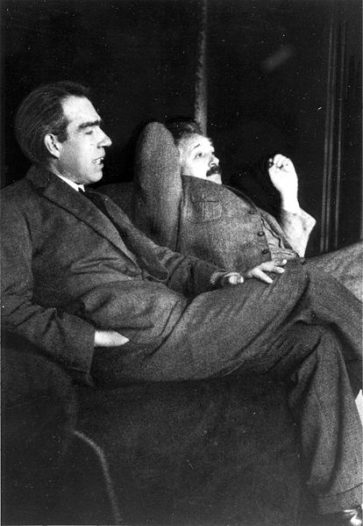
Quantum Mechanical Model
Niels Bohr &
Albert Einstein
Modern atomic theory describes the electronic structure of the atom as the probability of finding electrons within certain regions of space (orbitals).
Notes:
The development of quantum theory
Rutherford's planetary model of the atom in which electrons are considered as particles with defined co-ordinates has been a useful tool in explaining certain types of chemical phenomena in a qualitative sense. The idea, however, of a circulatory charge such as the electron is contrary to the classical laws of physics unless it continuously emits electromagnetic radiation (emr) - this of course does not happen.
Other experiments of the time such as those involving the interaction between radiation and matter also showed violation of classical laws of physics - examples include black body radiation, the photoelectric effect and atomic spectra.
The classical laws of physics regarded radiation to be continuous - any energy being possible. In order to satisfactorily explain black body radiation Max Plank (1900) suggested that radiant energy is quantized and can only be emitted in discrete amounts called quanta. A quantum of radiation is a photon. The following equation was postulated;
E = h v
Where E is one quantum of energy, v is the frequency of absorbed or emitted radiation and h is Planck's constant (6.624 x 10⁻³⁴ Js)
This equation is the fundamental equation of quantum theory.
Mathematical interpretations of particles based on quantum theory are called quantum mechanics.
It follows that the energy content of a system is not continuously variable, but can be visualized in terms of energy levels. Energy absorbed or emitted involves the transition of a component of the system between energy levels. Absorbed radiation involves a transition to a higher (not necessarily adjacent) energy level whilst emission involves a transition to a lower energy level. The spacing between these energy levels determines the frequency of the absorbed or emitted radiation.
We can imagine the various energy levels as steps in a staircase, a person can move between steps either one at a time or more if they are daring enough to jump. But one cannot stand at a point between steps.

Slide 45
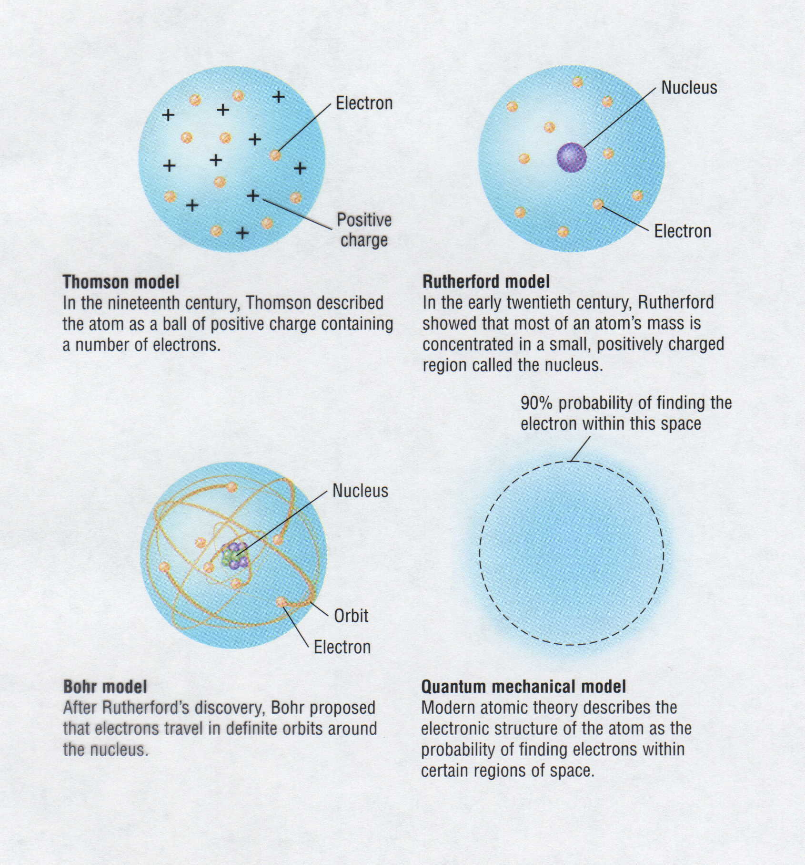
Development of Atomic Models
Thomson model
In the nineteenth century, Thomson described
the atom as a ball of positive charge containing
a number of electrons.
Rutherford model
In the early twentieth century, Rutherford
showed that most of an atom's mass is
concentrated in a small, positively charged
region called the nucleus.
Bohr model
After Rutherford's discovery, Bohr proposed
that electrons travel in definite orbits around
the nucleus.
Quantum mechanical model
Modern atomic theory described the
electronic structure of the atom as the
probability of finding electrons within
certain regions of space.

Slide 46
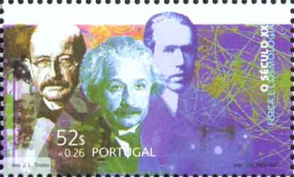
Modern View
The atom is mostly empty space
Two regions
  Nucleus
    protons and neutrons
  Electron cloud
    region where you might find an electron

Slide 47
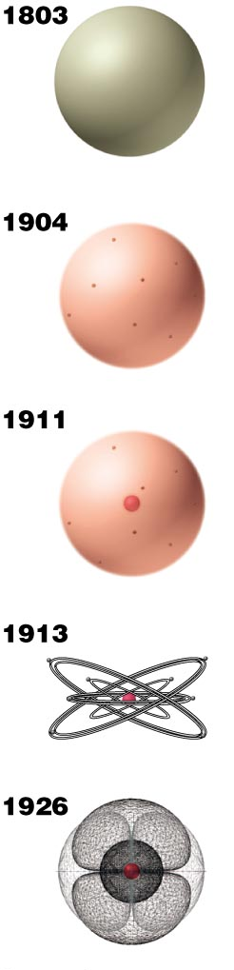
Review
Models of the
Atom
Dalton proposes the
indivisible unit of an
element is the atom.
Thomson discovers
electrons, believed to
reside within a sphere of
uniform positive charge
(the “plum-pudding model).
Rutherford demonstrates
the existence of a positively
charged nucleus that
contains nearly all the
mass of an atom.
Bohr proposes fixed
circular orbits around
the nucleus for electrons.
In the current model of the atom,
electrons occupy regions of space
(orbitals) around the nucleus
determined by their energies.
Copyright © 2007 Pearson Benjamin Cummings. All rights reserved.
Notes:
Atomic Theory I
The Early Days
by Anthony Carpi, Ph.D. http://www.visionlearning.com/library/modulo_espanol.php?c3=&mid=50&ut=&l=e
Until the final years of the nineteenth century, the accepted model of the atom resembled that of a billiard ball - a small, solid sphere. In 1897, J. J. Thomson dramatically changed the modern view of the atom with his discovery of the electron. Thomson's work suggested that the atom was not an "indivisible" particle as John Dalton had suggested but, a jigsaw puzzle made of smaller pieces. Thomson's notion of the electron came from his work with a nineteenth century scientific curiosity: the cathode ray tube. For years scientists had known that if an electric current was passed through a vacuum tube, a stream of glowing material could be seen; however, no one could explain why. Thomson found that the mysterious glowing stream would bend toward a positively charged electric plate. Thomson theorized, and was later proven correct, that the stream was in fact made up of small particles, pieces of atoms that carried a negative charge. These particles were later named electrons. After Eugene Goldstein’s 1886 discovery that atoms had positive charges, Thomson imagined that atoms looked like pieces of raisin bread, a structure in which clumps of small, negatively charged electrons (the "raisins") were scattered inside a smear of positive charges. In 1908, Ernest Rutherford, a former student of Thomson's, proved Thomson's raisin bread structure incorrect. Rutherford performed a series of experiments with radioactive alpha particles. While it was unclear at the time what the alpha particle was, it was known to be very tiny. Rutherford fired tiny alpha particles at solid objects such as gold foil. He found that while most of the alpha particles passed right through the gold foil, a small number of alpha particles passed through at an angle (as if they had bumped up against something) and some bounced straight back like a tennis ball hitting a wall. Rutherford's experiments suggested that gold foil, and matter in general, had holes in it! These holes allowed most of the alpha particles to pass directly through, while a small number ricocheted off or bounced straight back because they hit a solid object. In 1911, Rutherford proposed a revolutionary view of the atom. He suggested that the atom consisted of a small, dense core of positively charged particles in the center (or nucleus) of the atom, surrounded by a swirling ring of electrons. The nucleus was so dense that the alpha particles would bounce off of it, but the electrons were so tiny, and spread out at such great distances, that the alpha particles would pass right through this area of the atom. Rutherford's atom resembled a tiny solar system with the positively charged nucleus always at the center and the electrons revolving around the nucleus.
Interpreting Rutherford's Gold Foil Experiment
The positively charged particles in the nucleus of the atom were called protons. Protons carry an equal, but opposite, charge to electrons, but protons are much larger and heavier than electrons.
In 1932, James Chadwick discovered a third type of subatomic particle, which he named the neutron. Neutrons help stabilize the protons in the atom's nucleus. Because the nucleus is so tightly packed together, the positively charged protons would tend to repel each other normally. Neutrons help to reduce the repulsion between protons and stabilize the atom's nucleus. Neutrons always reside in the nucleus of atoms and they are about the same size as protons. However, neutrons do not have any electrical charge; they are electrically neutral.
Atoms are electrically neutral because the number of protons (+ charges) is equal to the number of electrons (- charges) and thus the two cancel out. As the atom gets larger, the number of protons increases, and so does the number of electrons (in the neutral state of the atom).
Atoms are extremely small. One hydrogen atom (the smallest atom known) is approximately 5 x 10⁻⁸ mm in diameter. To put that in perspective, it would take almost 20 million hydrogen atoms to make a line as long as this dash -. Most of the space taken up by an atom is actually empty because the electron spins at a very far distance from the nucleus. For example, if we were to draw a hydrogen atom to scale and used a 1-cm proton, the atom's electron would spin at a distance of ~0.5 km from the nucleus. In other words, the atom would be larger than a football field!
Atoms of different elements are distinguished from each other by their number of protons (the number of protons is constant for all atoms of a single element; the number of neutrons and electrons can vary under some circumstances). To identify this important characteristic of atoms, the term atomic number (Z) is used to describe the number of protons in an atom. For example, Z = 1 for hydrogen and Z = 2 for helium.
Another important characteristic of an atom is its weight, or atomic mass. The weight of an atom is roughly determined by the total number of protons and neutrons in the atom. While protons and neutrons are about the same size, the electron is more that 1,800 times smaller than the two. Thus the electrons' weight is inconsequential in determining the weight of an atom - it's like comparing the weight of a flea to the weight of an elephant. Refer to the animation above to see how the number of protons plus neutrons in the hydrogen and helium atoms corresponds to the atomic mass.

Slide 48
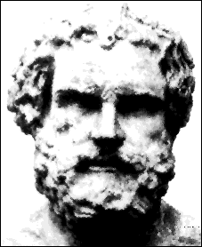
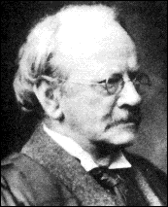
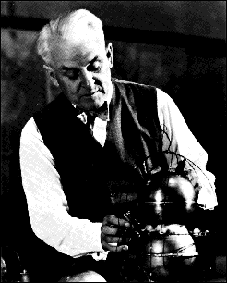
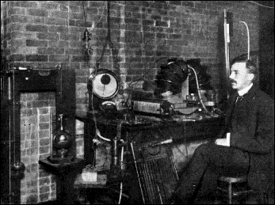
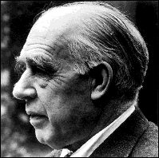
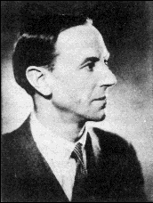
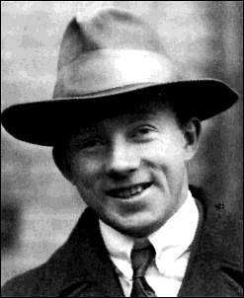

Link One - The original paper in which J.J. Thomson announces his discovery of the
electron to the world.
Link Two - Thomson on the number of corpuscles (electrons) in an atom.
Link Three - Thomson on the structure of the atom.
Link Four excerpts from Thomson's Nobel prize address
Democritus
c460-371 BC
J.J. Thomson
1856-1940
Link One - Geiger's paper on the gold foil
Link Two - Rutherford describing the gold foil experiment
Link Three - Rutherford's paper on the structure of the atom
Lord Ernest Rutherford
1871-1937
Robert Millikan
1868-1953
Link One - Bohr's address on the spectrum of hydrogen
Link Two - An article on atomic structure written by Niels Bohr
James Chadwick
1891-1974
Niels Bohr
1913-1963
Link One - A letter on the possible existence of the neutron
Link Two - Chadwick's paper on the discovery of the neutron
Werner Heisenberg
http://www.fordhamprep.org/gcurran/sho/sho/lessons/lesson32.htm
Notes:
Development of the Atomic Model
To borrow an example from Albert Einstein, imagine if you had never seen a clock or a watch before, and someone gave you an intricate Swiss timepiece. Imagine studying the motion of the hands, but never being allowed to remove the watch face and see the mechanisms which produced the synchronized movements. If you thought about it long enough, you might be able to come up with a model to explain the motion of the hands, but you could never be sure that your model was an accurate depiction of what was going behind the face of the watch. In fact, if someone was to come along with a better explanation for the motion of the hands, you would be forced to update your model.
Our atomic model has much in common with the imaginary watch from the above example. We can't base our model on actual observations of atoms, because they are too small to be seen with our most sensitive instruments. Instead, we must come up with a model of an atom that can account for and explain observations that we can actually see. As new observations are made, we are forced to update our model to accommodate them. As a result, our model of the atom has evolved over time, and we must accept the fact that it is likely to change again in the future.
The story so far . . .
Democritus may not have been the first of the ancient Greeks to suggest an atomic theory, this distinction goes to his teacher Leucippus, but his name is often associated with the first atomic theory, because of his support of it. To Democritus, atoms were completely solid, homogeneous, indestructible objects.
Joseph John Thomson subjected cathode rays to magnetic and electric fields and showed that the beam was deflected as would be expected for negatively charged particles. He calculated the ratio of the electron's charge to its mass. On April 30, 1897, Thomson announced that the cathode rays consisted of negatively charged particles, which represented fundamental particles of matter. He was not the first person to suggest that these particles existed, nor did he coin the term "electron", yet he is generally credited with the discovery of the electron. He was awarded with the Nobel Prize in Physics in 1906. J.J. Thomson is also remembered for his "plum-pudding" model of the atom, which suggested a solid atom with positively and negatively charged particles evenly distributed throughout the mass of the atom.
Ernest Rutherford, who was once a student of Thomson's, is credited with discovering that most of the atom is made up of "empty space." In 1909 he and his assistants conducted the "gold foil" experiment, from which he concluded that "the greater part of the mass of the atom was concentrated in a minute nucleus." In this model, the positively charged nucleus was surrounded by a great deal of "empty space" through which the electrons moved.
In 1909, Robert Millikan conducted his "oil-drop" experiment which allowed him to measure the charge on an electron. Combining his results with those of Thomson, Millikan found the mass of the electron to be 9.11x10-28 g. He was awarded with the Nobel Prize in physics in 1923.
In 1913, Niels Bohr proposed improvement to Rutherford atomic model. For this reason, the planetary model of the atom is sometimes called the Rutherford-Bohr model. Bohr added the idea of fixed orbits, or energy levels for the electron traveling around the nucleus. This model allowed for the idea that electrons can become "excited" and move to higher energy levels for brief periods of time.
Lord Rutherford predicted the existence of the neutron is 1920. Walter Bothe obtained evidence of the neutron in 1930. However it was James Chadwick, who repeated Bothe's work, who is known as the discoverer of the neutron. He found these uncharged particles with essentially the same mass as the proton. He was awarded the Nobel Prize in physics in 1935.
Although there is something attractive about the idea of an atom being very much like a tiny solar system, the planetary model of the atom was found to be inadequate. Planck's quantum theory had illustrated the "particle-like" properties of waves. Louis de Broglie suggested that particles might have properties of waves. The result of this investigation is sometimes called the wave-particle duality of nature. This duality, which states that particles act like waves and waves like particles, applies to all waves and all particles. However, the more massive the particles, the less obvious the wave properties. Electrons, having very little mass, exhibit significant wave-like properties.
Heisenberg pointed out that it is impossible to know both the exact position and the exact momentum of an object at the same time. Applying this concept to the electron we realize that in order to get a fix on an electron's position at any time, we would alter its momentum. Any attempt to study the velocity of an electron will alter its position. This concept, called the Heisenberg Uncertainty principle, effectively destroys the idea of electrons traveling around in neat orbits. Any electron that is subjected to photons will have its momentum and position affected.
Experiments conducted in the 1920's, 1930's and 1940's continued to point out problems with the planetary model of the atom. These experiments, which will be discussed in next chapter, lead to the development of the charge-cloud model. The charge-cloud model, which is also called the quantum-mechanical model, does not attempt to describe the path of each electron in a fixed orbit. Scientists now describe the possible positions of electrons in terms of probability. Computers can calculate the points in space that an electron has the highest probability of occupying. These points can be connected to form a three-dimensional shape. Electrons are characterized in terms of the three-dimensional shapes that their probability fields define. The sum total of the various paths of electrons, traveling at very high speeds, is described as the electron cloud.

Slide 49
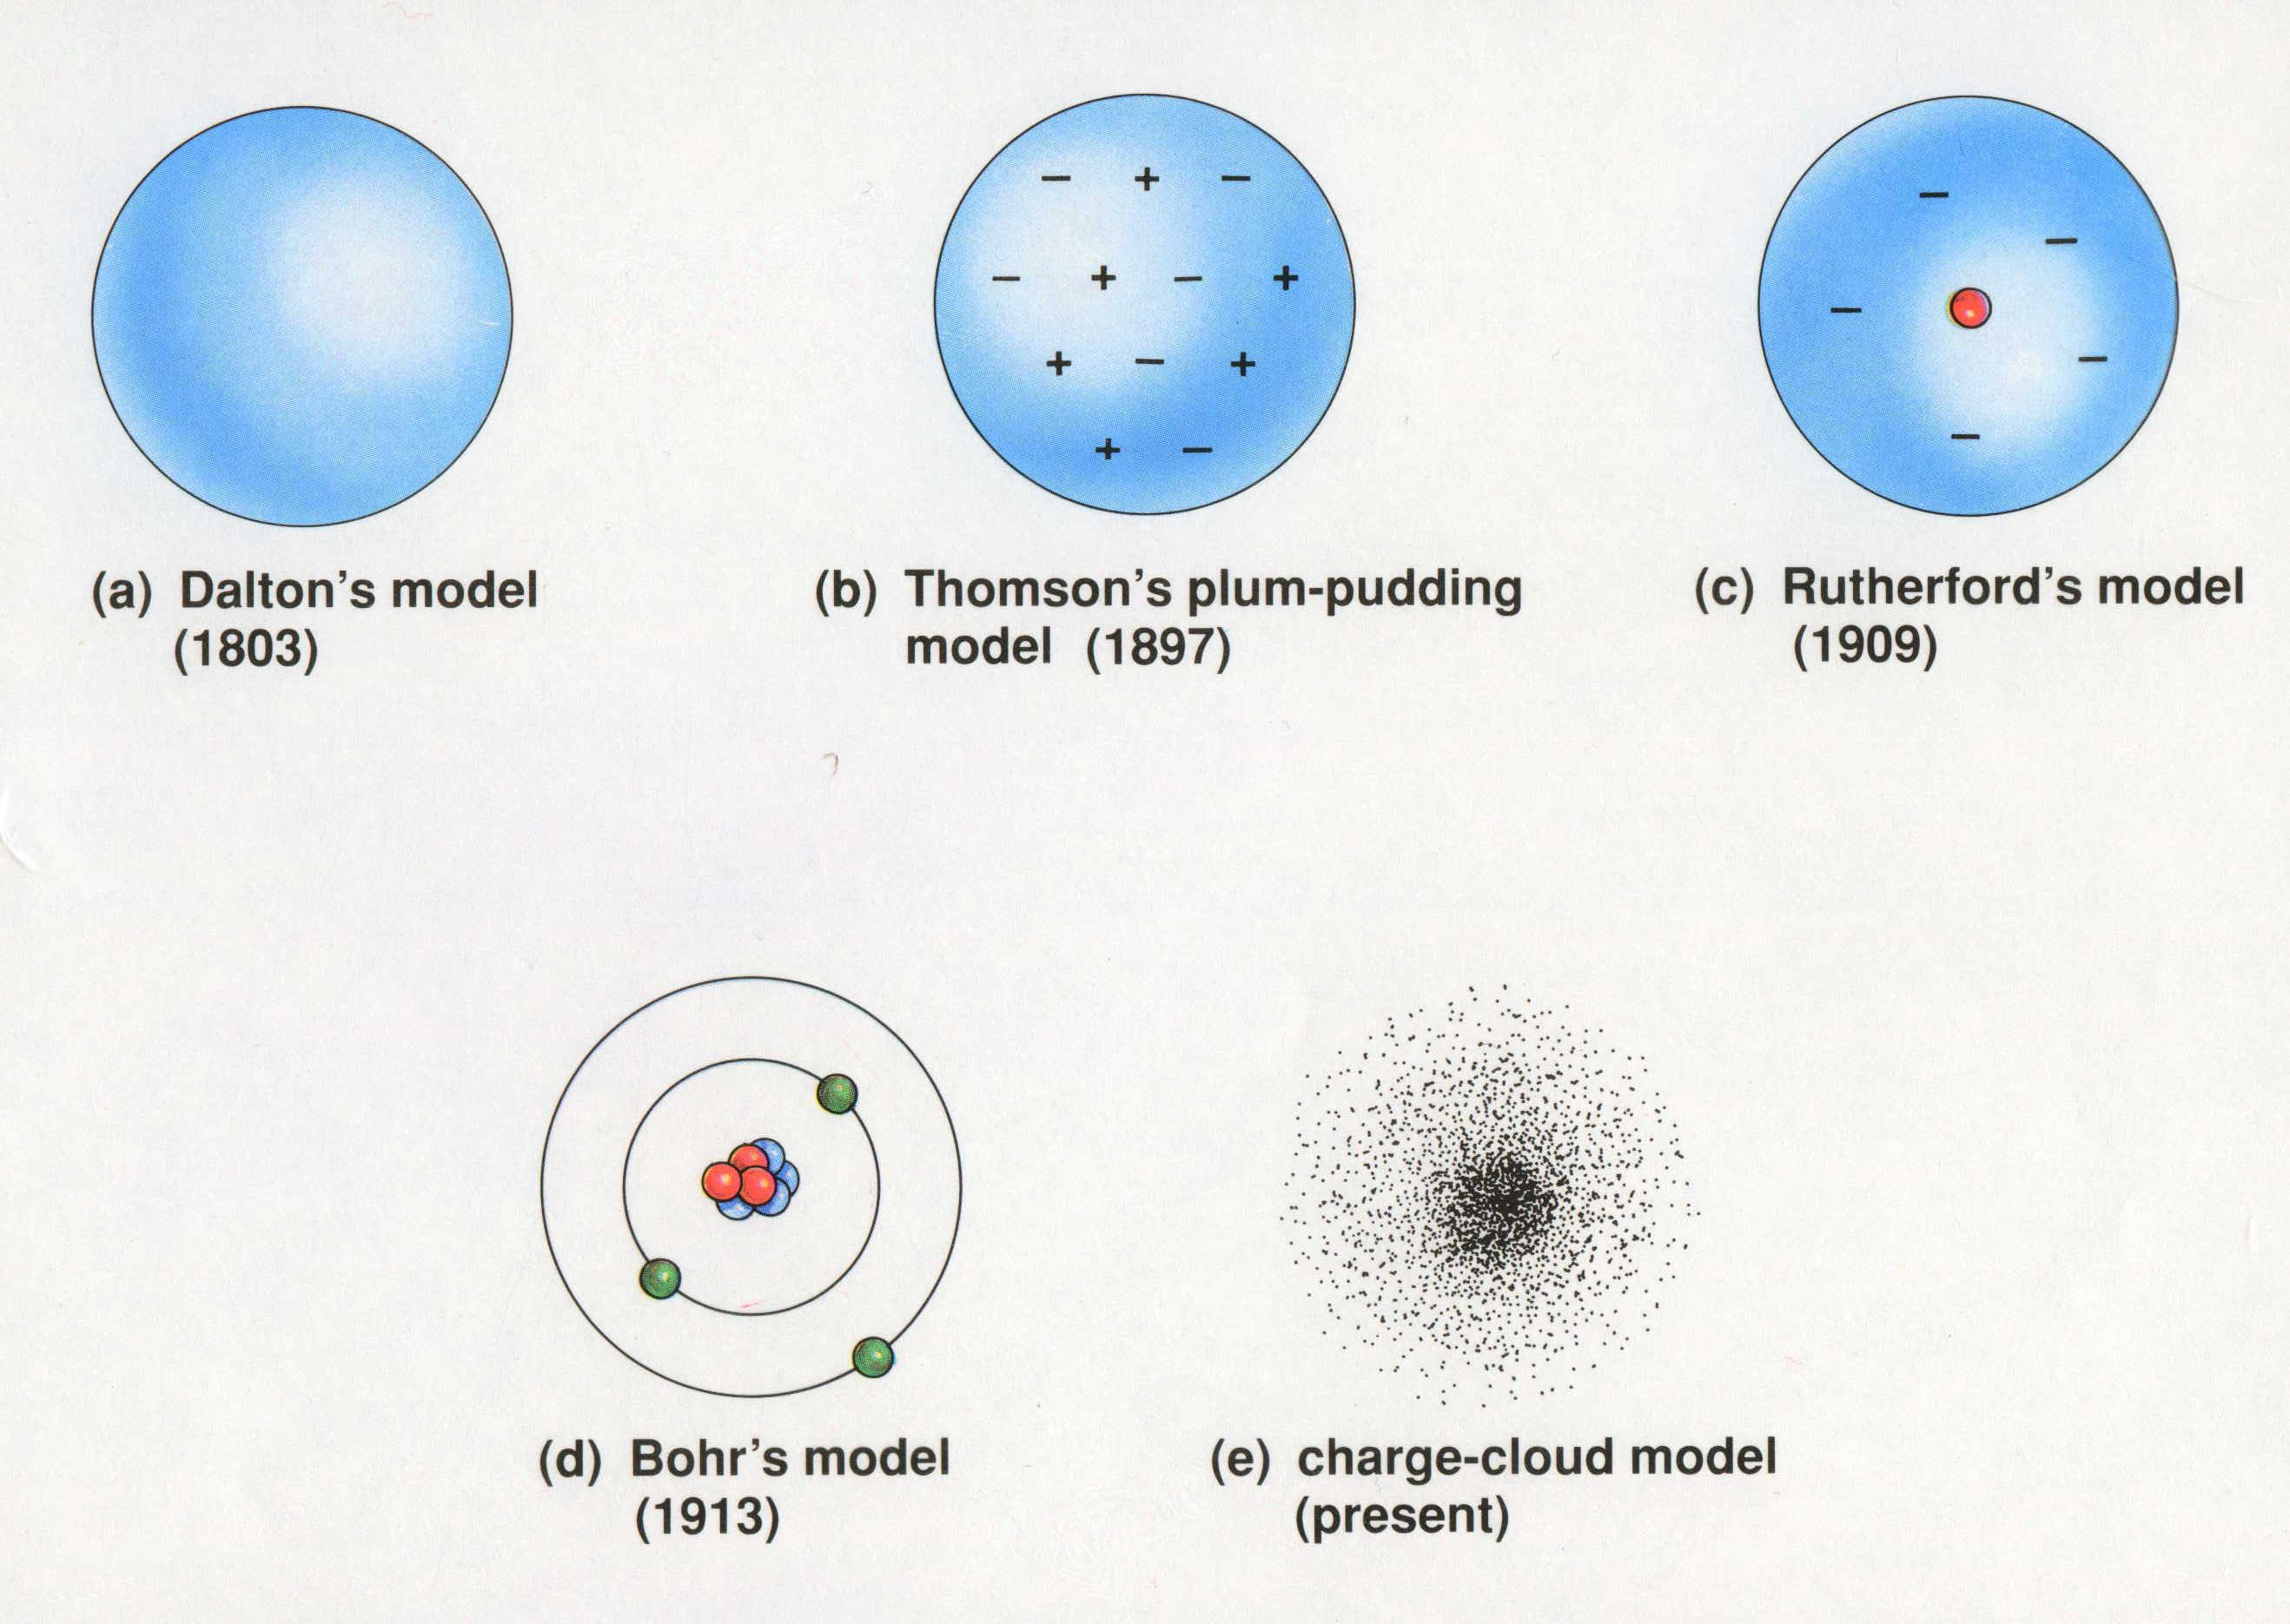
Models of the Atom
"In science, a wrong theory can be valuable and better than no theory at all."
- Sir William L. Bragg
+
e
-
e
e
+
e
-
+
+
-
+
+
e
+
-
e
e
e
-
+
e
+
e
Greek model
(400 B.C.)
Dalton’s model
(1803)
Thomson’s plum-pudding
model (1897)
Rutherford’s model
(1909)
Bohr’s model
(1913)
Charge-cloud model
(present)
Dorin, Demmin, Gabel, Chemistry The Study of Matter , 3rd Edition, 1990, page 125
Notes:
“Models of the Atom”
Description: This slide shows he evolution of the concept of the atom from John Dalton to the present.
Basic Concepts
• The model of the atom changed over time as more and more evidence about its structure became available.
• A scientific model differs from a replica (physical model) because it represents a phenomenon that cannot be observed directly.
Teaching Suggestions
Use this slide as a review of the experiments that led up to the present-day view of the atom. Ask students to describe the characteristics of each atomic model and the discoveries that led to its modification. Make sure that students understand that the present-day model shows the most probable location of an electron at a single instant.
Point out that most scientific models and theories go through an evolution similar to that of the atomic model. Modifications often must be made to account for new observations. Discuss why scientific models, such as the atomic models shown here, are useful in helping scientists interpret heir observations.
Questions
Describe the discovery that led scientists to question John Dalton’s model of the atom ad to favor J.J. Thomson’s model.
What experimental findings are the basis for the 1909 model of the atom?
What shortcomings in the atomic model of Ernest Rutherford led to the development of Niels Bohr’s model?
A friend tells you that an electron travels around an atom’s nucleus in much the same way that a planet revolves around the sun. Is this a good model for the present-day view of the atom? Why or why not?
Another friend tells you that the present-day view of an electron’s location in the atom can be likened to a well-used archery target. The target has many holes close to the bull’s-eye and fewer holes farther from the center. The probability that the next arrow will land at a certain distance from the center corresponds to the number of holes at that distance. Is this a good model for the present-day view of the atom? Why or why not?
Suppose that, it the future, an apparatus were developed that could track and record the path of an electron in an atom without disturbing its movement. How might this affect the present-day model of the atom? Explain your answer.
How does developing a model of an atom differ from making a model of an airplane? How are these two kinds of models the same?
Drawing on what you know in various fields of science, write a general statement about the usefulness of scientific models.
Bragg and his father, Sir W.H. Bragg, shared the 1915 Nobel prize in physics for studies of crystals with X-rays.

Slide 50
Models of the Atom
+
e
-
e
e
+
e
-
+
+
-
+
+
e
+
-
e
e
e
-
+
e
+
e
Dalton’s model
(1803)
Greek model
(400 B.C.)
Thomson’s plum-pudding
model (1897)
Rutherford’s model
(1909)
Bohr’s model
(1913)
Charge-cloud model
(present)
1803 John Dalton
pictures atoms as
tiny, indestructible
particles, with no
internal structure.
1897 J.J. Thomson, a British
scientist, discovers the electron,
leading to his "plum-pudding"
model. He pictures electrons
embedded in a sphere of
positive electric charge.
1911 New Zealander
Ernest Rutherford states
that an atom has a dense,
positively charged nucleus.
Electrons move randomly in
the space around the nucleus.
1913 In Niels Bohr's
model, the electrons move
in spherical orbits at fixed
distances from the nucleus.
1926 Erwin Schrödinger
develops mathematical
equations to describe the
motion of electrons in
atoms. His work leads to
the electron cloud model.
1800 1805 ..................... 1895 1900 1905 1910 1915 1920 1925 1930 1935 1940 1945
1904 Hantaro Nagaoka, a
Japanese physicist, suggests
that an atom has a central
nucleus. Electrons move in
orbits like the rings around Saturn.
1924 Frenchman Louis
de Broglie proposes that
moving particles like electrons
have some properties of waves.
Within a few years evidence is
collected to support his idea.
1932 James
Chadwick, a British
physicist, confirms the
existence of neutrons,
which have no charge.
Atomic nuclei contain
neutrons and positively
charged protons.
Dorin, Demmin, Gabel, Chemistry The Study of Matter , 3rd Edition, 1990, page 125
Notes:
“Models of the Atom”
Description: This slide shows he evolution of the concept of the atom from John Dalton to the present.
Basic Concepts
• The model of the atom changed over time as more and more evidence about its structure became available.
• A scientific model differs from a replica (physical model) because it represents a phenomenon that cannot be observed directly.
Teaching Suggestions
Use this slide as a review of the experiments that led up to the present-day view of the atom. Ask students to describe the characteristics of each atomic model and the discoveries that led to its modification. Make sure that students understand that the present-day model shows the most probable location of an electron at a single instant.
Point out that most scientific models and theories go through an evolution similar to that of the atomic model. Modifications often must be made to account for new observations. Discuss why scientific models, such as the atomic models shown here, are useful in helping scientists interpret heir observations.
Questions
Describe the discovery that led scientists to question John Dalton’s model of the atom ad to favor J.J. Thomson’s model.
What experimental findings are the basis for the 1909 model of the atom?
What shortcomings in the atomic model of Ernest Rutherford led to the development of Niels Bohr’s model?
A friend tells you that an electron travels around an atom’s nucleus in much the same way that a planet revolves around the sun. Is this a good model for the present-day view of the atom? Why or why not?
Another friend tells you that the present-day view of an electron’s location in the atom can be likened to a well-used archery target. The target has many holes close to the bull’s-eye and fewer holes farther from the center. The probability that the next arrow will land at a certain distance from the center corresponds to the number of holes at that distance. Is this a good model for the present-day view of the atom? Why or why not?
Suppose that, it the future, an apparatus were developed that could track and record the path of an electron in an atom without disturbing its movement. How might this affect the present-day model of the atom? Explain your answer.
How does developing a model of an atom differ from making a model of an airplane? How are these two kinds of models the same?
Drawing on what you know in various fields of science, write a general statement about the usefulness of scientific models.
Timeline: Wysession, Frank, Yancopoulos Physical Science Concepts in Action, Prentice Hall/Pearson, 2004 pg 114

Slide 51
Models of the Atom
Greek model
(400 B.C.)
Dalton’s model
(1803)
Thomson’s plum-pudding
model (1897)
Rutherford’s model
(1909)
Bohr’s model
(1913)
Charge-cloud model
(present)
Dorin, Demmin, Gabel, Chemistry The Study of Matter , 3rd Edition, 1990, page 125
Notes:
“Models of the Atom”
Description: This slide shows he evolution of the concept of the atom from John Dalton to the present.
Basic Concepts
• The model of the atom changed over time as more and more evidence about its structure became available.
• A scientific model differs from a replica (physical model) because it represents a phenomenon that cannot be observed directly.
Teaching Suggestions
Use this slide as a review of the experiments that led up to the present-day view of the atom. Ask students to describe the characteristics of each atomic model and the discoveries that led to its modification. Make sure that students understand that the present-day model shows the most probable location of an electron at a single instant.
Point out that most scientific models and theories go through an evolution similar to that of the atomic model. Modifications often must be made to account for new observations. Discuss why scientific models, such as the atomic models shown here, are useful in helping scientists interpret heir observations.
Questions
Describe the discovery that led scientists to question John Dalton’s model of the atom ad to favor J.J. Thomson’s model.
What experimental findings are the basis for the 1909 model of the atom?
What shortcomings in the atomic model of Ernest Rutherford led to the development of Niels Bohr’s model?
A friend tells you that an electron travels around an atom’s nucleus in much the same way that a planet revolves around the sun. Is this a good model for the present-day view of the atom? Why or why not?
Another friend tells you that the present-day view of an electron’s location in the atom can be likened to a well-used archery target. The target has many holes close to the bull’s-eye and fewer holes farther from the center. The probability that the next arrow will land at a certain distance from the center corresponds to the number of holes at that distance. Is this a good model for the present-day view of the atom? Why or why not?
Suppose that, it the future, an apparatus were developed that could track and record the path of an electron in an atom without disturbing its movement. How might this affect the present-day model of the atom? Explain your answer.
How does developing a model of an atom differ from making a model of an airplane? How are these two kinds of models the same?
Drawing on what you know in various fields of science, write a general statement about the usefulness of scientific models.

Slide 52
Models of the Atom
Dalton’s model
(1803)
Greek model
(400 B.C.)
Thomson’s plum-pudding
model (1897)
Rutherford’s model
(1909)
Bohr’s model
(1913)
Charge-cloud model
(present)
1803 John Dalton
pictures atoms as
tiny, indestructible
particles, with no
internal structure.
1897 J.J. Thomson, a British
scientist, discovers the electron,
leading to his "plum-pudding"
model. He pictures electrons
embedded in a sphere of
positive electric charge.
1911 New Zealander
Ernest Rutherford states
that an atom has a dense,
positively charged nucleus.
Electrons move randomly in
the space around the nucleus.
1913 In Niels Bohr's
model, the electrons move
in spherical orbits at fixed
distances from the nucleus.
1926 Erwin Schrödinger
develops mathematical
equations to describe the
motion of electrons in
atoms. His work leads to
the electron cloud model.
1800 1805 ..................... 1895 1900 1905 1910 1915 1920 1925 1930 1935 1940 1945
1904 Hantaro Nagaoka, a
Japanese physicist, suggests
that an atom has a central
nucleus. Electrons move in
orbits like the rings around Saturn.
1924 Frenchman Louis
de Broglie proposes that
moving particles like electrons
have some properties of waves.
Within a few years evidence is
collected to support his idea.
1932 James
Chadwick, a British
physicist, confirms the
existence of neutrons,
which have no charge.
Atomic nuclei contain
neutrons and positively
charged protons.
Dorin, Demmin, Gabel, Chemistry The Study of Matter , 3rd Edition, 1990, page 125
Notes:
“Models of the Atom”
Description: This slide shows he evolution of the concept of the atom from John Dalton to the present.
Basic Concepts
• The model of the atom changed over time as more and more evidence about its structure became available.
• A scientific model differs from a replica (physical model) because it represents a phenomenon that cannot be observed directly.
Teaching Suggestions
Use this slide as a review of the experiments that led up to the present-day view of the atom. Ask students to describe the characteristics of each atomic model and the discoveries that led to its modification. Make sure that students understand that the present-day model shows the most probable location of an electron at a single instant.
Point out that most scientific models and theories go through an evolution similar to that of the atomic model. Modifications often must be made to account for new observations. Discuss why scientific models, such as the atomic models shown here, are useful in helping scientists interpret heir observations.
Questions
Describe the discovery that led scientists to question John Dalton’s model of the atom ad to favor J.J. Thomson’s model.
What experimental findings are the basis for the 1909 model of the atom?
What shortcomings in the atomic model of Ernest Rutherford led to the development of Niels Bohr’s model?
A friend tells you that an electron travels around an atom’s nucleus in much the same way that a planet revolves around the sun. Is this a good model for the present-day view of the atom? Why or why not?
Another friend tells you that the present-day view of an electron’s location in the atom can be likened to a well-used archery target. The target has many holes close to the bull’s-eye and fewer holes farther from the center. The probability that the next arrow will land at a certain distance from the center corresponds to the number of holes at that distance. Is this a good model for the present-day view of the atom? Why or why not?
Suppose that, it the future, an apparatus were developed that could track and record the path of an electron in an atom without disturbing its movement. How might this affect the present-day model of the atom? Explain your answer.
How does developing a model of an atom differ from making a model of an airplane? How are these two kinds of models the same?
Drawing on what you know in various fields of science, write a general statement about the usefulness of scientific models.
Timeline: Wysession, Frank, Yancopoulos Physical Science Concepts in Action, Prentice Hall/Pearson, 2004 pg 114

Slide 53
Lesson Done !!! https://www.youtube.com/watch?v=xazQRcSCRaY

Slide 54
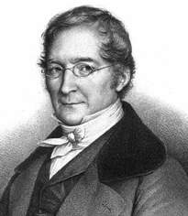
Minor-Major Contributors
1. Lavoisier’s (1743-1794)
Law of conservation of mass
2. Proust’s (1754 - 1826)
Law of definite proportions
3. Gay-Lussac’s (1778- 1850)
Law of Combining Volumes
Under constant conditions, the volume of reacting gases and products are in small whole number ratios

Slide 55
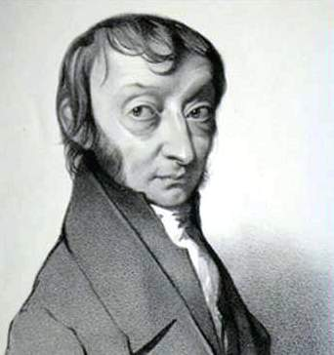
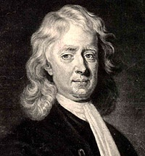
4. Avogadro’s Principle (1776-1856)
Equal volumes of gases, under the
same conditions, have the same
number of molecules
Amedeo Avogadro
Newton (1643-1727)
Mechanical universe with small,
solid masses in motion (1704)
Sir Isaac Newton

Slide 56
Particles in the Atom
Electrons
(-) charge no mass located outside the nucleus
Protons
(+) charge 1 amu located inside the nucleus
Neutrons
no charge 1 amu located inside the nucleus
Notes:
Atom – the smallest unit of an element that retains its chemical properties.
Atoms can be split into smaller parts.

Slide 57
Particles in the Atom
Atoms consist of electrons, protons, and neutrons.
1. Electrons and protons have electrical charges that are identical in magnitude but opposite in sign. Relative charges of −1 and +1 are assigned to the electron and proton, respectively.
2. Neutrons have approximately the same mass as protons but no charge—they are electrically neutral.
3. The mass of a proton or a neutron is about 1836 times greater than the mass of an electron. Protons and neutrons constitute the bulk of the mass of the atom.
Copyright 2007 Pearson Benjamin Cummings. All rights reserved.

Slide 58
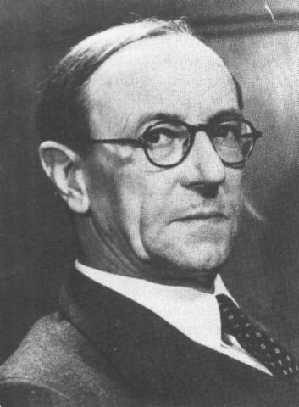
Discovery of the Neutron
+
+
James Chadwick bombarded beryllium-9 with alpha particles,
carbon-12 atoms were formed, and neutrons were emitted.
Dorin, Demmin, Gabel, Chemistry The Study of Matter 3rd Edition, page 764
*Walter Boethe
Notes:
Lord Rutherford predicted the existence of the neutron is 1920. Walter Bothe obtained evidence of the neutron in 1930. However it was James Chadwick, who repeated Bothe's work, who is known as the discoverer of the neutron. He found these uncharged particles with essentially the same mass as the proton. He was awarded the Nobel Prize in physics in 1935.
Chadwick is credited with the discovery of the neutron as a result of this transmutation experiment.
When Ernest Rutherford bombarded the gold foil with alpha particles...we said four possible things may happen.
(a) the particle will pass through the foil
(b) the particle will be deflected while passing through the gold foil
(c) the particle is deflected back towards the source
(d) the alpha particle is absorbed by the gold foil
It is this last event that is occurring above as beryllium is changed into carbon.
Notice this is a nuclear reaction - the nucleus is changed in the atom.
The neutron was postulated as a neutral nuclear particle having a mass equal to that of the proton but with no charge to accommodate the fact that the alpha-particle has a mass equal to 4 amu but a charge of +2. It was discovered by J Chadwick in 1932.

Slide 59
Humor
Two atoms are walking down the street.
One atom says to the other, “Hey! I think I lost an electron!”
The other says, “Are you sure??”
“Yes, I’m positive!”
A neutron walks into a restaurant and orders a couple
of drinks. As she is about to leave, she asks the waiter
how much she owes. The waiter replies, “For you,
No Charge!!!”

Slide 60
Subatomic particles
Relative
mass
Actual
mass (g)
Name
Symbol
Charge
Electron
e⁻
-1
1/1840
9.11 x 10⁻²⁸
Proton
p⁺
+1
1
1.67 x 10⁻²⁴
Neutron
nº
0
1
1.67 x 10⁻²⁴

Slide 61
Structure of the Atom
There are two regions
  The nucleus
    With protons and neutrons
  Positive charge
  Almost all the mass
Electron cloud
  Most of the volume of an atom
  The region where the electron can be found

Slide 62
Subatomic Particles
ATOM
NUCLEUS
ELECTRONS
PROTONS
NEUTRONS
Negative Charge
Positive
Charge
Neutral
Charge
QUARKS
equal in a neutral atom
Atomic Number
equals the # of...
Most of the atom’s mass.
Courtesy Christy Johannesson www.nisd.net/communicationsarts/pages/chem

Slide 63
Subatomic Particles
ATOM
NUCLEUS
ELECTRONS
PROTONS
NEUTRONS
Negative Charge
Positive
Charge
Neutral
Charge
QUARKS
equal in a neutral atom
Atomic Number
equals the # of...
Most of the atom’s mass.
Courtesy Christy Johannesson www.nisd.net/communicationsarts/pages/chem

Slide 64
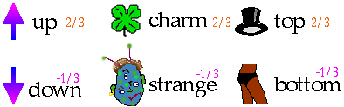
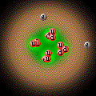
Subatomic Particles
Quarks
  component of protons & neutrons
  6 types
  3 quarks =
  1 proton or
  1 neutron
He
Courtesy Christy Johannesson www.nisd.net/communicationsarts/pages/chem

Slide 65
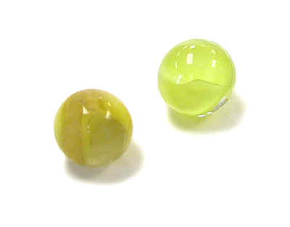
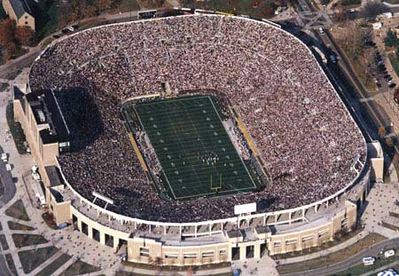
Size of an atom
Atoms are incredibly tiny.
Measured in picometers (10⁻¹² meters)
  Hydrogen atom, 32 pm radius
Nucleus tiny compared to atom
  Radius of the nucleus near 10⁻¹⁵ m.
  Density near 10¹⁴ g/cm³
IF the atom was the size of a stadium, the nucleus would be the size of a marble.
California WEB
Notes:
http://graphics.fansonly.com/photos/schools/nd/nonsport/facilities/stadium-450w.jpg Notre Dame Stadium
http://www.orau.org/PTP/collection/consumer%20products/marbles.jpg

Slide 66
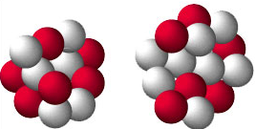
Counting the Pieces
C
12
C
14
6
6
Mass Number = A
Atomic Number = number of protons
# of protons determines kind of atom
Atomic Number = number of electrons in a neutral atom
Mass Number = the number of protons + neutrons
C
12
6
Atomic Number = Z
California WEB

Slide 67
Symbols
Contain the symbol of the element, the mass number and the atomic number
Mass
number
X
# protons
+ # neutrons
mass number
# protons
Atomic
number

Slide 68

Symbols
Find the
  number of protons
  number of neutrons
  number of electrons
  Atomic number
  Mass number
= 9
+
= 10
19
F
= 9
9
= 9
= 19
Notes:
http://ptcl.chem.ox.ac.uk/MSDS/glossary/corrosive.jpg

Slide 69
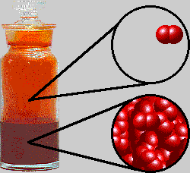
Symbols
Find the
  number of protons
  number of neutrons
  number of electrons
  Atomic number
  Mass number
= 35
= 45
80
Br
= 35
35
= 35
= 80
http://www.chem.purdue.edu/gchelp/liquids/bromine.gif

Slide 70
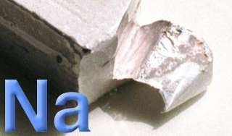
Symbols
Find the
  number of protons
  number of neutrons
  number of electrons
  Atomic number
  Mass number
= 11
= 12
23
Na
= 11
= 11
11
= 23
Sodium atom
Notes:
http://www.webelements.com/webelements/elements/media/element-pics/Na.jpg

Slide 71
Symbols
Find the
  number of protons
  number of neutrons
  number of electrons
  Atomic number
  Mass number
= 11
= 12
23
Na
1+
= 10
11
= 11
= 23
Sodium ion

Slide 72

Symbols
If an element has an atomic number of 23 and a mass number of 51 what is the
  number of protons
  number of neutrons
  number of electrons
  Complete symbol
= 23
= 28
= 23
51
V
23
Notes:
http://www.klenktools.com/Main/Images/All-combo-wrenches-sm.jpg

Slide 73
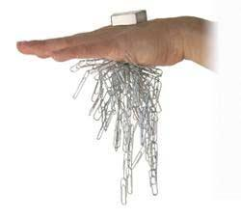
Symbols
If an element has 60 protons and 84 neutrons what is the
  Atomic number
  Mass number
  number of electrons
  Complete symbol
= 60
= 144
= 60
144
Nd
60
Notes:
http://www.stevespanglerscience.com/img/cache/02268c260f8fff6f7502dd93a20e39be/WMLN-100-260x250.jpg

Slide 74
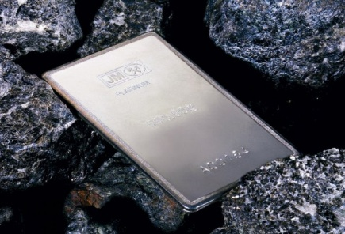
Symbols
If a neutral atom of an element has 78 electrons and 117 neutrons what is the
  Atomic number
  Mass number
  number of protons
  Complete symbol
= 78
= 195
= 78
195
Pt
78
Notes:
Platinum is even more rare than gold. In fact, 50 tons of ore is required to produce just 50 grams of platinum.
Platinum is a grayish-white metal that is malleable yet, like gold, is resistant to attack by air, moisture, and most solutions.
Its melting point is even higher than gold, at just over 3,000°F. It ranks 72 in abundance among the elements.
http://www.patbakersfinejewelry.com/graphics/platinum%20bar.jpg

Slide 75
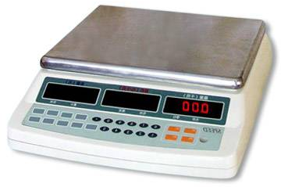
Masses of Atoms
        Mass Number
        Isotopes
        Ions
        Relative Atomic Mass
        Average Atomic Mass
Courtesy Christy Johannesson www.nisd.net/communicationsarts/pages/chem
Notes:
Law of definite proportions states that a chemical compound always contains the same proportion of elements by mass
Percent composition — the percentage of each element present in a pure substance—is constant
Calculation of mass percentage
1. Use atomic masses to calculate the molar mass of the compound
2. Divide the mass of each element by the molar mass of the compound and then multiply by 100% to obtain percentages
3. To find the mass of an element contained in a given mass of the compound, multiply the mass of the compound by the mass percentage of that element expressed as a decimal
http://www.lakewoodconferences.com/direct/dbimage/50267226/Electronic_Scale.jpg

Slide 76
Atomic
Mass
p⁺
n⁰
e–
Ca
20
40
20
20
20
Ar
18
40
18
22
18
Br
35
80
35
45
35
20
18
35
Ca
Ar
Br
40.08
39.948
79.904

Slide 77
Bohr - Rutherford diagrams
Putting all this together, we get B-R diagrams
To draw them you must know the # of protons, neutrons, and electrons (2,8,8,2 filling order)
Draw protons (p⁺), (n⁰) in circle (i.e. “nucleus”)
Draw electrons around in shells
He
Li
Li shorthand
3 p⁺
4 n⁰
2 p⁺
2 n⁰
3 p⁺
4 n⁰
2e– 1e–
Draw Be, B, Al and shorthand diagrams for O, Na

Slide 78
Be
B
Al
4 p+
5 n°
5 p+
6 n°
13 p+
14 n°
O
Na
8 p+
8 n°
11 p+
12 n°
2e– 6e–
2e– 8e– 1e–

Slide 79
Mass Number
mass # = protons + neutrons
always a whole number
NOT on the
Periodic Table!
Neutron
+
+
+
Electrons
Nucleus
e-
+
+
+
Proton
e-
e-
Nucleus
e-
e-
Carbon-12
Neutrons 6
Protons 6
Electrons 6
e-

Slide 80
Isotopes
Atoms of the same element with different mass numbers.
Nuclear symbol:
Mass #
12
6
C
Atomic #
Hyphen notation: carbon-12
Courtesy Christy Johannesson www.nisd.net/communicationsarts/pages/chem
Notes:
Each isotope has a different number of neutrons.

Slide 81
Isotopes
Neutron
+
+
+
Electrons
Nucleus
+
+
+
Proton
Nucleus
Nucleus
Proton
+
+
+
Neutron
Carbon-12
+
+
Neutrons 6
Protons 6
Electrons 6
Electrons
+
Carbon-14
Neutrons 8
Protons 6
Electrons 6
Nucleus
Notes:
The chemistry of each element is determined by its number of protons and electrons.
In a neutral atom, the number of electrons equals the number of protons.
Symbols for elements are derived directly from the element’s name.
Nuclei of atoms contain neutrons as well as protons.
The number of neutrons is not fixed for most elements, unlike protons.
Atoms that have the same number of protons, and hence the same atomic number, but different numbers of neutrons are called isotopes.

Slide 82
⁶Li ⁷Li
3 p⁺
3 n⁰
3 p⁺
4 n⁰
2e– 1e–
2e– 1e–
Neutron
Neutron
Electrons
+
Electrons
+
Nucleus
+
+
Nucleus
+
+
Proton
Proton
Nucleus
Nucleus
Lithium-6
Lithium-7
Neutrons 3
Protons 3
Electrons 3
Neutrons 4
Protons 3
Electrons 3

Slide 83
Isotopes
17
Cl
37
Chlorine-37
  atomic #:
  mass #:
  # of protons:
  # of electrons:
  # of neutrons:
  17
  37
  17
  17
  20
37
17
Cl
Courtesy Christy Johannesson www.nisd.net/communicationsarts/pages/chem
Notes:
Atoms that have the same number of protons, and hence the same atomic number, but different numbers of neutrons are called isotopes.

Slide 84
Relative Atomic Mass
¹²C atom = 1.992 × 10⁻²³ g
atomic mass unit (amu)
1 amu = ¹/₁₂ the mass of a ¹²C atom
Neutron
1 p = 1.007276 amu
1 n = 1.008665 amu
1 e⁻ = 0.0005486 amu
+
+
+
Electrons
Nucleus
+
+
+
Proton
Nucleus
Carbon-12
Neutrons 6
Protons 6
Electrons 6
Notes:
Atomic mass
1. The mass of any given atom is not simply the sum of the masses of its electrons, protons, and neutrons.
2. Atoms are too small to measure individually and do not have a charge.
3. The arbitrary standard that has been established for describing atomic mass is the atomic mass unit (amu), defined as one-twelfth of the mass of one atom of ¹²C.
4. Most elements exist as mixtures of several stable isotopes. The weighted average is of the masses of the isotopes is called the atomic mass.
5. Electrons added or removed from an atom produce a charged particle called an ion, whose charge is indicated by a superscript after the symbol for the element.

Slide 85
Average Atomic Mass
weighted average of all isotopes
on the Periodic Table
round to 2 decimal places
Avg.
Atomic
Mass
(mass)(%) + (mass)(%)
=
100
Courtesy Christy Johannesson www.nisd.net/communicationsarts/pages/chem

Slide 86
Average Atomic Mass
EX: Calculate the avg. atomic mass of oxygen if its abundance in nature is 99.76% ¹⁶O, 0.04% ¹⁷O, and 0.20% ¹⁸O.
Avg.
Atomic
Mass
=
(16)(99.76) + (17)(0.04) + (18)(0.20)
=
16.00
amu
100
Courtesy Christy Johannesson www.nisd.net/communicationsarts/pages/chem

Slide 87
Average Atomic Mass
EX: Find chlorine’s average atomic mass if approximately 8 of every 10 atoms are chlorine-35 and 2 are chlorine-37.
Avg.
Atomic
Mass
(35)(8) + (37)(2)
=
=
35.40 amu
10
Courtesy Christy Johannesson www.nisd.net/communicationsarts/pages/chem

Slide 88
100
17
Cl
Mass spectrum of chlorine. Elemental chlorine (Cl₂) contains
only two isotopes: 34.97 amu (75.53%) and 36.97 (24.47%)
90
35.4594
80
Cl-35
70
60
AAM = (34.97 amu)(0.7553) + (36.97 amu)(0.2447)
AAM = (26.412841 amu) + (9.046559 amu)
AAM = 35.4594 amu
50
Abundance
40
30
Cl-37
20
10
0
34
35
36
37
Mass
Notes:
Mass spectrum of chlorine. Elemental chlorine (Cl₂) contains
only two isotopes: 34.97 amu (75.53%) and 36.97 (24.47%)

Slide 89
Mass Spectrophotometer
magnetic field
heaviest
ions
stream
of ions of
different
masses
lightest
ions
electron
beam
gas
Dorin, Demmin, Gabel, Chemistry The Study of Matter 3rd Edition, page 138

Slide 90
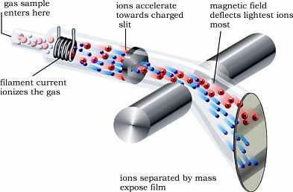
Weighing atoms
.
gas sample
enters here
ions accelerate
towards charged
slit
magnetic field
deflects lightest ions
most
filament current
ionizes the gas
The first mass spectrograph was built in 1919 by F. W. Aston, who received the 1922 Nobel Prize for this accomplishment
ions separated by mass
expose film
mass spectrometry is used to experimentally determine isotopic masses
and abundances
interpreting mass spectra
average atomic weights
  - computed from isotopic masses and abundances
  - significant figures of tabulated atomic weights gives some idea
  of natural variation in isotopic abundances
Copyright © 1997-2005 by Fred Senese

Slide 91
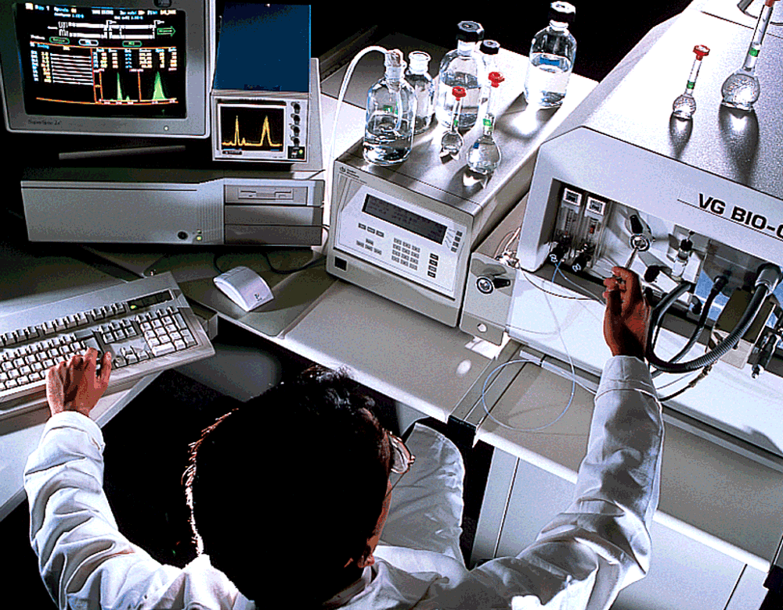
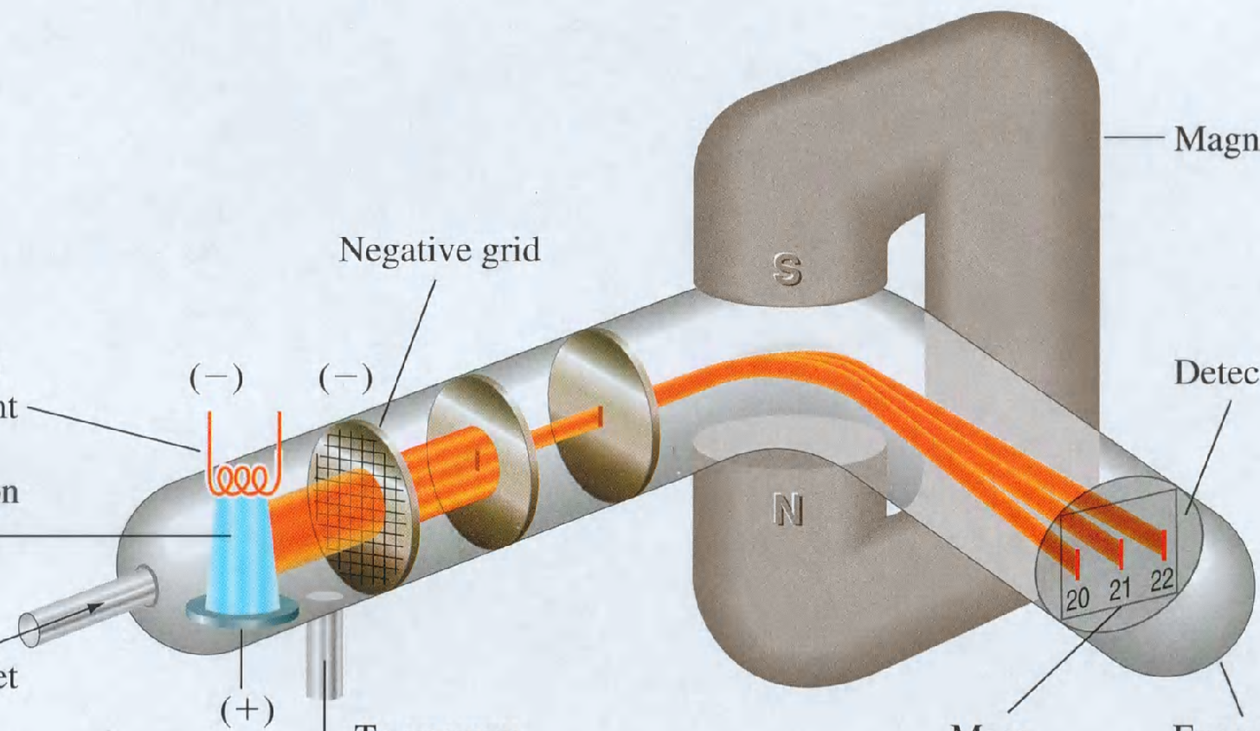
Mass Spectrophotometer
Magnet
Negative grid
Heated
filament
(-)
(-)
Detector
Electron
beam
Neon
gas inlet
(+)
To vacuum
pump
Mass
numbers
Evacuated
glass tube
Image Copyrighted by Houghton Mifflin Company

Slide 92
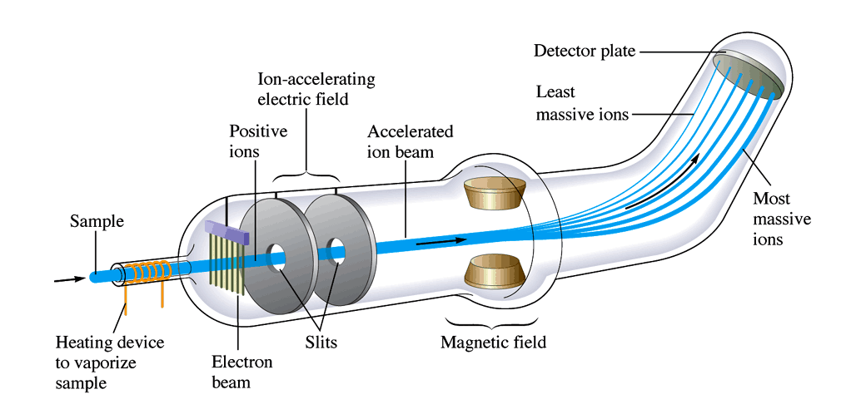
Mass Spectrometer
Notes:
Gives a ratio of the masses to each other that can be multiplied by the amu’s to get the atomic mass.

Slide 93
Mass Spectrometry
198 200 202
Photographic plate
196 199 201 204
-
+
Mass spectrum of mercury vapor
Stream of positive ions
Hill, Petrucci, General Chemistry An Integrated Approach 1999, page 320
Notes:
A gaseous sample is ionized by bombarding it with electrons in the lower part of the apparatus (not shown), producing positive ions.
The ions pass through an electric field in which they are brought to a particular velocity. The ions then pass through a narrow slit
into a curved chamber. A magnetic field is applied perpendicular to the beam of ions. All the ions with the same mass-to-charge ratio
are deflected into the same circular path. (In most cases, the ionic charge is 1+ and the mass-to-charge ratio is the same as the mass.)
Modern spectrophotometers use electronic detection devices (TOF = time of flight detectors) rather than photographic plates or film to
establish mass-to-charge ratios and relative number of ions.

Slide 94
Mass Spectrum for Mercury
(The photographic record has been converted to a scale of relative number of atoms)
The percent natural abundances
for mercury isotopes are:
Hg-196 0.146%
Hg-198 10.02%
Hg-199 16.84%
Hg-200 23.13%
Hg-201 13.22%
Hg-202 29.80%
Hg-204 6.85%
198 200 202
30
25
20
15
10
5
196 199 201 204
Mass spectrum of mercury vapor
Relative number of atoms
196 197 198 199 200 201 202 203 204
Mass number

Slide 95
80
Hg
200.59
The percent natural abundances
for mercury isotopes are:
Hg-196 0.146%
Hg-198 10.02%
Hg-199 16.84%
Hg-200 23.13%
Hg-201 13.22%
Hg-202 29.80%
Hg-204 6.85%
A
B
C
D
E
F
G
(% "A")(mass "A") + (% "B")(mass "B") + (% "C")(mass "C") + (% "D")(mass "D") + (% "E")(mass "E") + (% F)(mass F) + (% G)(mass G) = AAM
(0.00146)(196) + (0.1002)(198) + (0.1684)(199) + (0.2313)(200) + (0.1322)(201) + (0.2980)(202) + (0.0685)(204) = x
0.28616 + 19.8396 + 33.5116 + 46.2600 + 26.5722 + 60.1960 + 13.974 = x
x = 200.63956 amu

Slide 96
Separation of Isotopes
92
U
238
Natural uranium, atomic weight = 238.029 g/mol
Density is 19 g/cm³. Melting point 1000ºC.
Two main isotopes:
238
92
U
99.3%
0.7%
(238 amu) x (0.993) + (235 amu) x (0.007)
235
92
U
236.334 amu + 1.645 amu
237.979 amu
Because isotopes are chemically identical
(same electronic structure), they cannot be
separated by chemistry.
So Physics separates them by diffusion or
centrifuge (mass spectrograph is too slow)…

Slide 97
17
Cl
35.453
Assume you have only two atoms of chlorine.
One atom has a mass of 35 amu (Cl-35)
The other atom has a mass of 36 amu (Cl-36)
What is the average mass of these two isotopes?
35.5 amu
Looking at the average atomic mass printed on the periodic table...approximately what percentage is Cl-35 and Cl-36?
55% Cl-35 and 45% Cl-36 is a good approximation

Slide 98
17
Cl
35.453
Using our estimated % abundance data
55% Cl-35 and 45% Cl-36
calculate an average atomic mass for chlorine.
Average Atomic Mass = (% abundance of isotope "A")(mass "A") + (% "B")(mass "B")
AAM = (% abundance of isotope Cl-35)(mass Cl-35) + (% abundance of Cl-36)(mass Cl-36)
AAM = (0.55)(35 amu) + (0.45)(36 amu)
AAM = (19.25 amu) + (16.2 amu)
AAM = 35.45 amu

Slide 99
Isotopes
Dalton was wrong.
Atoms of the same element can have different numbers of neutrons
different mass numbers
called isotopes
C-12 vs. C-14
California WEB
Notes:
The word isotope comes from the Greek words isos, meaning "equal," and topos, meaning "place."

Slide 100
Naming Isotopes
Put the mass number after the name of the element
carbon- 12
carbon -14
uranium-235
California WEB

Slide 101
Using a periodic table and what you know about atomic number, mass, isotopes, and electrons, fill in the chart:
Element | Symbol | Atomic Number | Atomic Mass | # of protons | # of neutron | # of electron | charge
 |  |  |  | 8 | 8 | 8
Potassium |  |  | 39 |  |  |  | +1
 | Br |  |  |  | 45 |  | -1
 |  | 30 | 35 |  |  | 30
Atomic Number = Number of Protons
Number of Protons + Number of Neutrons = Atomic Mass
Atom (no charge) : Protons = Electrons
Ion (cation) : Protons > Electrons
Ion (anion) : Electrons > Protons

Slide 102
Using a periodic table and what you know about atomic number, mass, isotopes, and electrons, fill in the chart:
A N S W E R K E Y
Element | Symbol | Atomic Number | Atomic Mass | # of protons | # of neutron | # of electron | charge
 |  |  |  | 8 | 8 | 8
Potassium |  |  | 39 |  |  |  | +1
 | Br |  |  |  | 45 |  | -1
 |  | 30 | 35 |  |  | 30
Oxygen
O
8
16
0
K
19
19
20
18
Bromine
35
80
35
36
Zinc
Zn
30
65
0
Atomic Number = Number of Protons
Number of Protons + Number of Neutrons = Atomic Mass
Atom (no charge) : Protons = Electrons
Ion (cation) : Protons > Electrons
Ion (anion) : Electrons > Protons

Slide 103
Atomic Number and Mass Number
Atomic Number and Mass Number
Atomic Number and Mass Number
Keys
http://www.unit5.org/chemistry/Atom.html

Slide 104
Ions and Subatomic Particles
Ions and Subatomic Particles
Ions and Subatomic Particles
Keys
http://www.unit5.org/chemistry/Atom.html

Slide 105
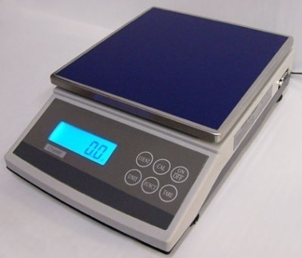
Atomic Mass
How heavy is an atom of oxygen?
There are different kinds of oxygen atoms.
More concerned with average atomic mass.
Based on abundance of each element in nature.
Don’t use grams because the numbers would be too small
Notes:
California Web
http://www.unitednuclear.com/scale6000.jpg

Slide 106
Measuring Atomic Mass
Unit is the Atomic Mass Unit (amu)
One twelfth the mass of a carbon-12 atom.
Each isotope has its own atomic mass we need the average from percent abundance.
carbon atom
(12 amu)
(1 amu)
(1 amu)
(1 amu)
(1 amu)
(1 amu)
(1 amu)
(1 amu)
(1 amu)
(1 amu)
(1 amu)
(1 amu)
(1 amu)
Notes:
The Mole - abbreviated mol
Defined as the amount that contains the number of carbon atoms in exactly 12 g of isotopically pure carbon-12.
The mass of carbon-12 contains 6.022 x 10²³ atoms (Avogadro’s number)

Slide 107
Mass spectrums reflect the abundance of naturally occurring isotopes.
Natural Abundance of Common Elements
Hydrogen
¹H = 99.985% ²H = 0.015%
Carbon
¹²C = 98.90% ¹³C = 1.10%
Nitrogen
¹⁴N = 99.63% ¹⁵N = 0.37%
Oxygen
¹⁶O = 99.762% ¹⁷O = 0.038% ¹⁸O = 0.200%
Sulfur
³²S = 95.02% ³³S = 0.75%
³⁴S = 4.21% ³⁶S = 0.02%
Chlorine
³⁵Cl = 75.77% ³⁷Cl = 24.23%
Bromine
⁷⁹Br = 50.69% ⁸¹Br = 49.31%

Slide 108
For example….Methane
For carbon 1 in approximately 90 atoms are carbon-13
The rest are carbon-12 the isotope that is 98.9% abundant.
So, for approximately 90 methane molecules…1 carbon is carbon-13

Slide 109
C-13
Where’s Waldo?

Slide 110
Calculating averages
You have five rocks, four with a mass of 50 g, and one with a mass of 60 g. What is the average mass of the rocks?
Total mass = (4 x 50) + (1 x 60) = 260 g
Average mass = (4 x 50) + (1 x 60) = 260 g 5 5
Average mass = 4 x 50 + 1 x 60 = 260 g 5 5 5
California WEB

Slide 111
Calculating averages
Average mass = 4 x 50 + 1 x 60 = 260 g 5 5 5
Average mass = .8 x 50 + .2 x 60
80% of the rocks were 50 grams
20% of the rocks were 60 grams
Average = % as decimal x mass + % as decimal x mass + % as decimal x mass +
California WEB

Slide 112
Isotopes
Because of the existence of isotopes, the mass of a collection of atoms has an average value.
Average mass = ATOMIC WEIGHT
Boron is 20% B-10 and 80% B-11. That is, B-11 is 80 percent abundant on earth.
For boron atomic weight
= 0.20 (10 amu) + 0.80 (11 amu) = 10.8 amu

Slide 113
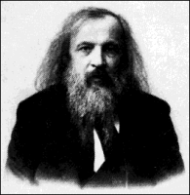
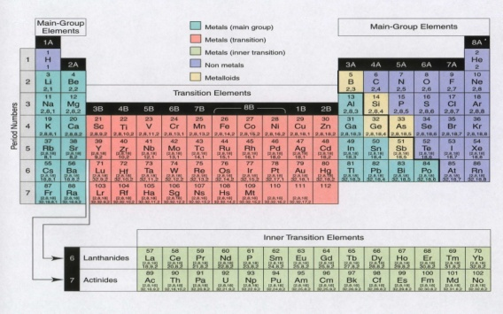
Periodic Table
Dmitri Mendeleev developed the modern periodic table.
Argued that element properties are periodic functions of their atomic weights.
We now know that element properties are periodic functions of their ATOMIC NUMBERS.

Slide 114
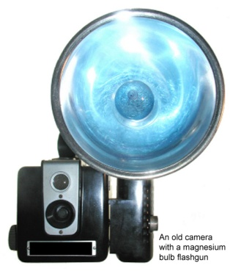
Atomic Mass
Magnesium has three isotopes. 78.99% magnesium 24 with a mass of 23.9850 amu, 10.00% magnesium 25 with a mass of 24.9858 amu, and the rest magnesium 26 with a mass of 25.9826 amu. What is the atomic mass of magnesium?
If not told otherwise,
the mass of the isotope is the mass number in amu.
Isotope | Percent Abundance | Mass
Mg-24 | 78.99 | 23.9850
Mg-25 | 10.00 | 24.9585
Mg-26 |  | 25.9826
18.94575
2.49585
11.01
2.86068
24.304 amu
California WEB
Notes:
Atomic mass is not a whole number because it is an average.
This is why their are the decimal numbers on the periodic table.
http://www.trustedreviews.com/images/article/inline/4066-Flashbulb.jpg

Slide 115

Atomic Mass
Calculate the atomic mass of copper if copper has two isotopes. 69.1% has a mass of 62.93 amu and the rest has a mass of 64.93 amu.
Isotope | Percent Abundance | Mass
Cu-63 | 69.1 | 62.93
Cu-65 |  | 64.93
43.48463
30.9
20.06337
63.548
29
Cu
63.548
Notes:
http://upload.wikimedia.org/wikipedia/commons/e/e2/United_States_penny,_obverse,_2002.jpg

Slide 116
 | Protons | Neutrons | Electrons | Mass number
Cu-65 | A | B | 29 | C
Argon | D | E | F | 40
Ba²⁺ | 56 | G | H | I
B. C.
D. E. F.
G. H. I.
Given the average atomic mass of an element is 118.21 amu and it has
three isotopes (“A”, “B”, and “C”):
isotope “A” has a mass of 117.93 amu and is 87.14% abundant
isotope “B” has a mass of 120.12 amu and is 12.36% abundant
Find the mass of isotope “C”.
Show work for credit.
Extra Credit: What is a cation?

Slide 117
 | Protons | Neutrons | Electrons | Mass number
Cu-65 | A = 29 | B = 36 | 29 | C = 65
Argon | D = 18 | E = 22 | F = 18 | 40
Ba²⁺ | 56 | G = 81 | H = 54 | I = 137
Given the average atomic mass of an element is 118.21 amu and it has
three isotopes (“A”, “B”, and “C”):
isotope “A” has a mass of 117.93 amu and is 87.14% abundant
isotope “B” has a mass of 120.12 amu and is 12.36% abundant
Find the mass of isotope “C”.
Show work for credit.
119.7932 amu
Extra Credit: What is a cation?
A positively charged atom. An atom that has lost a(n) electron(s).

Slide 118
Given the average atomic mass of an element is 118.21 amu and it has
three isotopes (“A”, “B”, and “C”):
isotope “A” has a mass of 117.93 amu and is 87.14% abundant
isotope “B” has a mass of 120.12 amu and is 12.36% abundant
Find the mass of isotope “C”.
Show work for credit.

Slide 119
Isotopes
Isotopes Lab
Isotopes Lab
Keys
http://www.unit5.org/chemistry/Atom.html

Slide 120

Electron Configuration & Orbitals
Quantum Model
of the Atom
Ch. 4 - Electrons in Atoms
1s²2s²2p⁶3s²3p⁶4s²3d¹⁰4p⁶5s²4d¹⁰4p⁶5s²4d¹⁰5p⁶6s²4f¹⁴5d¹⁰6p⁶…
Notes:
Objectives:
To describe the quantum mechanical model of the atom.
To describe the relative sizes and shapes of s and p orbitals.

Slide 121
Quantum Model of the Atom
Ch. 4 - Electrons in Atoms
Courtesy Christy Johannesson www.nisd.net/communicationsarts/pages/chem

Slide 122

I. Waves and Particles
De Broglie’s Hypothesis
  Particles have wave characteristics
  Waves have particle characteristics
  λ = h/mν
Wave-Particle Duality of Nature
Waves properties are significant at small momentum

Slide 123

Electrons as Waves
Louis de Broglie (1924)
  Applied wave-particle theory to electrons
  electrons exhibit wave properties
Louis de Broglie
~1924
QUANTIZED WAVELENGTHS
200
150
100
50
0
- 50
-100
-150
-200
Fundamental mode
200
150
100
50
0
- 50
-100
-150
-200
Second Harmonic or First Overtone
200
150
100
50
0
- 50
-100
-150
-200
Standing Wave
0 50 100 150 200
0 50 100 150 200
0 50 100 150 200
Adapted from work by Christy Johannesson www.nisd.net/communicationsarts/pages/chem
Notes:
Louis de Broglie wondered if the converse was true — could particles exhibit the properties of waves?
• de Broglie proposed that a particle such as an electron could be described by a wave whose wavelength is given by
λ = h ,
mν
where h is Planck’s constant, m is the mass of the particle, and ν is the velocity of the particle.
• de Broglie proposal was confirmed by Davisson and Germer, who showed that beams of electrons, regarded as particles, were diffracted by a sodium chloride crystal in the same manner as X
-rays, which were regarded as waves.
• de Broglie also investigated why only certain orbits were allowed in Bohr’s model of the hydrogen atom.
• de Broglie hypothesized that the electron behaves like a standing wave, a wave that does not travel in space.
• Standing waves are used in music: the lowest-energy standing wave is the fundamental vibration, and higher-energy vibrations are overtones and have successively more nodes, points where the amplitude of the wave is zero.
• de Broglie stated that Bohr’s allowed orbits could be understood if the electron behaved like a standing circular wave. The standing wave could exist only if the circumference of the circle was an integral multiple of the wavelength causing constructive interference. Otherwise, the wave would be out of phase with itself on successive orbits and would cancel out, causing destructive interference.

Slide 124

Electrons as Waves
QUANTIZED WAVELENGTHS
n = 4
n = 5
n = 6
Forbidden
n = 3.3
Courtesy Christy Johannesson www.nisd.net/communicationsarts/pages/chem
Notes:
http://www.lakewoodconferences.com/direct/dbimage/50222255/Classical_Guitar.jpg

Slide 125

Electrons as Waves
QUANTIZED WAVELENGTHS
L
n = 4
n = 1
L = 1
(λ)
2
n = 5
1 half-wavelength
n = 2
L = 2
(λ)
n = 6
2
2 half-wavelengths
Forbidden
n = 3.3
n = 3
L = 3
(λ)
2
3 half-wavelengths
Courtesy Christy Johannesson www.nisd.net/communicationsarts/pages/chem
Notes:
http://www.lakewoodconferences.com/direct/dbimage/50222255/Classical_Guitar.jpg

Slide 126


Electrons as Waves
Evidence: DIFFRACTION PATTERNS
VISIBLE LIGHT
ELECTRONS
Davis, Frey, Sarquis, Sarquis, Modern Chemistry 2006, page 105
Courtesy Christy Johannesson www.nisd.net/communicationsarts/pages/chem

Slide 127

Dual Nature of Light
Waves can bend
around small obstacles…
…and fan out
from pinholes.
Particles effuse from pinholes
Three ways to tell a wave from a particle…
wave behavior particle behavior
waves interfere particle collide
waves diffract particles effuse
waves are delocalized particles are localized

Slide 128

Quantum Mechanics
Heisenberg Uncertainty Principle
  Impossible to know both the velocity and position of an electron at the same time
Werner Heisenberg
~1926
γ
Microscope
Electron
Notes:
Werner Heisenberg (1901 - 1976)
The uncertainty principle: a free electron moves into the focus of a hypothetical microscope and is struck by a photon of light;
the photon transfers momentum to the electron. The reflected photon is seen in the microscope, but the electron has moved
out of focus. The electron is not where it appears to be.
A wave is a disturbance that travels in space and has no fixed position.
The Heisenberg uncertainty principle states that the uncertainty in the position of a particle (Δx) multiplied by the uncertainty in its momentum [Δ(mν)] is greater than or equal to Planck’s constant divided by 4π:
(Δx) [Δ(mν)] ≥ h
4π
• It is impossible to describe precisely both the location and the speed of particles that exhibit wavelike behavior.
Heisenberg's Uncertainty Principle
In 1927, Werner Heisenberg showed from quantum mechanics that it was impossible to know simultaneously, with absolute precision, both the position and the velocity of a particle.
The Heisenberg Uncertainty Principle states that the product of the uncertainty in position and the uncertainty in momentum (mass x speed) of a particle can be no smaller than Planck's constant divided by 4 pi
If mass is large (macroscopic) then the effects of the Uncertainty Principle tend to insignificance but if mass is small (for example, the electron) then the uncertainties are large.
(mass of electron = 9.109 x 10⁻³¹ kg)
You may like to calculate the uncertainty in speed of two differing objects each located to ± 10⁻¹⁰ m. Say a drinking glass bottle 0.5 kg and an electron.
What does this tell us about our reliability in placing an electron at a particular point at a particular moment in time ? Well, if you did the calculation above, you would find that we can (almost) say precisely how fast the bottle was moving (at least in terms of our ability to measure such margins of error) but with the electron then the margin of error approaches ± the speed of light !
The upshot of all this is that we cannot state with absolute certainty the velocity and position of electrons and so we must replace the Bohr-Sommerfeld model with another which considers the probability of an electron being at a certain point. In effect, all we can say is that we are pretty certain that the electron is within a particular region for some (most) of the time. Of course outside that time, it could be anywhere !

Slide 129

Heisenberg uncertainty principle
In order to observe an electron, one would need to hit it with photons having a very short wavelength.
Short wavelength photons would have a high frequency and a great deal of energy.
If one were to hit an electron, it would cause the motion and the speed of the electron to change.
Lower energy photons would have a smaller effect but would not give precise information.
Notes:
http://www.mises.org/images4/dice.jpg

Slide 130

II. The electron as a wave
Schrödinger’s wave equation
  Used to determine the probability of finding the H electron at any given distance from the nucleus
  Electron best described as a cloud
    Effectively covers all points at the same time
    (fan blades)
Notes:
http://news.thomasnet.com/images/large/465/465828.jpg

Slide 131

Quantum Mechanics
Schrödinger Wave Equation (1926)
  finite # of solutions ⇒ quantized energy levels
  defines probability of finding an electron
Erwin Schrödinger
~1926
Courtesy Christy Johannesson www.nisd.net/communicationsarts/pages/chem
Notes:
Erwin Schrödinger (1887 – 1926) won the Nobel Prize in Physics in 1933.
In 1926, Erwin Schrödinger developed wave mechanics, a mathematical technique to describe the relationship between the motion of a particle that exhibits wavelike properties (such as an electron) and its allowed energies.
Schrödinger developed the theory of quantum mechanics, which describes the energies and spatial distributions of electrons in atoms and molecules.
Wave function — a mathematical function that relates the location of an electron at a given point in space (identified by x, y, z coordinates) to the amplitude of its wave, which corresponds to its energy, each wave function ψ is associated with a particular energy E.

Slide 132

Quantum Mechanics
Orbital (“electron cloud”)
  Region in space where there is 90% probability of finding an electron
90% probability of
finding the electron
Electron Probability vs. Distance
40
30
20
Electron Probability (%)
10
0
0
50
100
150
200
250
Distance from the Nucleus (pm)
Orbital
Courtesy Christy Johannesson www.nisd.net/communicationsarts/pages/chem

Slide 133

Quantum Numbers
Four Quantum Numbers:
  Specify the “address” of each electron in an atom
UPPER LEVEL
Courtesy Christy Johannesson www.nisd.net/communicationsarts/pages/chem

Slide 134
III. Quantum Numbers
Used the wave equation to represent different energy states of the electrons
Set of four #’s to represent the location of the outermost electron
Here we go…

Slide 135
Quantum Numbers
Principal Quantum Number ( n )
Angular Momentum Quantum # ( l )
Magnetic Quantum Number ( m_{l} )
Spin Quantum Number ( m_{s} )
Notes:
Schrödinger used three quantum numbers
(n, l, and m_{l}) to specify any wave functions.
• Quantum numbers provide information
about the spatial distribution of the electron.

Slide 136
Relative Sizes 1s and 2s
1s 2s
Zumdahl, Zumdahl, DeCoste, World of Chemistry 2002, page 334

Slide 137
Quantum Numbers
1. Principal Quantum Number ( n )
  Energy level
  Size of the orbital
  n² = # of orbitals in
  the energy level
1s
2s
3s
Courtesy Christy Johannesson www.nisd.net/communicationsarts/pages/chem
Notes:
s Orbitals
– Orbitals with l = 0 are s orbitals and are spherically symmetrical, with the greatest probability of finding the electron occurring at the nucleus.
– All orbitals with values of n > 1 and l ≥ 0 contain one or more nodes.
– Three things happen to s orbitals as n increases:
1. they become larger, extending farther from the nucleus
2. they contain more nodes
3. for a given atom, the s orbitals become higher in energy as n increases due to the increased distance from the nucleus

Slide 138
The Principal quantum number
      The quantum number n is the principal quantum number.
      – The principal quantum number tells the average
      relative distance of the electron from the nucleus
      – n = 1, 2, 3, 4 . . .
      – As n increases for a given atom, so does the average
      distance of the electrons from the nucleus.
      – Electrons with higher values of n are easier to remove
      from an atom.
      – All wave functions that have the same value of n are
      said to constitute a principal shell because those
      electrons have similar average distances from the
      nucleus.

Slide 139

1s orbital imagined as “onion”
Concentric spherical shells
Copyright © 2006 Pearson Benjamin Cummings. All rights reserved.
Notes:
Of course, these are not what atoms “look” like. Rather, they are visual depictions that help us to understand atomic behavior.

Slide 140

Shapes of s, p, and d-Orbitals
s orbital
p orbitals
d orbitals
Notes:
• p orbitals
– Orbitals with l = 1 are p orbitals and contain a nodal plane that includes the nucleus, giving rise to a “dumbbell shape.”
– The size and complexity of the p orbitals for any atom increase as the principal quantum number n increases.
• d orbitals
– Orbitals with l = 2 are d orbitals and have more complex shapes with at least two nodal surfaces.
• f orbitals
– Orbitals with l = 3 are f orbitals, and each f orbital has three nodal surfaces, so their shapes are complex.

Slide 141

Atomic Orbitals

Slide 142

s, p, and d-orbitals
A
s orbitals:
Hold 2 electrons
(outer orbitals of
Groups 1 and 2)
B
p orbitals:
Each of 3 pairs of
lobes holds 2 electrons
= 6 electrons
(outer orbitals of
Groups 13 to 18)
C
d orbitals:
Each of 5 sets of
lobes holds 2 electrons
= 10 electrons
(found in elements
with atomic no. of 21
and higher)
Kelter, Carr, Scott, , Chemistry: A World of Choices 1999, page 82

Slide 143

Copyright © 2006 Pearson Benjamin Cummings. All rights reserved.

Slide 144

(a) Electron probability (b) Contour probability (c) Radial probability
Copyright © 2006 Pearson Benjamin Cummings. All rights reserved.
Notes:
An Orbital — is the quantum mechanical refinement of Bohr’s orbit
Orbitals are mathematically derived regions of space with different probabilities of containing the electron
The different ways of representing electron probability distributions are
1. Because ψ² gives the probability of finding the electron in a given volume of space, a plot of ψ² versus distance from the nucleus, r, is a plot of the probability density.
Probability density is greatest at r = 0 (at the nucleus) and decreases steadily with increasing distance
2. The radial probability can be calculated by summing the probabilities of the electron being at all points on a series of x spherical shells of radius r₁, r₂ …r_{x −1}, r_{x} and
calculating the probability of finding the electron in each of the spherical shells.

Slide 145

Ψ²1s
Ψ²2s
Ψ²3s
r
r
r
r
r
r
Distance from nucleus
(a) 1s (b) 2s (c) 3s

Slide 146

Quantum Numbers
y
y
y
z
z
z
x
x
x
p_{x}
p_{z}
p_{y}

Slide 147
p-Orbitals
p_{x}
p_{z}
p_{y}
Zumdahl, Zumdahl, DeCoste, World of Chemistry 2002, page 335

Slide 148




y
y
y
y
z
z
z
z
x
x
x
x
s
p_{x}
p_{z}
p_{y}
2s
2p (x, y, z)
carbon
Mark Wirtz, Edward Ehrat, David L. Cedeno*
Notes:
Using Computational Chemistry to Explore Concepts in General Chemistry
Mark Wirtz, Edward Ehrat, David L. Cedeno*
Department of Chemistry, Illinois State University, Box 4160, Normal, IL 61790-4160

Slide 149

Copyright © 2006 Pearson Benjamin Cummings. All rights reserved.

Slide 150



Copyright © 2007 Pearson Benjamin Cummings. All rights reserved.

Slide 154
Copyright © 2007 Pearson Benjamin Cummings. All rights reserved.

Slide 155




Quantum Numbers
2. Angular Momentum Quantum # ( l )
  Energy sublevel
  Shape of the orbital
s
p
d
f
Courtesy Christy Johannesson www.nisd.net/communicationsarts/pages/chem

Slide 156
The azimuthal quantum number
    Second quantum number l
    is called the azimuthal quantum number
      – Value of l describes the shape of the region of space occupied by the electron
      – Allowed values of l depend on the value of n and can range from 0 to n – 1
      – All wave functions that have the same value of both n and l form a subshell
      – Regions of space occupied by electrons in the same subshell have the same shape but are oriented differently in space
Copyright © 2006 Pearson Benjamin Cummings. All rights reserved.

Slide 157
A Cross Section of an Atom
n⁰
p⁺
Rings of Saturn
1s
2s
2p
3s
3p
3d
The first ionization energy level has only one sublevel (1s).
The second energy level has two sublevels (2s and 2p).
The third energy level has three sublevels (3s, 3p, and 3d).
Although the diagram suggests that electrons travel in circular orbits,
this is a simplification and is not actually the case.
Corwin, Introductory Chemistry 2005, page 124
Notes:
First show photograph of Uranus (the planet) rings. From a distance the rings look solid. When viewed more closely, we notice the rings are made of smaller rings.
We can think about the Bohr model of an atom - where the second ring is actually made of two smaller (closely together) rings; the third ring is made of three closely grouped rings, etc...

Slide 158

Quantum Numbers
Orbitals combine to form a spherical shape.
2s
2p_{x}
2p_{y}
2p_{z}
Courtesy Christy Johannesson www.nisd.net/communicationsarts/pages/chem

Slide 159
Quantum Numbers
Principal
level
n = 1
n = 2
n = 3
Sublevel
s
s
p
s
p
d
Orbital
p_{x}
p_{y}
p_{z}
p_{x}
p_{y}
p_{z}
d_{xy}
d_{xz}
d_{yz}
d_{z}2
d_{x}2_{- y}2
n = # of sublevels per level
n² = # of orbitals per level
Sublevel sets: 1 s, 3 p, 5 d, 7 f
Courtesy Christy Johannesson www.nisd.net/communicationsarts/pages/chem
Notes:
An abbreviated system with lowercase letters is used to denote the value of l for a particular subshell or orbital:
l = 0 1 2 3
Designation s p d f
• The principal quantum number is named first, followed by the letter s, p, d, or f.
• A 1s orbital has n = 1 and l = 0; a 2p subshell has n = 2 and l = 1(and contains three 2p orbitals, corresponding to m_{l} = –1, 0, and +1); a 3d subshell has n = 3 and l = 2 (and contains five 3d orbitals, corresponding to m_{l} = –2, –1, 0, –1, and +2).

Slide 160
Maximum Capacities of Subshells and Principal Shells
n 1 2 3 4 ...n
l 0 0 1 0 1 2 0 1 2 3
Subshell
designation s s p s p d s p d f
Orbitals in
subshell 1 1 3 1 3 5 1 3 5 7
Subshell
capacity 2 2 6 2 6 10 2 6 10 14
Principal shell
capacity 2 8 18 32 ...2n²
Hill, Petrucci, General Chemistry An Integrated Approach 1999, page 320
Notes:
An abbreviated system with lowercase letters is used to denote the value of l for a particular subshell or orbital:
l = 0 1 2 3
Designation s p d f
• The principal quantum number is named first, followed by the letter s, p, d, or f.
• A 1s orbital has n = 1 and l = 0; a 2p subshell has n = 2 and l = 1(and contains three 2p orbitals, corresponding to m_{l} = –1, 0, and +1); a 3d subshell has n = 3 and l = 2 (and contains five 3d orbitals, corresponding to m_{l} = –2, –1, 0, –1, and +2).
Relationships between the quantum numbers and the number of subshells and orbitals are
1. each principal shell contains n subshells;
– for n = 1, only a single subshell is possible (1s);
for n = 2, there are two subshells (2s and 2p);
for n = 3, there are three subshells (3s, 3p, and 3d);
2. each subshell contains 2l + 1 orbitals;
– this means that all ns subshells contain a single s orbital, all np subshells contain three p orbitals, all nd subshells contain five d orbitals, and all nf subshells contain seven f orbitals.

Slide 161





Quantum Numbers
3. Magnetic Quantum Number ( m_{l} )
  Orientation of orbital
  Specifies the exact orbital within each sublevel
Courtesy Christy Johannesson www.nisd.net/communicationsarts/pages/chem

Slide 162
The magnetic quantum number
    Third quantum is m_{l}, the magnetic quantum number
      – Value of m_{l} describes the orientation of the region in space occupied by the electrons with respect to an applied magnetic field
      – Allowed values of m_{l} depend on the value of l
      – m_{l} can range from –l to l in integral steps
      m_{l} = −l, -l + l, . . . 0 . . ., l – 1, l
      – Each wave function with an allowed combination of n, l, and m_{l} values describes an atomic orbital, a particular spatial distribution for an electron
      – For a given set of quantum numbers, each principal shell contains a fixed number of subshells, and each subshell contains a fixed number of orbitals
Copyright © 2006 Pearson Benjamin Cummings. All rights reserved.

Slide 163

d-orbitals
Zumdahl, Zumdahl, DeCoste, World of Chemistry 2002, page 336

Slide 164

Copyright © 2006 Pearson Benjamin Cummings. All rights reserved.

Slide 165

Principal Energy Levels 1 and 2
Notes:
Note that p-orbital(s) have more energy than an s-orbital.

Slide 166

Quantum Numbers
4. Spin Quantum Number ( m_{s} )
  Electron spin ⇒ +½ or -½
  An orbital can hold 2 electrons that spin in opposite directions.
Courtesy Christy Johannesson www.nisd.net/communicationsarts/pages/chem
Notes:
Analyzing the emission and absorption spectra of the elements, it was found that for elements having more than one electron, nearly all the lines in the spectra were pairs of very closely spaced lines.
Each line represents an energy level available to electrons in the atom so there are twice as many energy levels available than predicted by the quantum numbers n, l, and m_{l}.
Applying a magnetic field causes the lines in the pairs to split apart.
Uhlenbeck and Goudsmit proposed that the splittings were caused by an electron spinning about its axis.

Slide 167
Electron Spin: The Fourth Quantum Number
When an electrically charged object spins, it produces a magnetic moment parallel to the axis of rotation and behaves like a magnet.
A magnetic moment is called electron spin.
An electron has two possible orientations in an external magnetic field, which are described by a fourth quantum number m_{s}.
For any electron, m_{s} can have only two possible values, designated + (up) and – (down), indicating that the two orientations are opposite and the subscript s is for spin.
An electron behaves like a magnet that has one of two possible orientations, aligned either with the magnetic field or against it.
Copyright © 2006 Pearson Benjamin Cummings. All rights reserved.

Slide 168

Copyright © 2006 Pearson Benjamin Cummings. All rights reserved.

Slide 169

Quantum Numbers
Pauli Exclusion Principle
  No two electrons in an atom can have the same 4 quantum numbers.
  Each electron has a unique “address”:
Wolfgang Pauli
  1. Principal # →
  2. Ang. Mom. # →
  3. Magnetic # →
  4. Spin # →
  energy level
  sublevel (s,p,d,f)
  orbital
  electron
Courtesy Christy Johannesson www.nisd.net/communicationsarts/pages/chem
Notes:
Wolfgang Pauli determined that each orbital can contain no more than two electrons.
Pauli exclusion principle: No two electrons in an atom can have the same value of all four quantum numbers (n, l, m_{l} , m_{s}).
By giving the values of n, l, and m_{l}, we specify a particular orbit.
Because m_{s} has only two values (+½ or -½), two electrons (and only two electrons) can occupy any given orbital, one with spin up and one with spin down.
Pauli's Exclusion Principle.
Put bluntly, this states that "No two electrons in one atom can have the same values for all four quantum numbers". (My interpretation of the Principal and not a direct quote)
This essentially means that a maximum of only two electrons can occupy a single orbital. When two electrons occupy an orbital they must have opposed spin (i.e. different values for the spin quantum number).
We are now beginning to see how the electronic configuration of the elements is built up.

Slide 170
Allowed Sets of Quantum Numbers for Electrons in Atoms
Level n 1 2 3
Sublevel l
0
0
1
0
1
2
Orbital m_{l}
0
0
1
0
-1
0
1
0
-1
2
1
0
-1
-2
Spin m_{s}
= +1/2
= -1/2

Slide 171

Feeling overwhelmed?
Read Section 5.10 - 5.11!
Chemistry
"Teacher, may I be excused? My brain is full."
Courtesy Christy Johannesson www.nisd.net/communicationsarts/pages/chem

Slide 172

Electron Orbitals:
Electron
orbitals
Equivalent
Electron
shells
(a) 1s orbital (b) 2s and 2p orbitals
c) Neon Ne-10: 1s, 2s and 2p
1999, Addison, Wesley, Longman, Inc.

Slide 173
What sort of covalent bonds are seen here?
H
H
H
H
O
O
O O
(a) H₂
(b) O₂
H
H
O
H
O
H
H
O
H
H
C
H
H
H
H
H
(c) H₂O
(d) CH₄

Slide 174
Electron Configuration
Notes:
Objectives:
To state the energy sublevels within a given energy level.
To state the maximum number of electrons that occupy a given energy level and sublevel.
To list the order of sublevels according to increasing energy.
To write the predicted electron configurations for selected elements.
Electronic Configuration
Each orbital can contain a maximum of two electrons each. So an s-orbital can contain two electron as can each p-orbital. Hence the set of three p-orbitals can contain a maximum of six electrons. We can express this mathematically, "The maximum number of electrons which can occupy a principal quantum group (or shell) is 2n²". For n = 1, we get 2 electrons, when n = 2 we get eight electrons and when n = 3 we get 18 electrons and so on.
How do the orbitals fill with electrons ? Electrons will enter orbitals at the lowest energy possible. (see Aufbau Principle). Thus a 1s orbital will be filled before a 2s. The order of filling orbitals is often shown in text books by way of a diagram, however, a list will do just as well; 1s, 2s, 2p, 3s, 3p, 4s, 3d, 4p, 5s…that will be sufficient for our needs at this level. Notice that the 3d orbitals are filled before the 4p. The effect of this upon the period table is quite striking - check it out.
In addition to filling in terms of energies of orbitals, electrons will also enter orbitals singularly. In other words, if we take the 2p-orbitals for example, each will be occupied by a single electron before electrons begin to pair up. Why do you think this is so ? We can explain this by considering the charge on the electron. By placing two like charges together in a confined region of space we set up some repulsion (inter-electron repulsion). The two electrons will effectively repel one another and so their energies will be increased slightly. The aim is always to get to lowest energy and so the electrons will not pair up until forced to do so.

Slide 175
THIS SLIDE IS ANIMATED
IN FILLING ORDER 2.PPT
= 1s¹
H
1s
He
= 1s²
1s
= 1s² 2s¹
Li
1s
2s
Be
= 1s² 2s²
1s
2s
= 1s² 2s² 2p²
C
1s
2s
2p_{x}
2p_{y}
2p_{z}
= 1s² 2s² 2p⁶3s² 3p⁴
S
1s
2s
2p_{x}
2p_{y}
2p_{z}
3s
3p_{x}
3p_{y}
3p_{z}

Slide 176
= 1s¹
H
1s
e⁻
+1
He
= 1s²
1s
e⁻
e⁻
+2
Coulombic attraction holds valence electrons to atom.
Be
= 1s² 2s²
1s
2s
e⁻
e⁻
e⁻
+4
Coulombic attraction holds valence electrons to atom.
e⁻
Valence electrons are shielded by the kernel electrons.
Therefore the valence electrons are not held as tightly in Be than in He.

Slide 177
26
= 1s¹ 2s²2p⁶3s²3p⁶4s²3d⁶
Iron has ___ electrons.
Fe
1s
2s
2p_{x}
2p_{y}
2p_{z}
3s
3p_{x}
3p_{y}
3p_{z}
4s
3d
3d
3d
3d
3d
6s 6p 5d 4f
32
5s 5p 4d
e⁻
e⁻
e⁻
18
e⁻
e⁻
e⁻
4s 4p 3d
e⁻
e⁻
e⁻
e⁻
18
e⁻
+26
e⁻
e⁻
Arbitrary
Energy Scale
e⁻
e⁻
3s 3p
e⁻
e⁻
e⁻
e⁻
e⁻
e⁻
e⁻
e⁻
8
e⁻
e⁻
e⁻
2s 2p
8
1s
2
NUCLEUS

Slide 178
Electron Configurations
Electron Configurations
Orbital Filling
Element 1s 2s 2p_{x} 2p_{y} 2p_{z} 3s Configuration
Orbital Filling
Element 1s 2s 2p_{x} 2p_{y} 2p_{z} 3s Configuration
Electron
Electron
H
He
Li
C
N
O
F
Ne
Na
H
He
Li
C
N
O
F
Ne
Na
1s¹
1s¹
1s²
1s²
NOT CORRECT
Violates Hund’s Rule
1s²2s¹
1s²2s¹
1s²2s²2p²
1s²2s²2p²
1s²2s²2p³
1s²2s²2p³
1s²2s²2p⁴
1s²2s²2p⁴
1s²2s²2p⁵
1s²2s²2p⁵
1s²2s²2p⁶
1s²2s²2p⁶
1s²2s²2p⁶3s¹
1s²2s²2p⁶3s¹
Notes:
The aufbau principle
1. For hydrogen, the single electron is placed in the 1s orbital, the orbital lowest in energy, and electron configuration is written as 1s¹. The orbital diagram is
H: 2p _ _ _
2s _
1s ↑
2. A neutral helium atom, with an atomic number of 2 (Z = 2), contains two electrons. Place one electron in the lowest-energy orbital, the 1s orbital. Place the second electron in the same orbital as the first but pointing down, so the electrons are paired. This is written as 1s².
He: 2p _ _ _
2s _
1s ↑↓
3. Lithium, with Z = 3, has three electrons in the neutral atom. The electron configuration is written as 1s²2s¹. Place two electrons in the 1s orbital and place one in the next lowest-energy orbital, 2s. The orbital diagram is
Li: 2p _ _ _
2s ↑
1s ↑↓
4. Beryllium, with Z = 4, has four electrons. Fill both the 1s and 2s orbitals to achieve 1s²2s²:
Be: 2p _ _ _
2s ↑↓
1s ↑↓
5. Boron, with Z = 5, has five electrons. Place the fifth electron in one of the 2p orbitals. The electron configuration is 1s²2s²2p¹
B: 2p ↑ _ _
2s ↑↓
1s ↑↓
6. Carbon, with Z = 6, has six electrons. One is faced with a choice — should the sixth electron be placed in the same 2p orbital that contains an electron or should it go in one of the empty 2p orbitals? And if it goes in an empty 2p orbital, will the sixth electron have its spin aligned with or be opposite to the spin of the fifth?
7. It is more favorable energetically for an electron to be in an unoccupied orbital rather than one that is already occupied due to electron-electron repulsions. According to Hund’s rule, the lowest-energy electron configuration for an atom is the one that has the maximum number of electrons with parallel spins in degenerate orbitals. Electron configuration for carbon is 1s²2s²2p² and the orbital diagram is
C: 2p ↑ ↑ _
2s ↑↓
1s ↑↓
8. Nitrogen (Z = 7) has seven electrons. Electron configuration is 1s²2s²2p³. Hund’s rule gives the lowest-energy arrangement with unpaired electrons as
N: 2p ↑ ↑ ↑
2s ↑↓
1s ↑↓
9. Oxygen, with Z = 8, has eight electrons. One electron is paired with another in one of the 2p orbitals. The electron configuration is 1s²2s²2p⁴:
O: 2p ↑↓ ↑ ↑
2s ↑↓
1s ↑↓
10. Fluorine, with Z = 9, has nine electrons with the electron configuration 1s²2s²2p⁵:
F: 2p ↑↓ ↑↓ ↑
2s ↑↓
1s ↑↓
11. Neon, with Z = 10, has 10 electrons filling the 2p subshell. The electron configuration is 1s²2s²2p⁶
Ne: 2p ↑↓ ↑↓ ↑↓
2s ↑↓
1s ↑↓

Slide 179
Electron Configurations
Orbital Filling
Element 1s 2s 2p_{x} 2p_{y} 2p_{z} 3s Configuration
Electron
H
He
Li
C
N
O
F
Ne
Na
1s¹
1s²
1s²2s¹
1s²2s²2p²
1s²2s²2p³
1s²2s²2p⁴
1s²2s²2p⁵
1s²2s²2p⁶
1s²2s²2p⁶3s¹
Notes:
The aufbau principle
1. For hydrogen, the single electron is placed in the 1s orbital, the orbital lowest in energy, and electron configuration is written as 1s¹. The orbital diagram is
H: 2p _ _ _
2s _
1s ↑
2. A neutral helium atom, with an atomic number of 2 (Z = 2), contains two electrons. Place one electron in the lowest-energy orbital, the 1s orbital. Place the second electron in the same orbital as the first but pointing down, so the electrons are paired. This is written as 1s².
He: 2p _ _ _
2s _
1s ↑↓
3. Lithium, with Z = 3, has three electrons in the neutral atom. The electron configuration is written as 1s²2s¹. Place two electrons in the 1s orbital and place one in the next lowest-energy orbital, 2s. The orbital diagram is
Li: 2p _ _ _
2s ↑
1s ↑↓
4. Beryllium, with Z = 4, has four electrons. Fill both the 1s and 2s orbitals to achieve 1s²2s²:
Be: 2p _ _ _
2s ↑↓
1s ↑↓
5. Boron, with Z = 5, has five electrons. Place the fifth electron in one of the 2p orbitals. The electron configuration is 1s²2s²2p¹
B: 2p ↑ _ _
2s ↑↓
1s ↑↓
6. Carbon, with Z = 6, has six electrons. One is faced with a choice — should the sixth electron be placed in the same 2p orbital that contains an electron or should it go in one of the empty 2p orbitals? And if it goes in an empty 2p orbital, will the sixth electron have its spin aligned with or be opposite to the spin of the fifth?
7. It is more favorable energetically for an electron to be in an unoccupied orbital rather than one that is already occupied due to electron-electron repulsions. According to Hund’s rule, the lowest-energy electron configuration for an atom is the one that has the maximum number of electrons with parallel spins in degenerate orbitals. Electron configuration for carbon is 1s²2s²2p² and the orbital diagram is
C: 2p ↑ ↑ _
2s ↑↓
1s ↑↓
8. Nitrogen (Z = 7) has seven electrons. Electron configuration is 1s²2s²2p³. Hund’s rule gives the lowest-energy arrangement with unpaired electrons as
N: 2p ↑ ↑ ↑
2s ↑↓
1s ↑↓
9. Oxygen, with Z = 8, has eight electrons. One electron is paired with another in one of the 2p orbitals. The electron configuration is 1s²2s²2p⁴:
O: 2p ↑↓ ↑ ↑
2s ↑↓
1s ↑↓
10. Fluorine, with Z = 9, has nine electrons with the electron configuration 1s²2s²2p⁵:
F: 2p ↑↓ ↑↓ ↑
2s ↑↓
1s ↑↓
11. Neon, with Z = 10, has 10 electrons filling the 2p subshell. The electron configuration is 1s²2s²2p⁶
Ne: 2p ↑↓ ↑↓ ↑↓
2s ↑↓
1s ↑↓

Slide 180
Filling Rules for Electron Orbitals
Aufbau Principle: Electrons are added one at a time to the lowest
energy orbitals available until all the electrons of the atom
have been accounted for.
Pauli Exclusion Principle: An orbital can hold a maximum of two electrons.
To occupy the same orbital, two electrons must spin in opposite
directions.
Hund’s Rule: Electrons occupy equal-energy orbitals so that a maximum
number of unpaired electrons results.
*Aufbau is German for “building up”

Slide 181
Filling Rules for Electron Orbitals
Aufbau Principle: Electrons are added one at a time to the lowest
energy orbitals available until all the electrons of the atom
have been accounted for.
6s 6p 5d 4f
32
5s 5p 4d
Pauli Exclusion Principle: An orbital can hold a maximum of two electrons.
To occupy the same orbital, two electrons must spin in opposite
directions.
18
4s 4p 3d
Arbitrary
Energy Scale
North
South
18
3s 3p
-
-
8
Hund’s Rule: Electrons occupy equal-energy orbitals so that a maximum
number of unpaired electrons results.
2s 2p
8
1s
*Aufbau is German for “building up”
S
N
2
NUCLEUS

Slide 182
Spin Quantum Number, m_{s}
North
South
-
N
-
S
Electron aligned with
magnetic field,
m_{s} = + ½
Electron aligned against
magnetic field,
m_{s} = - ½
The electron behaves as if it were spinning about an axis through its center.
This electron spin generates a magnetic field, the direction of which depends
on the direction of the spin.
Brown, LeMay, Bursten, Chemistry The Central Science, 2000, page 208

Slide 183
Energy Level Diagram of a Many-Electron Atom
6s 6p 5d 4f
32
5s 5p 4d
18
4s 4p 3d
Arbitrary
Energy Scale
18
3s 3p
8
2s 2p
8
1s
2
NUCLEUS
O’Connor, Davis, MacNab, McClellan, CHEMISTRY Experiments and Principles 1982, page 177

Slide 184
IV. Distribution of electrons
Aufbau Principle
  Electrons occupy the positions of the lowest energy
Hund’s Rule
  Electrons in the same sublevel occupy empty orbitals rather than pair up
Pauli exclusion principle
  no two electrons in an atom have the same four quantum number’s
Notes:
Aufbau Principle - Electrons enter at lowest energy possible.
As with all good rules, there are exceptions to the above and we will learn about these shortly.
You will be expected to be able to write down the electronic configuration of the first 36 elements of the periodic table. This sounds like an horrendous task but it really isn't too difficult. You will be given a table stating the electronic configuration in class, most text books will also give this information.
I mentioned earlier exceptions to the rule. If you take a look at the electronic configuration of elements Z = 24 (Cr) and Z= 29 (Cu) you will see that these do not follow the pattern described earlier.
Cr = 1s², 2s², 2p⁶, 3s², 3p⁶,4s¹, 3d⁵
Cu = 1s², 2s², 2p⁶, 3s², 3p⁶, 4s¹, 3d¹⁰
In both these cases, the 4s orbital is only partially full and yet the 3d orbitals have also been filled (at least partially). We can explain this anomaly in terms of the apparent enhanced stability of either half-filled or fully-filled sets of orbitals. It has been shown that atoms with half- or fully-filled sets of orbitals gain additional stability and so with Cr and Cu, we witness a rearrangement of electrons to produce this effect.
The electronic configuration of the elements is extremely important as it is this which, by and large, dictates the chemistry of the element (although other factors such as size also play a part). We shall examine some of the properties of the elements and the significance of the periodic table in the next set of notes.
Hund's Rule
As electrons enter a given subgroup, the order of occupation of energy levels (orbitals) is given by Hund's Rule.
Within a given subgroup, each further electron enters a new orbital until all the orbitals are each occupied by one electron only. The electrons in the singly occupied orbitals have parallel spin. Further electrons then enter the same orbitals to complete the pair, each having anti-parallel spin.

Slide 185
Maximum Number of Electrons In Each Sublevel
Maximum Number of Electrons
In Each Sublevel
Maximum Number
Sublevel Number of Orbitals of Electrons
s 1 2
p 3 6
d 5 10
f 7 14
LeMay Jr, Beall, Robblee, Brower, Chemistry Connections to Our Changing World , 1996, page 146

Slide 186
Quantum Numbers
n shell
1, 2, 3, 4, ...
l subshell
0, 1, 2, ... n - 1
m_{l} orbital
- l ... 0 ... +l
m_{s} electron spin
+¹/₂ and - ¹/₂

Slide 187
Electrons in n = 5 shell
What is the maximum shell population of n = 5?
m_{s} = ½
l = 0(s)
m_{l} = 0
m_{s} = - ½
½
m_{s} = ½
m_{s} = - ½
m_{l} = 1
m_{s} = ½
l = 1(p)
m_{l} = 0
m_{s} = - ½
m_{l} = -1
m_{s} = ½
n = 5
m_{s} = - ½
l = 2(d)
A - 50
(2+6+10+14+18)
l = 4 has 9 orbitals: it has 18 electrons
or 2(5)² = 50
l = 3(f)
l = 4(g)

Slide 188
Electron Configuration
Filling-Order of Electrons in an Atom

Slide 189
Order in which subshells are filled with electrons
1s
2s
3s
4s
5s
6s
7s
2p
3p
4p
5p
6p
3d
4d
5d
6d
4f
5f
2 2 6 2 6 2 10 6 2 10
1s 2s 2p 3s 3p 4s 3d 4p 5s 4d …

Slide 190

4f
Sublevels
4d
n = 4
4p
3d
4s
6d
5f
n = 3
3p
7s
6d
5f
Energy
6p
7s
5d
6p
4f
6s
5d
4f
5p
6s
4d
5p
3s
5s
4d
4p
5s
3d
4p
4s
3d
Energy
3p
4s
3s
3p
2p
2p
3s
2s
2p
n = 2
2s
2s
1s
1s
1s
n = 1
Notes:
The energy of an electron is determined by its average distance from the nucleus.
Each atomic orbital with a given set of quantum numbers has a particular energy associated with it, the orbital energy.
In atoms or ions that contain only a single electron, all orbitals with the same value of n have the same energy (they are degenerate).
Energies of the principal shells increase smoothly as n increases.
An atom or ion with the electron(s) in the lowest-energy orbital(s) is said to be in the ground state; an atom or ion in which one or more electrons occupy higher-energy orbitals is said to be in the excited state.

Slide 191
4f
Sublevels
4d
s
p
d
f
n = 4
s
p
d
4p
s
p
3d
s
4s
n = 3
3p
Energy
3s
1s²2s²2p⁶3s²3p⁶4s²3d¹⁰4p⁶5s²4d¹⁰…
2p
n = 2
2s
n = 1
1s
Notes:
Electron configuration of an element is the arrangement of its electrons in its atomic orbitals
One can obtain and explain a great deal of the chemistry of the element by knowing its electron configuration

Slide 192
Filling Rules for Electron Orbitals
Aufbau Principle: Electrons are added one at a time to the lowest
energy orbitals available until all the electrons of the atom
have been accounted for.
Pauli Exclusion Principle: An orbital can hold a maximum of two electrons.
To occupy the same orbital, two electrons must spin in opposite
directions.
Hund’s Rule: Electrons occupy equal-energy orbitals so that a maximum
number of unpaired electrons results.
*Aufbau is German for “building up”
Notes:
The Aufbau principle
– Used to construct the periodic table
– First, determine the number of electrons in the atoms
– Then add electrons one at a time to the lowest-energy orbitals available without violating the Pauli principle
– Each of the orbitals can hold two electrons, one with spin up ↑, which is written first, and one with spin down ↓
– A filled orbital is indicated by ↑↓, in which the electron spins are paired
– The electron configuration is written in an abbreviated form, in which the occupied orbitals are identified by their principal quantum n and their value of l (s, p, d, or f), with the number of electrons in the subshell indicated by a superscript

Slide 193
Energy Level Diagram of a Many-Electron Atom
6s 6p 5d 4f
32
5s 5p 4d
18
4s 4p 3d
Arbitrary
Energy Scale
18
3s 3p
8
2s 2p
8
1s
2
NUCLEUS
O’Connor, Davis, MacNab, McClellan, CHEMISTRY Experiments and Principles 1982, page 177

Slide 194





Electron capacities
Electron capacities
Copyright © 2006 Pearson Benjamin Cummings. All rights reserved.

Slide 196


Slide 200


Slide 201
Electron capacities
Copyright © 2006 Pearson Benjamin Cummings. All rights reserved.

Slide 202

32
32
18
18
8
8
2
Copyright © 2007 Pearson Benjamin Cummings. All rights reserved.
Notes:
Atoms don’t really look like this.
We know that the model is incorrect but it is good enough to help us understand important concepts.

Slide 203
Copyright © 2007 Pearson Benjamin Cummings. All rights reserved.

Slide 204
Energy Level Diagram
6s 6p 5d 4f
Bohr Model
5s 5p 4d
4s 4p 3d
Arbitrary Energy Scale
3s 3p
N
2s 2p
1s
Electron Configuration
NUCLEUS
H He Li C N Al Ar F Fe La
CLICK ON ELEMENT TO FILL IN CHARTS

Slide 205
Energy Level Diagram
Hydrogen
6s 6p 5d 4f
Bohr Model
5s 5p 4d
4s 4p 3d
Arbitrary Energy Scale
3s 3p
N
2s 2p
1s
Electron Configuration
NUCLEUS
H = 1s¹
H He Li C N Al Ar F Fe La
CLICK ON ELEMENT TO FILL IN CHARTS

Slide 206
Energy Level Diagram
Helium
6s 6p 5d 4f
Bohr Model
5s 5p 4d
4s 4p 3d
Arbitrary Energy Scale
3s 3p
N
2s 2p
1s
Electron Configuration
NUCLEUS
He = 1s²
H He Li C N Al Ar F Fe La
CLICK ON ELEMENT TO FILL IN CHARTS

Slide 207
Energy Level Diagram
Lithium
6s 6p 5d 4f
Bohr Model
5s 5p 4d
4s 4p 3d
Arbitrary Energy Scale
3s 3p
N
2s 2p
1s
Electron Configuration
NUCLEUS
Li = 1s²2s¹
H He Li C N Al Ar F Fe La
CLICK ON ELEMENT TO FILL IN CHARTS

Slide 208
Energy Level Diagram
Carbon
6s 6p 5d 4f
Bohr Model
5s 5p 4d
4s 4p 3d
Arbitrary Energy Scale
3s 3p
N
2s 2p
1s
Electron Configuration
NUCLEUS
C = 1s²2s²2p²
H He Li C N Al Ar F Fe La
CLICK ON ELEMENT TO FILL IN CHARTS

Slide 209
Energy Level Diagram
Nitrogen
6s 6p 5d 4f
Bohr Model
5s 5p 4d
4s 4p 3d
Arbitrary Energy Scale
3s 3p
N
Hund’s Rule “maximum
number of unpaired orbitals”.
2s 2p
1s
Electron Configuration
NUCLEUS
N = 1s²2s²2p³
H He Li C N Al Ar F Fe La
CLICK ON ELEMENT TO FILL IN CHARTS

Slide 210
Energy Level Diagram
Fluorine
6s 6p 5d 4f
Bohr Model
5s 5p 4d
4s 4p 3d
Arbitrary Energy Scale
3s 3p
N
2s 2p
1s
Electron Configuration
NUCLEUS
F = 1s²2s²2p⁵
H He Li C N Al Ar F Fe La
CLICK ON ELEMENT TO FILL IN CHARTS

Slide 211
Energy Level Diagram
Aluminum
6s 6p 5d 4f
Bohr Model
5s 5p 4d
4s 4p 3d
Arbitrary Energy Scale
3s 3p
N
2s 2p
1s
Electron Configuration
NUCLEUS
Al = 1s²2s²2p⁶3s²3p¹
H He Li C N Al Ar F Fe La
CLICK ON ELEMENT TO FILL IN CHARTS

Slide 212
Energy Level Diagram
Argon
6s 6p 5d 4f
Bohr Model
5s 5p 4d
4s 4p 3d
Arbitrary Energy Scale
3s 3p
N
2s 2p
1s
Electron Configuration
NUCLEUS
Ar = 1s²2s²2p⁶3s²3p⁶
H He Li C N Al Ar F Fe La
CLICK ON ELEMENT TO FILL IN CHARTS

Slide 213
Energy Level Diagram
Iron
6s 6p 5d 4f
Bohr Model
5s 5p 4d
4s 4p 3d
Arbitrary Energy Scale
3s 3p
N
2s 2p
1s
Electron Configuration
NUCLEUS
Fe = 1s²2s²2p⁶3s²3p⁶4s²3d⁶
H He Li C N Al Ar F Fe La
CLICK ON ELEMENT TO FILL IN CHARTS

Slide 214
Energy Level Diagram
Lanthanum
6s 6p 5d 4f
Bohr Model
5s 5p 4d
4s 4p 3d
Arbitrary Energy Scale
3s 3p
N
2s 2p
1s
Electron Configuration
NUCLEUS
La = 1s²2s²2p⁶3s²3p⁶4s²3d¹⁰
4s²3d¹⁰4p⁶5s²4d¹⁰5p⁶6s²5d¹
H He Li C N Al Ar F Fe La
CLICK ON ELEMENT TO FILL IN CHARTS

Slide 215
Orbital Diagrams
Orbital Diagrams
Orbital Diagrams
Keys
http://www.unit5.org/chemistry/Atom.html

Slide 216
Shorthand Configuration
A
neon's electron configuration (1s²2s²2p⁶)
B
third energy level
[Ne] 3s¹
C
one electron in the s orbital
D
orbital shape
Na = [1s²2s²2p⁶] 3s¹
electron configuration
Notes:
Valence electrons
– Tedious to keep copying the configurations of the filled inner subshells
– Simplify the notation by using a bracketed noble gas symbol to represent the configuration of the noble gas from the preceding row
– Example: [Ne] represents the 1s²2s²2p⁶ electron configuration of neon (Z = 10) so the electron configuration of sodium
(Z = 11), which is 1s²2s²2p⁶3s¹, is written as [Ne]3s¹
– Electrons in filled inner orbitals are closer and are more tightly bound to the nucleus and are rarely involved in chemical reactions

Slide 217
Shorthand Configuration
Element symbol
Electron configuration
Ca
[Ar] 4s²
V
[Ar] 4s² 3d³
F
[He] 2s² 2p⁵
Ag
[Kr] 5s² 4d⁹
I
[Kr] 5s² 4d¹⁰ 5p⁵
Xe
[Kr] 5s² 4d¹⁰ 5p⁶
Fe
[He] 2s²2p⁶3s²3p⁶4s²3d⁶
[Ar] 4s²3d⁶
Sg
[Rn] 7s² 5f¹⁴ 6d⁴

Slide 218
General Rules
Pauli Exclusion Principle
  Each orbital can hold TWO electrons with opposite spins.
Wolfgang Pauli
Courtesy Christy Johannesson www.nisd.net/communicationsarts/pages/chem

Slide 219
General Rules
6d
Aufbau Principle
  Electrons fill the
  lowest energy
  orbitals first.
  “Lazy Tenant
  Rule”
7s
5f
6d
6p
7s
5f
5d
4f
6p
6s
5d
5p
6s
4f
4d
5s
5p
4p
5s
4d
4s
3d
4p
3p
4s
3d
Energy
3s
3p
3s
2p
2s
2p
2s
1s
1s
Courtesy Christy Johannesson www.nisd.net/communicationsarts/pages/chem

Slide 220
General Rules
Hund’s Rule
  Within a sublevel, place one electron per orbital before pairing them.
  “Empty Bus Seat Rule”
WRONG
RIGHT
Courtesy Christy Johannesson www.nisd.net/communicationsarts/pages/chem

Slide 221
Notation
8
O
15.9994
Orbital Diagram
O
8e⁻
1s
2s
2p
Electron Configuration
1s² 2s² 2p⁴
Courtesy Christy Johannesson www.nisd.net/communicationsarts/pages/chem

Slide 222
Notation
16
S
32.066
Longhand Configuration
S 16e⁻
1s²
2s²
2p⁶
3s²
3p⁴
Core Electrons
Valence Electrons
Shorthand Configuration
S 16e⁻ [Ne] 3s² 3p⁴
Courtesy Christy Johannesson www.nisd.net/communicationsarts/pages/chem

Slide 223
Periodic Patterns
s
p
1
2
3
4
5
6
7
1s
1s
2s
2p
d (n-1)
3s
3p
4s
3d
4p
5s
4d
5p
6s
5d
6p
7s
6d
7p
6
7
4f
f (n-2)
5f

Slide 224
Periodic Patterns
Period #
  energy level (subtract for d & f)
A/B Group #
  total # of valence e⁻
Column within sublevel block
  # of e⁻ in sublevel
Courtesy Christy Johannesson www.nisd.net/communicationsarts/pages/chem

Slide 225
Periodic Patterns
Example - Hydrogen
1s¹
1st column of s-block
1st Period
s-block
Courtesy Christy Johannesson www.nisd.net/communicationsarts/pages/chem

Slide 226
Periodic Patterns
Shorthand Configuration
  Core electrons:
    Go up one row and over to the Noble Gas.
  Valence electrons:
    On the next row, fill in the # of e⁻ in each sublevel.
p
s
d (n-1)
f (n-2)
Courtesy Christy Johannesson www.nisd.net/communicationsarts/pages/chem

Slide 227
Periodic Patterns
32
Ge
72.61
Example - Germanium
[Ar]
4s²
3d¹⁰
4p²
Courtesy Christy Johannesson www.nisd.net/communicationsarts/pages/chem

Slide 228
Stability
Full energy level
Full sublevel (s, p, d, f)
Half-full sublevel
Courtesy Christy Johannesson www.nisd.net/communicationsarts/pages/chem

Slide 229
The Octet Rule
Atoms tend to gain, lose, or share electrons
until they have eight valence electrons.
This fills the valence
shell and tends to give
the atom the stability
of the inert gasses.
8
ONLY s- and p-orbitals are valence electrons.

Slide 230
Stability
Electron Configuration Exceptions
  Copper
  EXPECT: [Ar] 4s² 3d⁹
  ACTUALLY: [Ar] 4s¹ 3d¹⁰
  Copper gains stability with a full
  d-sublevel.
Courtesy Christy Johannesson www.nisd.net/communicationsarts/pages/chem

Slide 231
Stability
Electron Configuration Exceptions
  Chromium
  EXPECT: [Ar] 4s² 3d⁴
  ACTUALLY: [Ar] 4s¹ 3d⁵
  Chromium gains stability with a half-full d-sublevel.
Courtesy Christy Johannesson www.nisd.net/communicationsarts/pages/chem

Slide 232
Electron Filling in Periodic Table
s
s
1
p
2
3
d
K
4s¹
Ca
4s²
Sc
3d¹
Ti
3d²
V
3d³
Cr
3d⁴
Cr
3d⁵
Mn
3d⁵
Fe
3d⁶
Co
3d⁷
Ni
3d⁸
Cu
3d⁹
4
Cu
3d¹⁰
Zn
3d¹⁰
Ga
4p¹
Ge
4p²
As
4p³
Se
4p⁴
Br
4p⁵
Kr
4p⁶
4f
Cr
4s¹3d⁵
Cu
4s¹3d¹⁰
n = 4
4d
4p
3d
Cr
4s¹3d⁵
n = 3
4s
Energy
3p
3s
4s
3d
2p
n = 2
2s
Cu
4s¹3d¹⁰
n = 1
1s
4s
3d
Notes:
– Chemistry of an atom depends mostly on the electrons in its outermost shell, called valence electrons
– General order in which orbitals are filled:
1. Subshells corresponding to each value of n are written from left to right on successive horizontal lines, where each row represents a row in the periodic table.
2. The order in which these orbitals are filled is indicated by the diagonal lines running from upper right to lower left.
3. The 4s orbital is filled prior to the 3d orbital because of shielding and penetration effects.

Slide 233
Stability
Ion Formation
  Atoms gain or lose electrons to become more stable.
  Isoelectronic with the Noble Gases.
1+
2+
3+
NA
3-
2-
1-
0
Courtesy Christy Johannesson www.nisd.net/communicationsarts/pages/chem

Slide 234
Stability
Ion Electron Configuration
  Write the e⁻ configuration for the closest Noble Gas
    EX: Oxygen ion → O²⁻ ≡ Ne
  O²⁻ 10e⁻ [He] 2s² 2p⁶
Courtesy Christy Johannesson www.nisd.net/communicationsarts/pages/chem

Slide 235
Electron Configurations
Electron Configuration WS Pattern
Electron Configuration WS Pattern
Keys
http://www.unit5.org/chemistry/Atom.html
Notes:
Atomic Structure and Electronic Configuration - a summary
Atoms are composed of electrons, protons and neutrons.
Protons and neutrons reside in the atomic nucleus whereas electrons are outside the nucleus.
Chemical reactions involve electrons, the nucleus being unaffected.
Energy is quantized (Planck)
Matter (especially the electron) has wavelike properties (de Broglie)
Impossible to state with absolute precision both position and velocity of electron (Heisenberg)
Electron treated as a wave, wave equation gives information about location of the electron (Schrodinger)
Require three quantum numbers (n, l and ml) to find acceptable solution to wave equation.
Possible values of n = any positive integer
Possible values of l = n-n, n-1, n-2 …..
Possible values of ml = -1, (-l-1), … 0, … (+l-1), +l
Fourth quantum number m_{s} with possible values +/- ½
When l = 0, signifies s orbital which is spherical
When l = 1, signifies p orbital (hourglass shape)
When l = 2, signifies d orbital
Maximum number of electrons per orbital = 2 (Pauli Exclusion Principle)
Electrons enter orbitals at lowest energy possible. (Aufbau Principle)
Electrons in degenerate (same energy) orbitals do not pair up until each orbital is occupied (Hund's Rule)
Order of filling is 1s, 2s, 2p, 3s, 3p, 4s, 3d, 4p, 5s
Exceptions are known (Cr, Cu) but this can be explain in terms of half- and fully-filled orbitals.

Slide 236
Orbital Diagrams for Nickel
28
Ni
58.6934
1s
2 2 6 2 6 2 8
2s
2p
3s
3p
4s
3d
Excited State
1s
2 2 6 2 6 1 9
2s
2p
3s
3p
4s
3d
Pauli Exclusion
1s
2s
2p
3s
3p
4s
3d
Hund’s Rule
1s
2s
2p
3s
3p
4s
3d

Slide 237
Orbital Diagrams for Nickel
28
Ni
58.6934
1s
2 2 6 2 6 2 8
2s
2p
3s
3p
4s
3d
Excited State
1s
2 2 6 2 6 1 9
2s
2p
3s
3p
4s
3d
VIOLATES Pauli Exclusion
1s
2s
2p
3s
3p
4s
3d
VIOLATES Hund’s Rule
1s
2s
2p
3s
3p
4s
3d

Slide 238

POP
QUIZ
Write out the complete electron configuration for the following:
1) An atom of nitrogen
2) An atom of silver
3) An atom of uranium (shorthand)
Fill in the orbital boxes for an atom of nickel (Ni)
1s
2s
2p
3s
3p
4s
3d
Which rule states no two electrons can spin the same direction in a single orbital?
Extra credit: Draw a Bohr model of a Ti⁴⁺ cation.
Ti⁴⁺ is isoelectronic to Argon.
Notes:
Completing the Model
Study Questions
1. What is electron probability?
2. What did Max Planck say about energy?
3. What did deBroglie say about matter?
4. What is wave-particle duality?
5. Why does the electron change when we measure it?
6. What did Max Born develop from Schrödinger’s wave equations?
7. According to the Wave-Mechanical model of the atom what is the shape of the combination of all electron orbits?
8. What does the Wave-Mechanical model say about the nucleus?
9. What property is represented by each of the four quantum numbers?
10. According to wave-particle duality humans have a wavelength. Why is that wavelength undetectable?
11. What is an orbital?
12. How many electrons fit in an orbital?
13. What are the shapes of the four known orbitals?
14. What does the Pauli Exclusion Principle say about the electrons in an atom?
15. In what order are the orbitals filled with electrons?
16. What determines the maximum possible electrons in any level?
17. How are levels, sublevels, and orbitals related?
18. How do you determine the number of electrons in an atom?
19. How does an ion differ from an atom?
20. How is the principle quantum number shown in the periodic table?
21. How is the azimuthal quantum number shown in the periodic table?
22. What quantum number is represented by pairs of columns?
23. What quantum number is represented by a single column?
24. In the electron configuration 4p⁶, what does each of the three symbols mean?
25. According to the Aufbau Principle, how is a configuration written?
26. Why is the configuration [Ar]3d⁵ 4s¹ an exception to the rule?
27. What does the symbol [Ar] represent in question 26?
28. What is the configuration for these elements: Fe, Zr, U, Ar, and K.
29. Zn is much more stable that would be expected from the patterns in the periodic table. Why?
30. How many orbitals are possible in each sublevel?
31. What is the maximum number of electrons in each sublevel?
32. What is the maximum number of electrons in the outer level of an atom?

Slide 239
Answer Key
Write out the complete electron configuration for the following:
1) An atom of nitrogen
2) An atom of silver
3) An atom of uranium (shorthand)
Fill in the orbital boxes for an atom of nickel (Ni)
1s²2s²2p³
1s²2s²2p⁶3s²3p⁶4s²3d¹⁰4p⁶5s²4d⁹
[Rn]7s²6d¹5f³
1s
2s
2p
3s
3p
4s
3d
Which rule states no two electrons can spin the same direction in a single orbital?
Pauli exclusion principle
Extra credit: Draw a Bohr model of a Ti⁴⁺ cation.
n =
22+
n
Ti⁴⁺ is isoelectronic to Argon.

Slide 240
Periodic Table – Filling Order

Slide 241

Electron Configurations and the Periodic Table

Slide 242
Orbitals Being Filled
1
Groups
8
1s
2
1
3 4 5 6 7
1s
2
2s
2p
3
3s
3p
Periods
4
4s
3d
4p
5
5s
4d
5p
6
6s
La
5d
6p
7
7s
Ac
6d
4f
Lanthanide series
5f
Actinide series

Slide 243
Electron Filling in Periodic Table
s
s
1
p
2
3
d
4
5
6
∗
7
Ω
f
∗
Ω

Slide 244
s
s
H
1
He
2
1
H
1
p
2
Li
3
Be
4
B
5
C
6
N
7
O
8
F
9
Ne
10
3
Na
11
Mg
12
d
Al
13
Si
14
P
15
S
16
Cl
17
Ar
18
4
K
19
Ca
20
Sc
21
Ti
22
V
23
Cr
24
Mn
25
Fe
26
Co
27
Ni
28
Cu
29
Zn
30
Ga
31
Ge
32
As
33
Se
34
Br
35
Kr
36
5
Rb
37
Sr
38
Y
39
Zr
40
Nb
41
Mo
42
Tc
43
Ru
44
Rh
45
Pd
46
Ag
47
Cd
48
In
49
Sn
50
Sb
51
Te
52
I
53
Xe
54
6
Cs
55
Ba
56
∗
Hf
72
Ta
73
W
74
Re
75
Os
76
Ir
77
Pt
78
Au
79
Hg
80
Tl
81
Pb
82
Bi
83
Po
84
At
85
Rn
86
7
Fr
87
Ra
88
Ω
Rf
104
Db
105
Sg
106
Bh
107
Hs
108
Mt
109
f
La
57
Ce
58
Pr
59
Nd
60
Pm
61
Sm
62
Eu
63
Gd
64
Tb
65
Dy
66
Ho
67
Er
68
Tm
69
Yb
70
Lu
71
∗
Ac
89
Th
90
Pa
91
U
92
Np
93
Pu
94
Am
95
Cm
96
Bk
97
Cf
98
Es
99
Fm
100
Md
101
No
102
Lr
103
Ω

Slide 245
Electron Filling in Periodic Table
s
s
s
s
H
1s¹
He
1s²
H
1s¹
p
1
p
1
2
Li
2s¹
Be
2s²
B
2p¹
C
2p²
N
2p³
O
2p⁴
F
2p⁵
Ne
2p⁶
2
Na
3s¹
Mg
3s²
d
Al
3p¹
Si
3p²
P
3p³
S
3p⁴
Cl
3p⁵
Ar
3p⁶
3
d
3
4
K
4s¹
Ca
4s²
Sc
3d¹
Ti
3d²
V
3d³
Cr
3d⁵
Mn
3d⁵
Fe
3d⁶
Co
3d⁷
Ni
3d⁸
Cu
3d¹⁰
Zn
3d¹⁰
Ga
4p¹
Ge
4p²
As
4p³
Se
4p⁴
Br
4p⁵
Kr
4p⁶
4
5
Rb
5s¹
Sr
5s²
Y
4d¹
Zr
4d²
Nb
4d⁴
Mo
4d⁵
Tc
4d⁶
Ru
4d⁷
Rh
4d⁸
Pd
4d¹⁰
Ag
4d¹⁰
Cd
4p¹
In
5p¹
Sn
5p²
Sb
5p³
Te
5p⁴
I
5p⁵
Xe
5p⁶
5
Cs
6s¹
Ba
6s²
∗
Hf
5d²
Ta
5d³
W
5d⁴
Re
5d⁵
Os
5d⁶
Ir
5d⁷
Pt
5d⁹
Au
5d¹⁰
Hg
5d¹⁰
Tl
6p¹
Pb
6p²
Bi
6p³
Po
6p⁴
At
6p⁵
Rn
6p⁶
6
∗
6
Fr
7s¹
Ra
7s²
Ω
Rf
6d²
Db
6d³
Sg
6d⁴
Bh
6d⁵
Hs
6d⁶
Mt
6d⁷
7
Ω
7
f
f
La
5d¹
Ce
4f²
Pr
4f³
Nd
4f⁴
Pm
4f⁵
Sm
4f⁶
Eu
4f⁷
Gd
4f⁷
Tb
4f⁹
Dy
4f¹⁰
Ho
4f¹¹
Er
4f¹²
Tm
4f¹³
Yb
4f¹⁴
Lu
4f¹¹⁴
∗
∗
Ac
6d¹
Th
6d²
Pa
5f²
U
5f³
Np
5f⁴
Pu
5f⁶
Am
5f⁷
Cm
5f⁷
Bk
5f⁸
Cf
5f¹⁰
Es
5f¹¹
Fm
5f¹⁴
Md
5f¹³
No
5f¹⁴
Lr
5f¹⁴
Ω
Ω

Slide 246
Electron Filling in Periodic Table
s
s
1
p
2
3
d
K
4s¹
Ca
4s²
Sc
3d¹
Ti
3d²
V
3d³
Cr
3d⁴
Cr
3d⁵
Mn
3d⁵
Fe
3d⁶
Co
3d⁷
Ni
3d⁸
Cu
3d⁹
4
Cu
3d¹⁰
Zn
3d¹⁰
Ga
4p¹
Ge
4p²
As
4p³
Se
4p⁴
Br
4p⁵
Kr
4p⁶
4f
Cr
4s¹3d⁵
Cu
4s¹3d¹⁰
n = 4
4d
4p
3d
Cr
4s¹3d⁵
n = 3
4s
Energy
3p
3s
4s
3d
2p
n = 2
2s
Cu
4s¹3d¹⁰
n = 1
1s
4s
3d

Slide 247

Electron Configurations of First 18 Elements:
Hydrogen
₁H
Helium
₂He
Lithium
₃Li
Beryllium
₄Be
Boron
₅B
Carbon
₆C
Nitrogen
₇N
Oxygen
₈O
Fluorine
₉F
Neon
₁₀Ne
Sodium
₁₁Na
Magnesium
₁₂Mg
Aluminum
₁₃Al
Silicon
₁₄Si
Phosphorous
₁₅P
Sulfur
₁₆S
Chlorine
₁₇Cl
Argon
₁₈Ar

Slide 248
Electron Dot Diagrams
Group
1A 2A 3A 4A 5A 6A 7A 8A
1 2 13 14 15 16 17 18
H
He
Li
Be
B
C
N
O
F
Ne
Na
Mg
Al
Si
P
S
Cl
Ar
K
Ca
Ga
Ge
As
Se
Br
Kr
s¹
s²
s²p¹
s²p²
s²p³
s²p⁴
s²p⁵
s²p⁶
= valence electron
Notes:
In an electron dot diagram, each dot represents a valence electron.

Slide 249
V. Outer Level e-’s
Valence electrons
Usually involved in chemical changes
Dot diagram
  Symbol represents the nucleus
  Dots represent the outer e-’s

Slide 250
First Four Energy Levels
n = 4
n = 3
Energy
n = 2
n = 1

Slide 251
Sublevels
Sublevel designation
4s
Principal
level 4
Four sublevels
4p
4d
4f
3s
3p
3d
Principal
level 3
Three sublevels
2s
2p
Principal
level 2
Two sublevels
1s
Principal
level 1
One sublevel
Zumdahl, Zumdahl, DeCoste, World of Chemistry 2002, page 334

Slide 252
Principal Level 2 Divided
2s sublevel
2p sublevel
2s
2p_{x}
2p_{y}
2p_{z}
Zumdahl, Zumdahl, DeCoste, World of Chemistry 2002, page 334

Slide 253
4f
Sublevels
4d
Four sublevels
Principal
level 4
n = 4
Three sublevels
Principal
level 3
4p
Two sublevels
Principal
level 2
3d
One sublevel
Principal
level 1
4s
n = 3
3p
Energy
3s
2p
n = 2
2s
n = 1
1s

Slide 254

Metals, Nonmetals, Metalloids

Slide 255
Metals and Nonmetals
1
H
1
He
2
Li
3
Be
4
B
5
C
6
N
7
O
8
F
9
Ne
10
2
Nonmetals
3
Na
11
Mg
12
Al
13
Si
14
P
15
S
16
Cl
17
Ar
18
4
K
19
Ca
20
Sc
21
Ti
22
V
23
Cr
24
Mn
25
Fe
26
Co
27
Ni
28
Cu
29
Zn
30
Ga
31
Ge
32
As
33
Se
34
Br
35
Kr
36
METALS
5
Rb
37
Sr
38
Y
39
Zr
40
Nb
41
Mo
42
Tc
43
Ru
44
Rh
45
Pd
46
Ag
47
Cd
48
In
49
Sn
50
Sb
51
Te
52
I
53
Xe
54
6
Cs
55
Ba
56
∗
Hf
72
Ta
73
W
74
Re
75
Os
76
Ir
77
Pt
78
Au
79
Hg
80
Tl
81
Pb
82
Bi
83
Po
84
At
85
Rn
86
7
Fr
87
Ra
88
Ω
Rf
104
Db
105
Sg
106
Bh
107
Hs
108
Mt
109
Metalloids
La
57
Ce
58
Pr
59
Nd
60
Pm
61
Sm
62
Eu
63
Gd
64
Tb
65
Dy
66
Ho
67
Er
68
Tm
69
Yb
70
Lu
71
Ac
89
Th
90
Pa
91
U
92
Np
93
Pu
94
Am
95
Cm
96
Bk
97
Cf
98
Es
99
Fm
100
Md
101
No
102
Lr
103

Slide 256
Metals, Nonmetals, & Metalloids
1
2
Nonmetals
3
4
5
Metals
6
7
Metalloids
Zumdahl, Zumdahl, DeCoste, World of Chemistry 2002, page 349

Slide 257

Periodic Table

Slide 258
Isotopes
Notes:
Objectives:
To draw a diagram of an atom given its atomic notation.
To explain and illustrate the concept of isotopes.
To explain the concept of relative atomic mass.
To calculate the atomic mass for an element given the mass and abundance of the naturally occurring isotopes.

Slide 259
Isotopes of Magnesium
12e⁻
12e⁻
12e⁻
12p⁺
12n⁰
12p⁺
13n⁰
12p⁺
14n⁰
24
12
25
12
26
12
Atomic symbol Mg Mg Mg
Number of protons 12 12 12
Number of electrons 12 12 12
Mass number 24 25 26
Number of neutrons 12 13 14
Isotope Notation Mg-24 Mg-25 Mg-26
Timberlake, Chemistry 7th Edition, page 64

Slide 260
Isotopes of Hydrogen
Protium
Deuterium
Tritium
1 p⁺
1 p⁺
1 n
1 p+
2 n
1 e⁻
1 e⁻
1 e⁻
(ordinary hydrogen)
(heavy hydrogen)
(radioactive hydrogen)
H-1
H-2
H-3
Ralph A. Burns, Fundamentals of Chemistry 1999, page 100

Slide 261
Isotopes of Hydrogen
Protium (H-1)
  1 proton, 0 neutrons, 1 electron
  most abundant isotope
Deuterium (H-2)
  1 proton, 1 neutron, 1 electron
  used in “heavy water”
Tritium (H-3)
  1 proton, 2 neutrons, 1 electron
  radioactive
1 p⁺
1 e⁻
1 p⁺
1 n
1 e⁻
1 p+
2 n
1 e⁻

Slide 262
Isotopes of Three Common Elements
Element | Symbol |  |  | Fractional Abundance | Average Atomic Mass
Carbon
Chlorine
Silicon | Si Si Si | 28 29 30 | 27.977 28.976 29.974 | 92.21% 4.70% 3.09%
Mass
Number
Mass (amu)
12
6
C
12
12 (exactly)
99.89%
12.01
13
6
C
13
13.003
1.11%
Cl
35
34.969
75.53%
35
17
35.45
Cl
37
36.966
24.47%
37
17
28
14
29
14
28.09
30
14
LeMay Jr, Beall, Robblee, Brower, Chemistry Connections to Our Changing World , 1996, page 110

Slide 263

Radioisotopes
Radioactive isotopes
Many uses
  Medical diagnostics
  Optimal composition of fertilizers
  Abrasion studies in engines and tires
Radioisotope is injected
into the bloodstream to
observe circulation.

Slide 264
Half-Life of Isotopes
Half-Lives and Radiation of Some Naturally Occurring Radioisotopes
Isotope Half-Life Radiation emitted
Carbon-14
5.73 x 10³ years
β
Potassium-40
1.25 x 10⁹ years
β, γ
Radon-222
3.8 days
α
Radium-226
1.6 x 10³ years
α, γ
Thorium-230
7.54 x 10⁴ years
α, γ
Thorium-234
24.1 days
β, γ
Uranium-235
7.0 x 10⁸ years
α, γ
Uranium-238
4.46 x 10⁹ years
α

Slide 265
Atomic Structure
ATOMS
  Differ by number of protons
IONS
  Differ by number of electrons
ISOTOPES
  Differ by number of neutrons

Slide 266
Formation of Cation
sodium atom
Na
sodium ion
Na⁺
e⁻
e⁻
e⁻
e⁻
e⁻
e⁻
e⁻
e⁻
e⁻
loss of
one valence
electron
11p⁺
e⁻
11p⁺
e⁻
e⁻
e⁻
e⁻
e⁻
e⁻
e⁻
e⁻
e⁻
e⁻
e⁻
e⁻

Slide 267
Formation of Anion
chlorine atom
Cl
chloride ion
Cl¹⁻
gain of
one valence
electron
e⁻
e⁻
e⁻
e⁻
e⁻
e⁻
e⁻
e⁻
e⁻
e⁻
e⁻
e⁻
e⁻
e⁻
e⁻
17p⁺
e⁻
17p⁺
e⁻
e⁻
e⁻
e⁻
e⁻
e⁻
e⁻
e⁻
e⁻
e⁻
e⁻
e⁻
e⁻
e⁻
e⁻
e⁻
e⁻
e⁻
e⁻
e⁻

Slide 268
Formation of Ionic Bond
chloride ion
Cl¹⁻
sodium ion
Na⁺
e⁻
e⁻
e⁻
e⁻
e⁻
e⁻
e⁻
e⁻
e⁻
e⁻
e⁻
11p⁺
e⁻
e⁻
17p⁺
e⁻
e⁻
e⁻
e⁻
e⁻
e⁻
e⁻
e⁻
e⁻
e⁻
e⁻
e⁻
e⁻
e⁻
e⁻

Slide 269
Formación de cationes
Átomo de sodio
Na
De iones de sodio
Na⁺
e⁻
e⁻
e⁻
e⁻
e⁻
e⁻
e⁻
e⁻
e⁻
pérdida de
un Valence
electrón
11p⁺
e⁻
11p⁺
e⁻
e⁻
e⁻
e⁻
e⁻
e⁻
e⁻
e⁻
e⁻
e⁻
e⁻
e⁻

Slide 270
Formación de aniones
Átomo de cloro
Cl
De iones de cloruro
Cl¹⁻
de ganancia
un Valence
electrón
e⁻
e⁻
e⁻
e⁻
e⁻
e⁻
e⁻
e⁻
e⁻
e⁻
e⁻
e⁻
e⁻
e⁻
e⁻
17p⁺
e⁻
17p⁺
e⁻
e⁻
e⁻
e⁻
e⁻
e⁻
e⁻
e⁻
e⁻
e⁻
e⁻
e⁻
e⁻
e⁻
e⁻
e⁻
e⁻
e⁻
e⁻
e⁻

Slide 271
Formación de Ionic Bond
De iones de cloruro
Cl¹⁻
De iones de sodio
Na⁺
e⁻
e⁻
e⁻
e⁻
e⁻
e⁻
e⁻
e⁻
e⁻
e⁻
e⁻
11p⁺
e⁻
e⁻
17p⁺
e⁻
e⁻
e⁻
e⁻
e⁻
e⁻
e⁻
e⁻
e⁻
e⁻
e⁻
e⁻
e⁻
e⁻
e⁻

Slide 272

Ionic Bonding
NaCl
n = 3
n = 2
-
n = 3
-
-
-
-
-
-
-
-
-
-
-
-
-
-
-
+
-
-
-
-
-
-
-
-
-
-
-
-
-
-
-
-
Na
[Ne]3s¹
Cl
[Ne]3s²3p⁵
Na⁺
[Ne]
Cl⁻
[Ne]3s²3p⁶
Transfer of electrons to achieve a stable octet (8 electrons in valence shell).

Slide 273
Covalent Bonding
n = 2
-
-
n = 1
-
-
-
-
-
-
-
+
-
-
-
-
-
-
-
-
-
-
-
-
-
-
-
-
-
-
-
O
[He]2s²2p⁴
O
[He]2s²2p⁴
O₂
Sharing of electrons to achieve a stable octet (8 electrons in valence shell).

Slide 274

Extra Slides
Another casualty in the War of the Atoms.

Slide 275


Review - Development of Atom Model
+
e
-
e
e
+
e
-
+
+
-
+
+
e
+
-
e
e
e
-
+
e
+
e
Dalton’s model
(1803)
Greek model
(400 B.C.)
Thomson’s plum-pudding
model (1897)
Rutherford’s model
(1909)
Bohr’s model
(1913)
Charge-cloud model
(present)
Neils Bohr
planetary model of atom
electrons in fixed "orbit"
energy level = ring on atom
Democratus (Greek)
bowling ball
no experiments
mental model
term "atomos" = indivisible
discontinuos theory of matter
J.J. Thomson
cathode ray tube experiment
discovered electrons and protons
William Thomson (Lord Kelvin)
proposed "plum-pudding" model
_
Ernest Rutherford
gold foil experiment
  atom mostly empty space
  nucleus (small & (+) charge)
alpha particles (+) charged
Geiger counter to detect radiation
ZnS coated screen
Atom should collapse
+
Quantum-Mechanical Model
Developed by many scientists:
Albert Einstein
Erwin Schrodinger (math)
Louis DeBroglie (wave nature)
Werner Heisenberg (probability)
Max Planck (quanta)
s, p, d, f-orbitals
based on probability
Heisenberg Uncertainty principle
quantum mechanics (math)
John Dalton
bowling ball
based on experimental evidence
  law of conservation of mass - Lavoisier
  law of definite proportions - Proust
  law of multiple proportions
NO protons, NO electrons, NO neutrons

Slide 276
Cl₂
a molecule of chlorine
Cl¹⁻
e⁻
a chloride ion
(an anion)
Cl
an atom of chlorine
2Cl
two atoms of chlorine
NaCl
a compound of sodium chloride

Slide 277
27
Co
58.9332
p⁺ =
n⁰ =
e⁻ =
27
Co-60
33
Isotopes have different number of...
neutrons
ISOTOPES
27
Co-59
p⁺ =
n⁰ =
e⁻ =
27
32
27
a) element symbol b) mass of isotope
59
p⁺ =
n⁰ =
e⁻ =
27
Co²⁺
Ions have different number of...
electrons
32
27
25
1
2
Nonmetals
M e⁻ + M⁺
3
4
Metals
M 2e⁻ + M²⁺
Metals form CATIONS
5
6
N + 3e⁻ N³⁻
Nonmetals form ANIONS
7
Metalloids

Slide 278
Orbital Diagram for Sulfide Ion
16
S
32.066
sulfur atom
1s
2 2 6 2 4
2s
2p
3s
3p
4s
3d
S = 1s²2s²2p⁶3s²3p⁴
sulfide ion
(gain 2 electrons)
1s
2 2 6 2 6
2s
2p
3s
3p
4s
3d
S + 2e⁻ S²⁻
S²⁻ = 1s²2s²2p⁶3s²3p⁶
argon atom
1s
2s
2p
3s
3p
4s
3d
Ar = 1s²2s²2p⁶3s²3p⁶

Slide 279

Relative Size of Atoms
Notes:
Difficult to measure the dimensions of an individual atom
Distances between the nuclei in pairs of covalently bonded atoms can be measured and are used as a basis for describing the approximate sizes of atoms
Covalent atomic radius is half the internuclear distance in a molecule that contains two identical atoms bonded to each other, can be determined for most of the nonmetals
For metals, the metallic atomic radius is defined as half the distance between the nuclei of two adjacent metal atoms
For elements such as the noble gases, most of which form no stable compounds, van der Waals atomic radius is used and is half the internuclear distance between two nonbonded atoms in the solid

Slide 280

Nitrous Oxide Family
NO₂
N₂O
N₂O₅
NO
N₂O₄
N₂O₃

Slide 281
An atom viewed in cross section.
Nucleus
~10⁻¹³ cm
~10⁻⁸ cm

Slide 282

Two isotopes of sodium
Zumdahl, Zumdahl, DeCoste, World of Chemistry 2002, page 60

Slide 283
The Periodic Table
Noble
gases
Alkaline
earth metals
Halogens
1
18
H
1
He
2
2
13
14
15
16
17
Li
3
Be
4
B
5
C
6
N
7
O
8
F
9
Ne
10
Na
11
Mg
12
3
4
5
6
7
8
9
10
11
12
Al
13
Si
14
P
15
S
16
Cl
17
Ar
18
Transition metals
K
19
Ca
20
Sc
21
Ti
22
V
23
Cr
24
Mn
25
Fe
26
Co
27
Ni
28
Cu
29
Zn
30
Ga
31
Ge
32
As
33
Se
34
Br
35
Kr
36
Alkali metals
Rb
37
Sr
38
Y
39
Zr
40
Nb
41
Mo
42
Tc
43
Ru
44
Rh
45
Pd
46
Ag
47
Cd
48
In
49
Sn
50
Sb
51
Te
52
I
53
Xe
54
Cs
55
Ba
56
∗
Hf
72
Ta
73
W
74
Re
75
Os
76
Ir
77
Pt
78
Au
79
Hg
80
Tl
81
Pb
82
Bi
83
Po
84
At
85
Rn
86
Fr
87
Ra
88
Ψ
Rf
104
Db
105
Sg
106
Bh
107
Hs
108
Mt
109
Zumdahl, Zumdahl, DeCoste, World of Chemistry 2002, page 64
∗ Lanthanides
La
57
Ce
58
Pr
59
Nd
60
Pm
61
Sm
62
Eu
63
Gd
64
Tb
65
Dy
66
Ho
67
Er
68
Tm
69
Yb
70
Lu
71
Ψ Actinides
Ac
89
Th
90
Pa
91
U
92
Np
93
Pu
94
Am
95
Cm
96
Bk
97
Cf
98
Es
99
Fm
100
Md
101
No
102
Lr
103

Slide 284
Metals, Nonmetals, & Metalloids
1
2
Nonmetals
3
4
5
Metals
6
7
Metalloids
Zumdahl, Zumdahl, DeCoste, World of Chemistry 2002, page 66

Slide 285

A Collection of Argon Atoms
Zumdahl, Zumdahl, DeCoste, World of Chemistry 2002, page 68

Slide 286

Nitrogen gas molecules
Zumdahl, Zumdahl, DeCoste, World of Chemistry 2002, page 68

Slide 287

Oxygen gas molecules
Zumdahl, Zumdahl, DeCoste, World of Chemistry 2002, page 68

Slide 288
Diatomic Molecules
Elements That Exist as Diatomic Molecules in Their Elemental Forms
Element Present Elemental State at 25 ºC Molecule
hydrogen colorless gas H₂
nitrogen colorless gas N₂
oxygen pale blue gas O₂
fluorine pale yellow gas F₂
chlorine pale green gas Cl₂
bromine reddish-brown liquid Br₂
iodine lustrous, dark purple solid I₂

Slide 289
Diatomic Elements, 1 and 7
H₂
N₂
O₂
F₂
Cl₂
Br₂
F₂
Notes:
Some students think that diatomic elements ALWAYS have a “2” under their symbols no matter where they show up. Not so! Make sure you know that this is only true for the pure element. As a result, chlorine gas has the formula Cl₂, because it contains only chlorine atoms, while sodium chloride has the formula NaCl (without the “2”) because chlorine has bonded to sodium.

Slide 290

The decomposition of two water molecules.

Slide 291

Spherical atoms packed closely together.
Zumdahl, Zumdahl, DeCoste, World of Chemistry 2002, page 70

Slide 292

Various Ions
Zn²⁺
Ag¹⁺
Zumdahl, Zumdahl, DeCoste, World of Chemistry 2002, page 74
Notes:
Many elements have a tendency to gain or lose enough electrons to attain the same number of electrons as the noble gas closest to them in the periodic table.
Monatomic ions contain only a single atom.
Charges of most monatomic ions derived from the main group elements are predicted by simply looking at the periodic table and counting how many columns an element lies from the extreme left or right.

Slide 293

Pure water does not conduct an electric current
Zumdahl, Zumdahl, DeCoste, World of Chemistry 2002, page 75

Slide 294

Water containing dissolved salt conducts a current.
Zumdahl, Zumdahl, DeCoste, World of Chemistry 2002, page 75

Slide 295
Electron Filling in Periodic Table
s
s
H
1s¹
He
1s²
1
H
1s¹
p
2
Li
2s¹
Be
2s²
B
2p¹
C
2p²
N
2p³
O
2p⁴
F
2p⁵
Ne
2p⁶
3
Na
3s¹
Mg
3s²
d
Al
3p¹
Si
3p²
P
3p³
S
3p⁴
Cl
3p⁵
Ar
3p⁶
4
K
4s¹
Ca
4s²
Sc
3d¹
Ti
3d²
V
3d³
Cr
3d⁵
Mn
3d⁵
Fe
3d⁶
Co
3d⁷
Ni
3d⁸
Cu
3d¹⁰
Zn
3d¹⁰
Ga
4p¹
Ge
4p²
As
4p³
Se
4p⁴
Br
4p⁵
Kr
4p⁶
5
Rb
5s¹
Sr
5s²
Y
4d¹
Zr
4d²
Nb
4d⁴
Mo
4d⁵
Tc
4d⁶
Ru
4d⁷
Rh
4d⁸
Pd
4d¹⁰
Ag
4d¹⁰
Cd
4p¹
In
5p¹
Sn
5p²
Sb
5p³
Te
5p⁴
I
5p⁵
Xe
5p⁶
6
Cs
6s¹
Ba
6s²
∗
Hf
5d²
Ta
5d³
W
5d⁴
Re
5d⁵
Os
5d⁶
Ir
5d⁷
Pt
5d⁹
Au
5d¹⁰
Hg
5d¹⁰
Tl
6p¹
Pb
6p²
Bi
6p³
Po
6p⁴
At
6p⁵
Rn
6p⁶
7
Fr
7s¹
Ra
7s²
Ω
H
1s¹
H
1s¹
H
1s¹
H
1s¹
H
1s¹
H
1s¹
f
La
5d¹
Ce
4f²
Pr
4f³
Nd
4f⁴
Pm
4f⁵
Sm
4f⁶
Eu
4f⁷
Gd
4f⁷
Tb
4f⁹
Dy
4f¹⁰
Ho
4f¹¹
Er
4f¹²
Tm
4f¹³
Yb
4f¹⁴
Lu
4f¹¹⁴
∗
Ac
6d¹
Th
6d²
Pa
5f²
U
5f³
Np
5f⁴
Pu
5f⁶
Am
5f⁷
Cm
5f⁷
Bk
5f⁸
Cf
5f¹⁰
Es
5f¹¹
Fm
5f¹⁴
Md
5f¹³
No
5f¹⁴
Lr
5f¹⁴
Ω

Slide 296
Electron Filling in Periodic Table
s
s
H
1s¹
He
1s²
1
H
1s¹
p
2
Li
2s¹
Be
2s²
B
2p¹
C
2p²
N
2p³
O
2p⁴
F
2p⁵
Ne
2p⁶
3
Na
3s¹
Mg
3s²
d
Al
3p¹
Si
3p²
P
3p³
S
3p⁴
Cl
3p⁵
Ar
3p⁶
4
K
4s¹
Ca
4s²
Sc
3d¹
Ti
3d²
V
3d³
Cr
3d⁵
Mn
3d⁵
Fe
3d⁶
Co
3d⁷
Ni
3d⁸
Cu
3d¹⁰
Zn
3d¹⁰
Ga
4p¹
Ge
4p²
As
4p³
Se
4p⁴
Br
4p⁵
Kr
4p⁶
5
Rb
5s¹
Sr
5s²
Y
4d¹
Zr
4d²
Nb
4d⁴
Mo
4d⁵
Tc
4d⁶
Ru
4d⁷
Rh
4d⁸
Pd
4d¹⁰
Ag
4d¹⁰
Cd
4p¹
In
5p¹
Sn
5p²
Sb
5p³
Te
5p⁴
I
5p⁵
Xe
5p⁶
6
Cs
6s¹
Ba
6s²
∗
Hf
5d²
Ta
5d³
W
5d⁴
Re
5d⁵
Os
5d⁶
Ir
5d⁷
Pt
5d⁹
Au
5d¹⁰
Hg
5d¹⁰
Tl
6p¹
Pb
6p²
Bi
6p³
Po
6p⁴
At
6p⁵
Rn
6p⁶
7
Fr
7s¹
Ra
7s²
Ω
H
1s¹
H
1s¹
H
1s¹
H
1s¹
H
1s¹
H
1s¹
f
La
5d¹
Ce
4f²
Pr
4f³
Nd
4f⁴
Pm
4f⁵
Sm
4f⁶
Eu
4f⁷
Gd
4f⁷
Tb
4f⁹
Dy
4f¹⁰
Ho
4f¹¹
Er
4f¹²
Tm
4f¹³
Yb
4f¹⁴
Lu
4f¹¹⁴
∗
Ac
6d¹
Th
6d²
Pa
5f²
U
5f³
Np
5f⁴
Pu
5f⁶
Am
5f⁷
Cm
5f⁷
Bk
5f⁸
Cf
5f¹⁰
Es
5f¹¹
Fm
5f¹⁴
Md
5f¹³
No
5f¹⁴
Lr
5f¹⁴
Ω

Slide 297
Table of Contents
‘Atomic Structure’
A). History of the Atom
Dalton
Thomson
Rutherford
Bohr
Quantum Mechanical
Review Models of Atom
    Millikan Oil Drop
B). Particles in the Atom
Orbitals
Electron Configuration
Periodic Table – Orbital filling order
Isotopes
C). Light
Frequency and Wavelength
Emission spectra
Excited state vs. Ground State
Hydrogen spectral lines
Electromagnetic spectrum
Color
Photoelectric Effect

Slide 298
Chemical Foundations
Elements and Atoms

Slide 299

Isaac Newton (1642-1727)
One of the last well known alchemists was the English scientist Isaac Newton.
In addition to studying more legitimate sciences such as physics and math, Newton spent much of his time on alchemy. Indeed it has been said that Newton was not the "first of the age of reason but that he was the last of the magicians."

Slide 300
Newton’s First Law of Motion (Law of Inertia)
Object at rest tends to stay at rest, and object in motion tends to stay in motion at constant velocity unless object is acted upon by an unbalanced, external force.

Slide 301


Why are elements important?
Elements can be looked at like the alphabet.
Everything around us can be broken down into smaller “building blocks.”
CHEMISTRY
It’s all
about
building
blocks

Slide 302
Current View of Elements
Currently there are 112 different elements known.
Only 88 of these are naturally occurring.
Two new elements this year.
  They were stable for 1.2 sec.

Slide 303

Elements on Earth
Distribution (Mass Percent) of the 18 Most Abundant Elements in the Earth’s Crust, Oceans, and Atmosphere
Element Mass Percent Element Mass Percent
oxygen 49.2 titanium 0.58
silicon 25.7 chlorine 0.19
aluminum 7.50 phosphorus 0.11
iron 4.71 manganese 0.09
calcium 3.39 carbon 0.08
sodium 2.63 sulfur 0.06
potassium 2.40 barium 0.04
magnesium 1.93 nitrogen 0.03
hydrogen 0.87 fluorine 0.03
all others 0.49
Zumdahl, Zumdahl, DeCoste, World of Chemistry 2002, page 48

Slide 304
Top Ten
Elements in the Human Body
Mass
Element Percent
1. Oxygen 65.0
2. Carbon 18.0
3. Hydrogen 10.0
4. Nitrogen 3.0
5. Calcium 1.4
6. Phosphorus 1.0
7. Magnesium 0.50
8. Potassium 0.34
9. Sulfur 0.26
10. Sodium 0.14
Six Million Dollar Man
Carbon: 18%
Calcium: 2%
Nitrogen: 3%
Hydrogen: 10%
Other elements: 2%
Oxygen: 65%
H
C
N
O
Ca
As a percentage of mass, humans
are made up of mostly nonmetals.
Zumdahl, Zumdahl, DeCoste, World of Chemistry 2002, page 48

Slide 305
Names for the Elements
Names of elements are based in
  Greek, Latin, German
  Gold called aurum, Latin for “shining dawn.”
  Lead was known as plumbum, which means heavy.
  Chlorine and iodine comes from Greek words describing their colors.

Slide 306
Elements in the Human Body
H
Carbon: 18%
Calcium: 2%
Nitrogen: 3%
Hydrogen: 10%
Other elements: 2%
Oxygen: 65%
C
N
O
Ca
As a percentage of mass, humans are made up of mostly nonmetals.

Slide 307
Symbols for Elements
We use abbreviations to make our lives easier.
The symbols normally consist of the first letter or first two letters of the element name.
  The first letter is always capitalized.

Slide 308
Examples
Examples
Odd examples

Slide 309
The Names and Symbols of the Most Common Elements
Element Symbol Element Symbol
Aluminum Al Lithium Li
Antimony (stibium)* Sb Magnesium Mg
Argon Ar Manganese Mn
Arsenic As Mercury (hydrargyrum) Hg
Barium Ba Neon Ne
Bismuth Bi Nickel Ni
Boron B Nitrogen N
Bromine Br Oxygen O
Cadmium Cd Phosphorus P
Calcium Ca Platinum Pt
Carbon C Potassium (kalium) K
Chlorine Cl Radium Ra
Chromium Cr Silicon Si
Cobalt Co Silver (argentum) Ag
Copper Cu Sodium (natrum) Na
Fluorine F Strontium Sr
Gold (aurum) Au Sulfur S
Helium He Tin (stannum) Sn
Hydrogen H Titanium Ti
Iodine I Tungsten (wolfram) W
Iron (ferrum) Fe Uranium U
Lead (plumbum) Pb Zinc Zn
*Where appropriate, the original name is shown in parentheses so that you can see the sources of some of the symbols.
Zumdahl, Zumdahl, DeCoste, World of Chemistry 2002, page 51

Slide 310
Keys - Atomic Structure
Objectives
Worksheet - vocabulary
Worksheet - development of atomic theory
Worksheet - atomic number and mass number
Worksheet - ions and subatomic particles
Worksheet - isotopes
Worksheet - orbital diagrams
Worksheet - electron configuration
Worksheet - light problems
Review Sheet - KEY
Worksheet - half-life
Textbook - questions
Outline (general)

Slide 311
Resources - Atomic Structure
Objectives
General Chemistry PP
Worksheet - vocabulary
Worksheet - development of atomic theory
Worksheet - atomic number and mass number
Worksheet - ions and subatomic particles
Lab - isotopes
Worksheet - orbital diagrams
Worksheet - electron configuration
Episode 6 - Atom
Worksheet - light problems
Review Sheet
Worksheet - half-life
Textbook - questions
Outline (general)
Notes:
Video 06: Atom
Viewers journey inside the atom to appreciate its architectural beauty and grasp how atomic structure determines chemical behavior. (added 2006/10/08)
World of Chemistry > http://www.learner.org/vod/vod_window.html?pid=798

